Slide 1
AP Biology
Daily Agenda Slides
Evolution
Unit 9
12 days

Slide 2
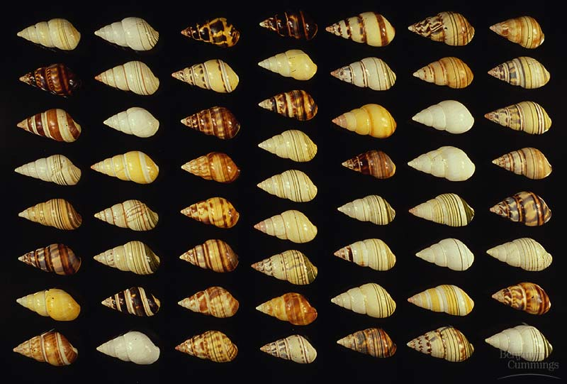
Chapter 20~ The Evolution of Populations

Slide 3
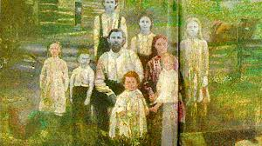
Blue People of Kentucky
After reading the article and watching the video segment, discuss with your group:
  What genetic event initially caused the blue color
  What behaviors might have contributed to this problem

Slide 4
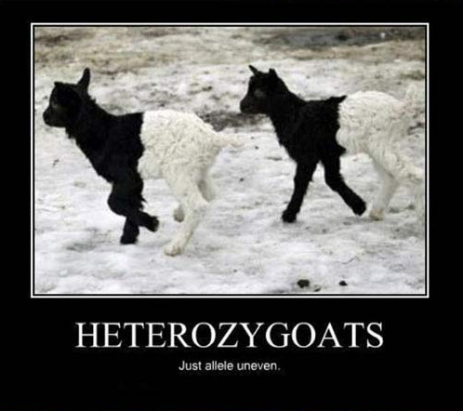

Slide 5
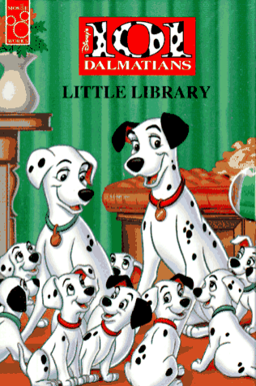
Population genetics
Population: a localized group of individuals belonging to the same species
Species: a group of populations whose individuals have the potential to interbreed and produce fertile offspring
Gene pool: the total aggregate of genes in a population at any one time
Population genetics: the study of genetic changes in populations
Modern synthesis/neo-Darwinism
“Individuals are selected, but populations evolve.”

Slide 6
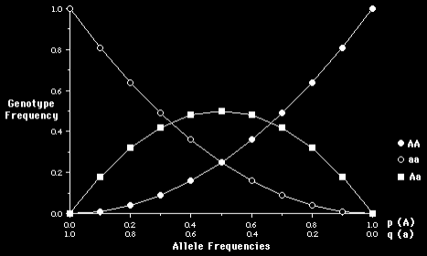
Hardy-Weinberg Theorem
Serves as a model for the genetic structure of a nonevolving population (equilibrium)
5 conditions:
  1- Very large population size;
  2- No migration;
  3- No net mutations;
  4- Random mating;
  5- No natural selection

Slide 7
Hardy-Weinberg Equation
p=frequency of one allele (A); q=frequency of the other allele (a);
p+q=1.0
(p=1-q & q=1-p)
P²=frequency of AA genotype; 2pq=frequency of Aa plus aA genotype; q²=frequency of aa genotype; p² + 2pq + q² = 1.0

Slide 8
PTC
Genetics of PTC : http://learn.genetics.utah.edu/content/basics/ptc/ ap evolution for use with hardy Weinberg

Slide 9
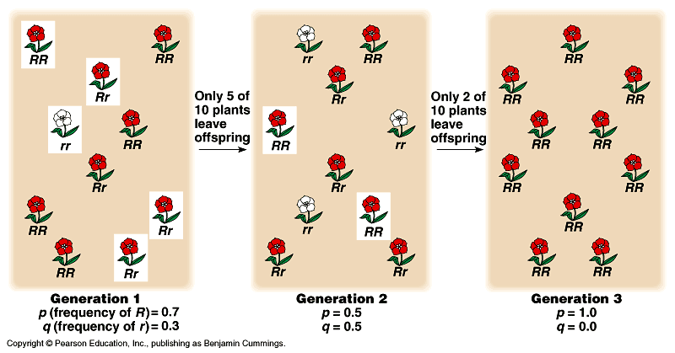
Microevolution, I
A change in the gene pool of a population over a succession of generations
1- Genetic drift: changes in the gene pool of a small population due to chance (usually reduces genetic variability)

Slide 10
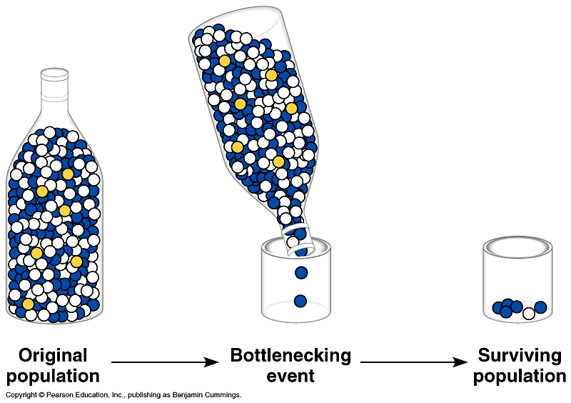
Microevolution, II
The Bottleneck Effect: type of genetic drift resulting from a reduction in population (natural disaster) such that the surviving population is no longer genetically representative of the original population

Slide 11
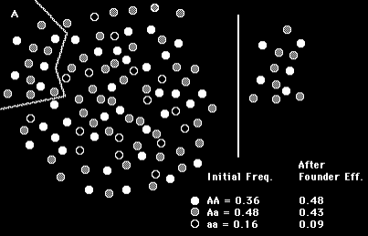
Microevolution, III
Founder Effect: a cause of genetic drift attributable to colonization by a limited number of individuals from a parent population

Slide 12
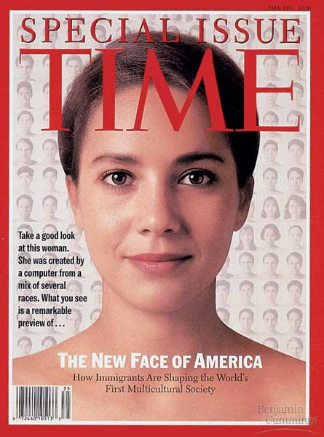
Microevolution, IV
2- Gene Flow: genetic exchange due to the migration of fertile individuals or gametes between populations (reduces differences between populations)

Slide 13
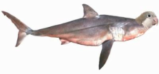
Microevolution, V
3- Mutations: a change in an organism’s DNA (gametes; many generations); original source of genetic variation (raw material for natural selection)

Slide 14
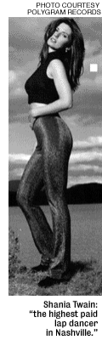
Microevolution, VI
4- Nonrandom mating: inbreeding and assortive mating (both shift frequencies of different genotypes)

Slide 15

Microevolution, VII
5- Natural Selection: differential success in reproduction; only form of microevolution that adapts a population to its environment

Slide 16
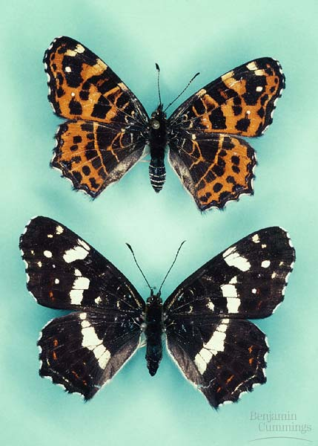
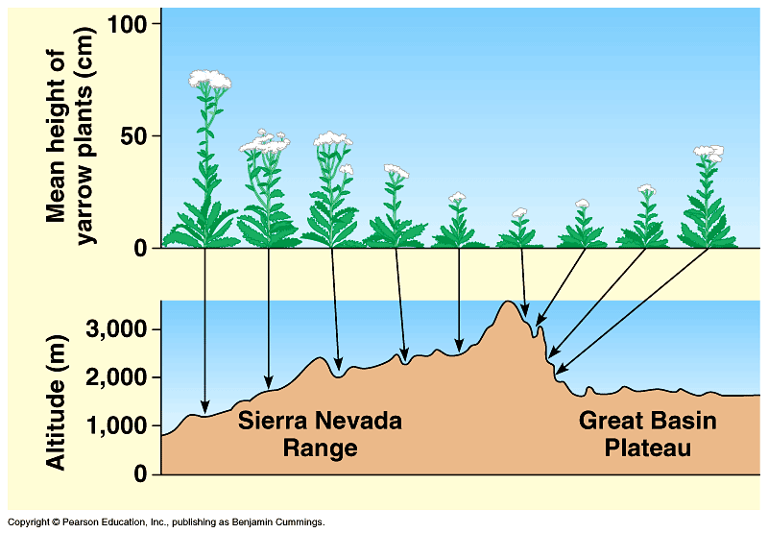
Population variation
Polymorphism: coexistence of 2 or more distinct forms of individuals (morphs) within the same population
Geographical variation: differences in genetic structure between populations (cline)

Slide 17
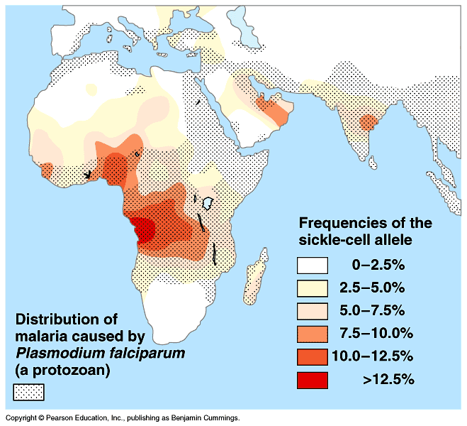
Variation preservation
Prevention of natural selection’s reduction of variation
Diploidy 2nd set of chromosomes hides variation in the heterozygote
Balanced polymorphism 1- heterozygote advantage (hybrid vigor; i.e., malaria/sickle-cell anemia); 2- frequency dependent selection (survival & reproduction of any 1 morph declines if it becomes too common; i.e., parasite/host)

Slide 18
Vocabulary Posters
You may work with a partner
Fold a piece of computer paper in half (hamburger)
On one half, illustrate your assigned concept
On the other half, define and give a specific example
Share your poster with the class
Word List
  Founder Effect
  Bottleneck effect
  Stabilizing selection
  Divergent selection
  Directional selection
  Sexual dimorphism
  Polygenic inheritance
  Genetic drift
  Non random mating
  Gene flow

Slide 19
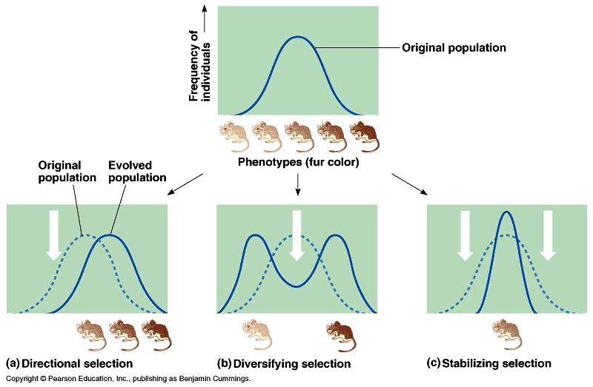
Natural selection
Fitness: contribution an individual makes to the gene pool of the next generation
3 types:
A. Directional
B. Divergent
C. Stabilizing

Slide 20
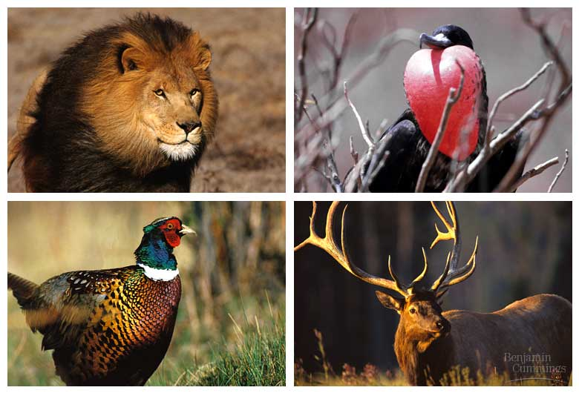
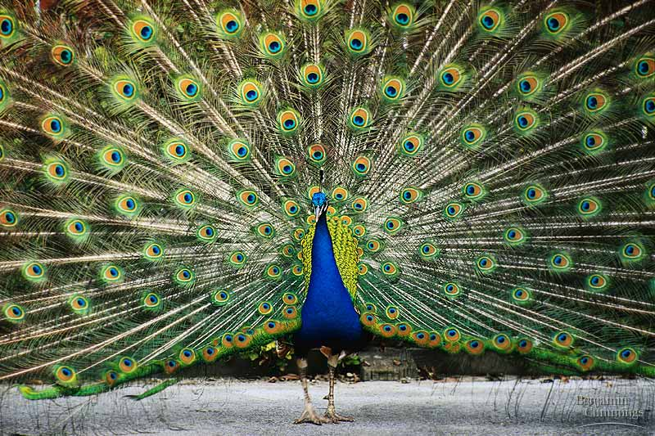
Sexual selection
Sexual dimorphism: secondary sex characteristic distinction
Sexual selection: selection towards secondary sex characteristics that leads to sexual dimorphism

Slide 21
Day 1
Introduction and Genetic Variation
Objectives:
  Describe the primary source of genetic variation
  What factors in a population increase its ability to respond to changes in the environment?
  Why can some members of a population respond differently to the same environmental factors?
  Describe the range of species in which evolution has occurred

Slide 22
Day 2
Selection
Objectives
  Explain why metabolic pathways are conserved in evolution
  Describe the functional unit of evolution
  Explain how natural selection increases reproductive fitness.
  Explain how environmental factors can influence traits both directly and indirectly
  Describe the link between environmental stress and speciation

Slide 23
Day 3
Hardy Weinberg
Objectives:
  Use the Hardy-Weinberg equations to calculate changes in allele frequency over time.
  Describe the conditions necessary to maintain Hardy-Weinberg equilibrium

Slide 24
Day 4
Evidence
Objective:
  Describe the range of dates that correspond to formation of the earth, life being able to exist on earth and earliest fossils and explain why these dates are significant

Slide 25
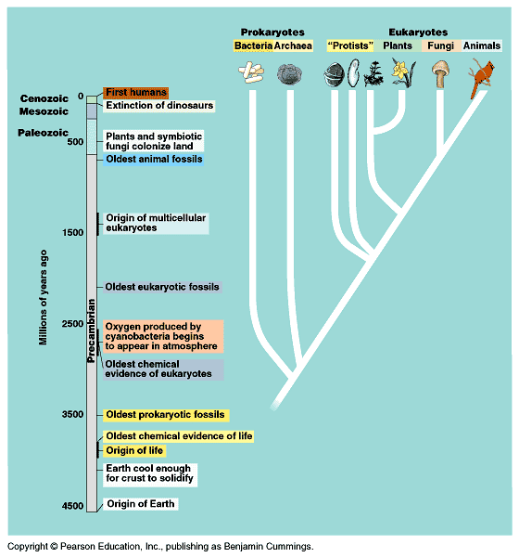
Early history of life
Solar system~ 12 billion years ago (bya)
Earth~ 4.5 bya
Life~ 3.5 to 4.0 bya
Prokaryotes~ 3.5 to 2.0 bya stromatolites
Oxygen accumulation~ 2.7 bya photosynthetic cyanobacteria
Eukaryotic life~ 2.1 bya
Muticelluar eukaryotes~ 1.2 bya
Animal diversity~ 543 mya
Land colonization~ 500 mya

Slide 26
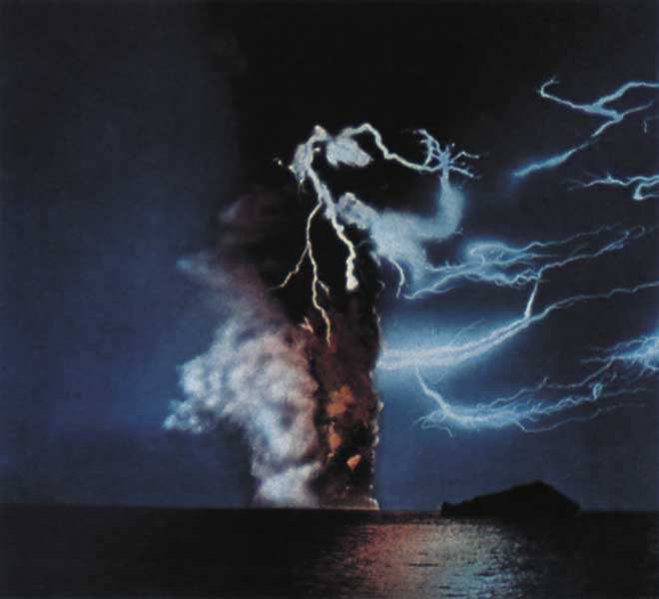
The Origin of Life
Spontaneous generation vs. biogenesis (Pasteur)
The 4-stage Origin of life Hypothesis:
1- Abiotic synthesis of organic monomers
2- Polymer formation
3- Origin of Self-replicating molecules
4- Molecule packaging (“protobionts”)

Slide 27
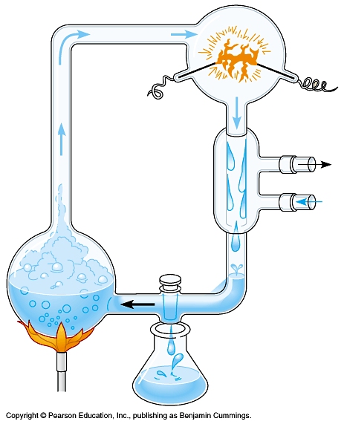
Organic monomers/polymer synthesis
Oparin /Haldane hypothesis (primitive earth): volcanic vapors (reducing atmosphere) with lightning & UV radiation enhances complex molecule formation (no O2)
Miller/Urey experiment:
water, hydrogen, methane, ammonia
all 20 amino acids, nitrogen bases, & ATP formed
Fox proteinoid formation (abiotic polypeptides) from organic monomers dripped on hot sand, clay or rock
Oparin (coacervates) protobionts (aggregate macromolecules; abiotic) surrounded by a shell of H2O molecules coated by a protein membrane

Slide 28
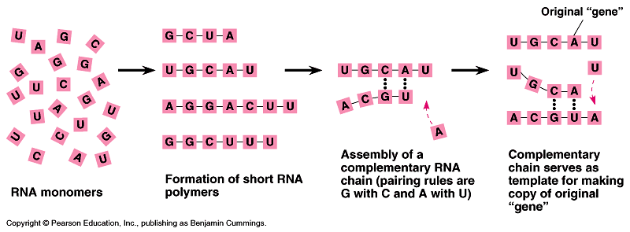
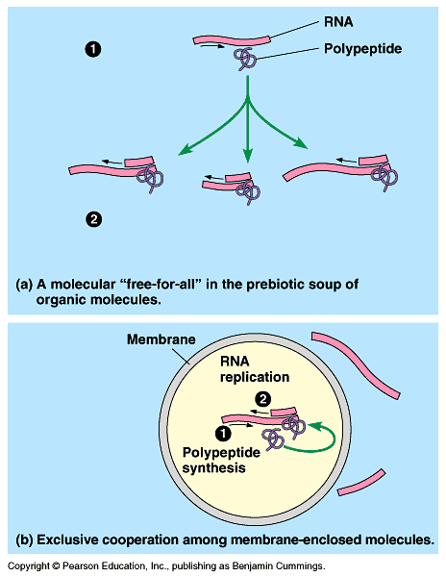
Abiotic genetic replication
First genetic material
Abiotic production of ribonucleotides
Ribozymes (RNA catalysts)
RNA “cooperation”
Formation of short polypeptides (replication enzyme?)
RNA~ DNA template?

Slide 29
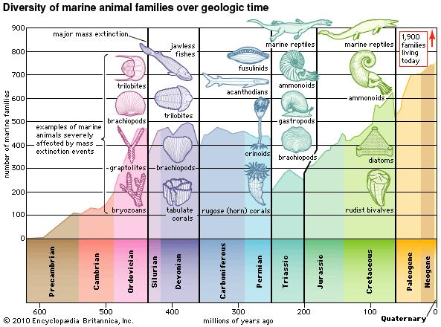

Slide 30
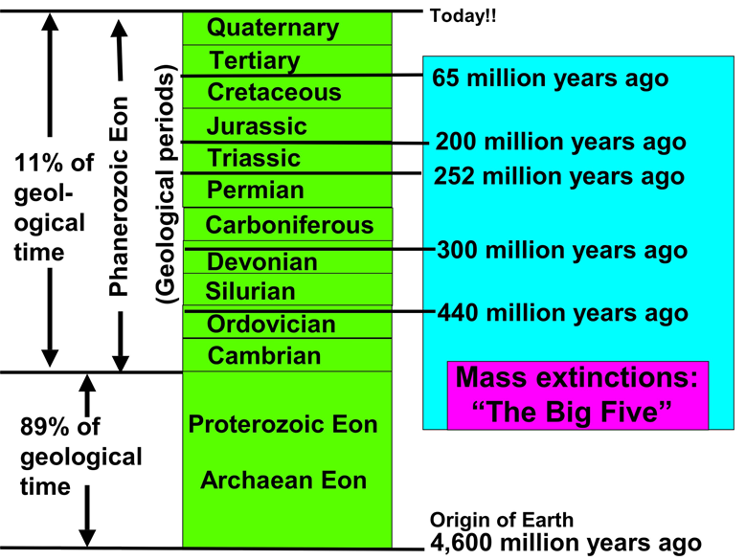

Slide 31
The five greatest mass extinctions
 | Ordivician-silurian | Late Devonian | Permian-triassic | Late Triassic | Final Cretaceous
When Occurred | 439 million years ago | 365 million years ago | 251 million years ago | 199–214 million years ago | 65 million years ago
Casualties | Up to estimated 85% species and 45–60% of marine genuses killed. | 70–80% of all species and 30% of families vanish; marine life more decimated than freshwater and land fauna. | Most devastating of all, eliminating 85–90% of all marine and land vertebrate species, 95% of marine species. End of trilobites and many trees. | More than three quarters of all species and one quarter of families disappear. End of mammal-like reptiles and eel–like conodonts, leaving mainly dinosaurs. | 47% of marine genuses and 18% of land vertebrates wiped out, including the dinosaurs, leaving mainly turtles, lizards, birds, and mammals.
HypothesizedCause(s) | Unusually fast plate movement; glaciation leading to sharp de- clines in sea levels. | Unknown if one cat- astrophic event or several smaller ones–possibly large asteroid or asteroid shower over time; possible glaciation and lethal temperature de- clines; oceanic anoxia (oxygen-lacking) | Possible asteroid; volcanic eruptions; dropping sea levels and oceanic anoxia | Little known but suspected fall in sea level, oceanic anoxia, major increase in rainfall. Possible comet showers or asteroid impact. | Suspected asteroid 10 km. in diameter hitting near Yucatán peninsula, coinciding with Siberian eruptions and dramatic climatic cooling.
SOURCE: Adapted from A. Hallam, and P. B. Wignall, 1997; David Raup, and John J. Sepkosi Jr., 1986; and Lee Siegel, 2000.

Slide 32
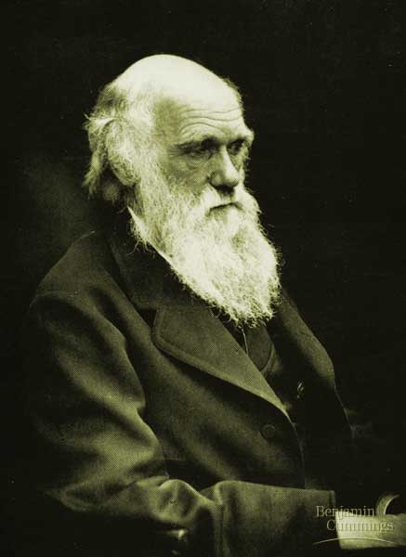
Descent with Modification: A Darwinian View of Life

Slide 33
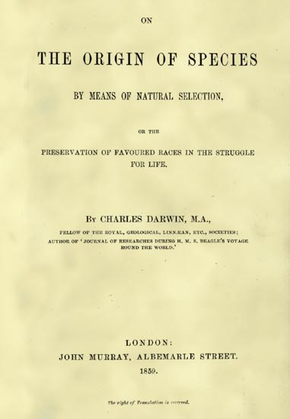
Evolution
Evolution: the change over time of the genetic composition of populations
Natural selection: populations of organisms can change over the generations if individuals having certain heritable traits leave more offspring than others (differential reproductive success)
Evolutionary adaptations:a prevalence of inherited characteristics that enhance organisms’ survival and reproduction
November 24, 1859

Slide 34
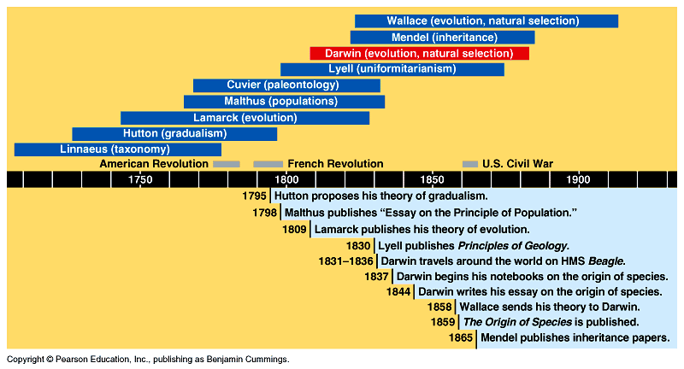
Evolutionary history
Lyell: uniformitarianism
Darwin: evolution
Mendel: inheritance
Wallace: evolution
Weisman: gametes and somatic cells
DeVries: pangenesis
Linnaeus: taxonomy
Hutton: gradualism
Lamarck: evolution
Malthus: populations
Cuvier: paleontology
Dobhanzsky: modern synthesis

Slide 35
1 Page Poster Assignment
Picture of scientist
Picture that represents his contribution to evolution
Dates of birth and death
Major field of study
Educational background
Contribution to evolutionary thought
A quote that sums it all up

Slide 36
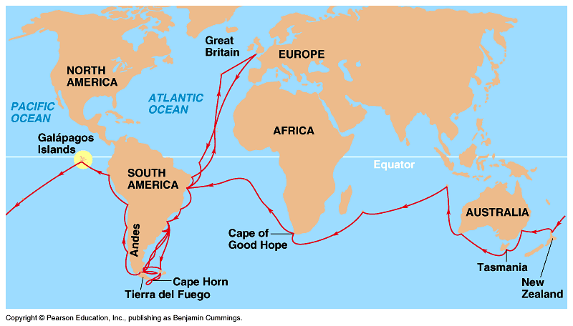
Descent with Modification, I
5 observations:
1- Exponential fertility
2- Stable population size
3- Limited resources
4- Individuals vary
5- Heritable variation

Slide 37
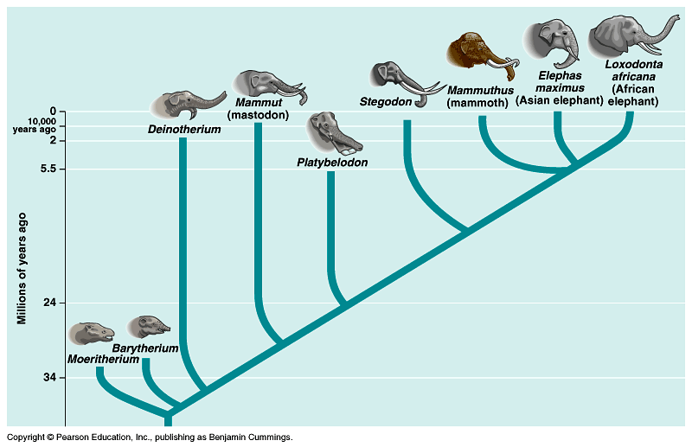
Descent with Modification, II
3 Inferences:
1- Struggle for existence
2- Non-random survival
3- Natural selection (differential success in reproduction)

Slide 38
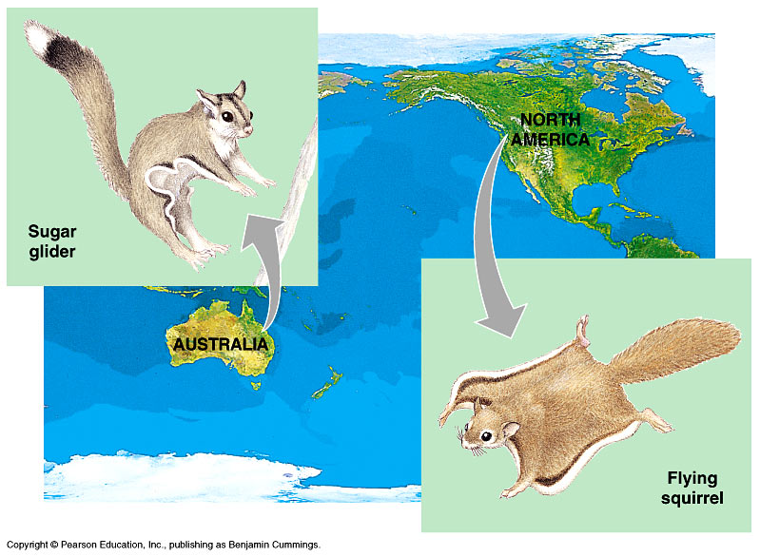
Evolution evidence: Biogeography
Geographical distribution of species
Examples: Islands vs. Mainland Australia Continents

Slide 39
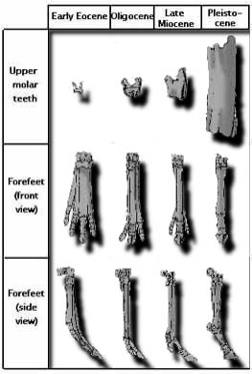
Evolution evidence: The Fossil Record
Succession of forms over time
Transitional links
Vertebrate descent

Slide 40
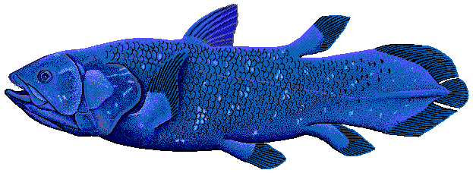
Living Fossils
Animated Life: http://www.hhmi.org/biointeractive/animated-life-living-fossil-fish

Slide 41
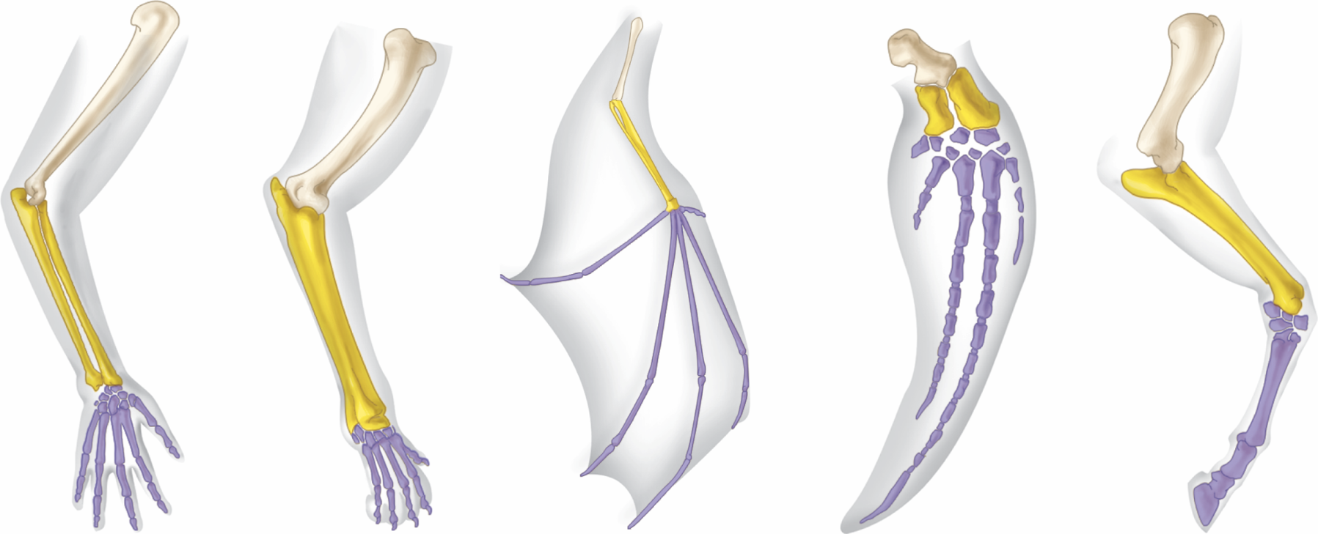
Fig. 1.9
Copyright © The McGraw-Hill Companies, Inc. Permission required for reproduction or display.
Human
Cat
Bat
Porpoise
Horse

Slide 42
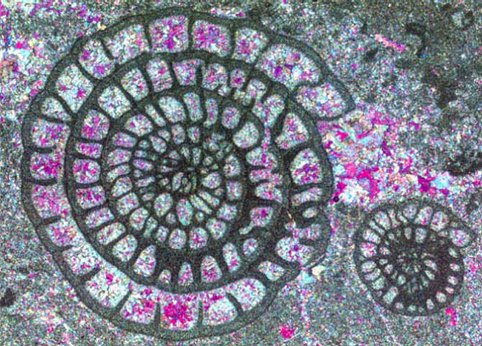
Microfossils

Slide 43
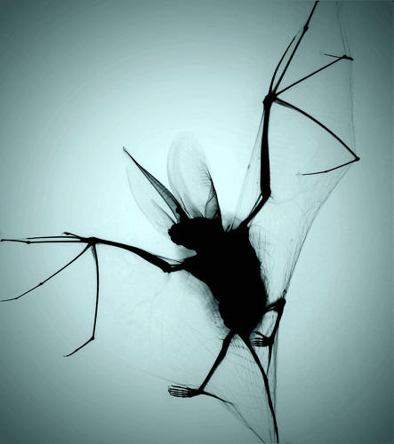

Slide 44
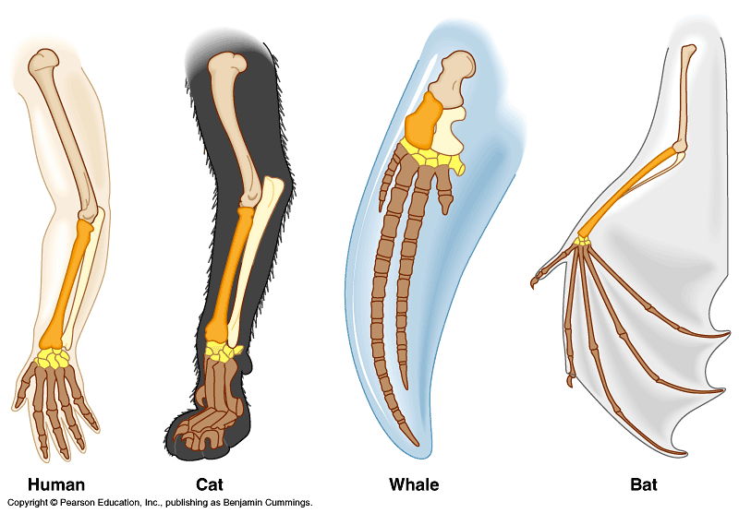
Evolution evidence: Comparative Anatomy
Homologous structures (homology)
Descent from a common ancestor
Vestigial organs Ex: whale/snake hindlimbs; wings on flightless birds

Slide 45
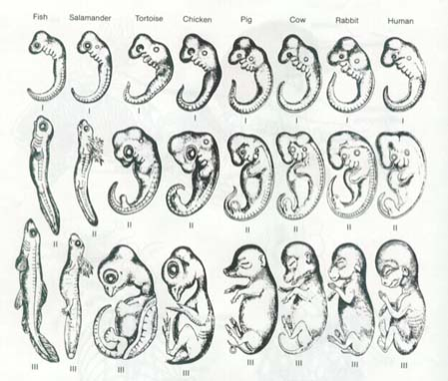
Evolution evidence: Comparative Embryology
Pharyngeal pouches, ‘tails’ as embryos

Slide 46
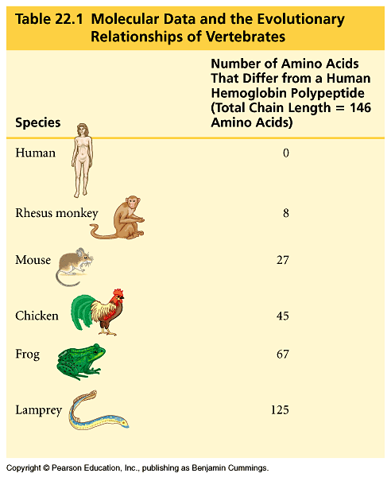
Evolution evidence: Molecular Biology
Similarities in DNA, proteins, genes, and gene products
Common genetic code

Slide 47
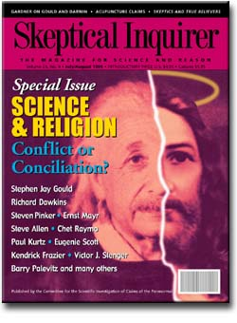
Final words…...
“Absence of evidence is not evidence of absence.”

Slide 48
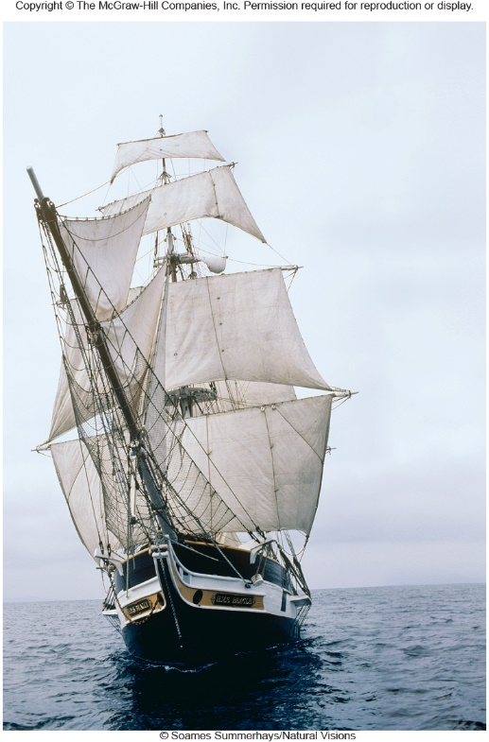
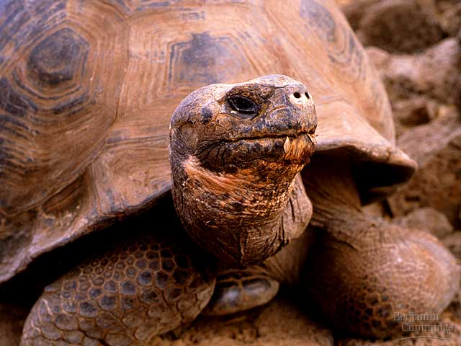
The Origin of Species

Slide 49
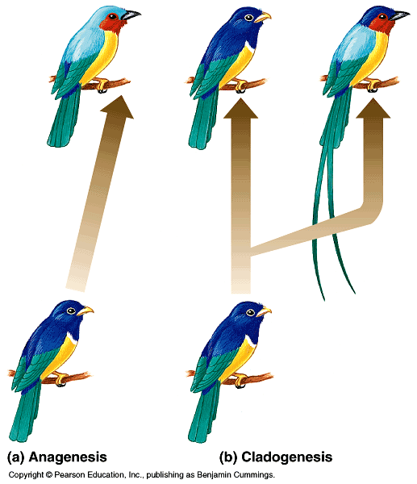
Macroevolution: the origin of new taxonomic groups
Speciation: the origin of new species
1- Anagenesis (phyletic evolution): accumulation of heritable changes
2- Cladogenesis (branching evolution): budding of new species from a parent species that continues to exist (basis of biological diversity)

Slide 50
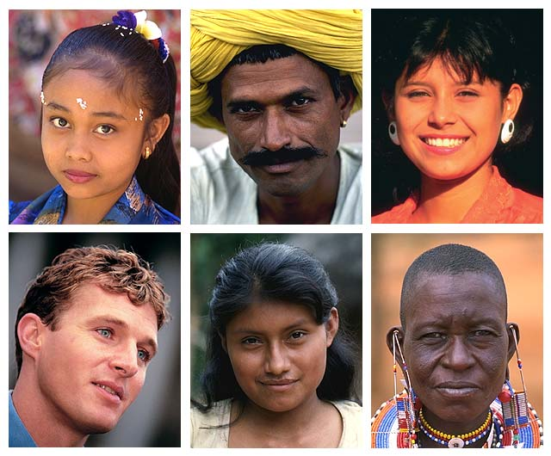
What is a species?
Biological species concept (Mayr): a population or group of populations whose members have the potential to interbreed and produce viable, fertile offspring (genetic exchange is possible and that is genetically isolated from other populations)

Slide 51
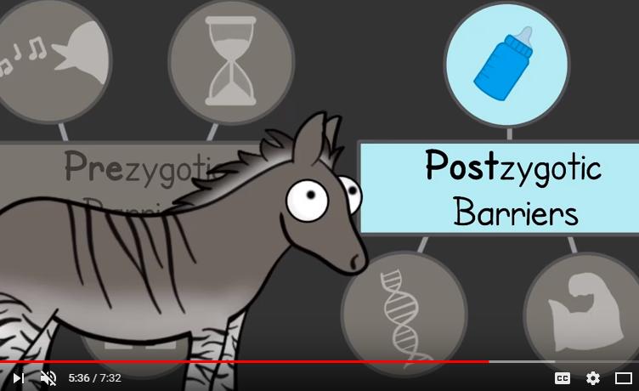
Speciation
https://www.youtube.com/watch?v=udZUaNKXbJA

Slide 52
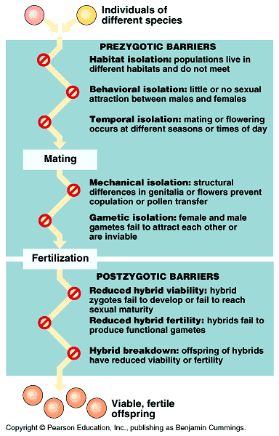
Reproductive Isolation (isolation of gene pools), I
Prezygotic barriers: impede mating between species or hinder the fertilization of the ova
Habitat (snakes; water/terrestrial)
Behavioral (fireflies; mate signaling)
Temporal (salmon; seasonal mating)
Mechanical (flowers; pollination anatomy)
Gametic (frogs; egg coat receptors)

Slide 53
Reproductive Isolation, II
Postzygotic barriers: fertilization occurs, but the hybrid zygote does not develop into a viable, fertile adult
Reduced hybrid viability (frogs; zygotes fail to develop or reach sexual maturity)
Reduced hybrid fertility (mule; horse x donkey; cannot backbreed)
Hybrid breakdown (cotton; 2nd generation hybrids are sterile)

Slide 54
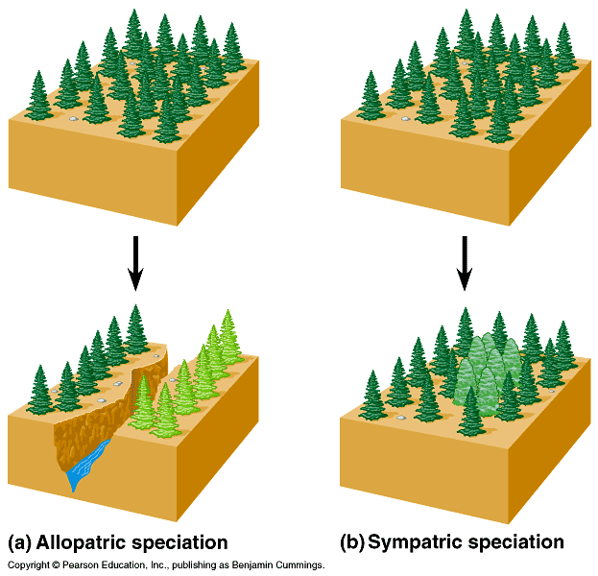
Modes of speciation
(based on how gene flow is interrupted)
Allopatric: populations segregated by a geographical barrier; can result in adaptive radiation (island species)
Sympatric: reproductively isolated subpopulation in the midst of its parent population (change in genome); polyploidy in plants; cichlid fishes

Slide 55
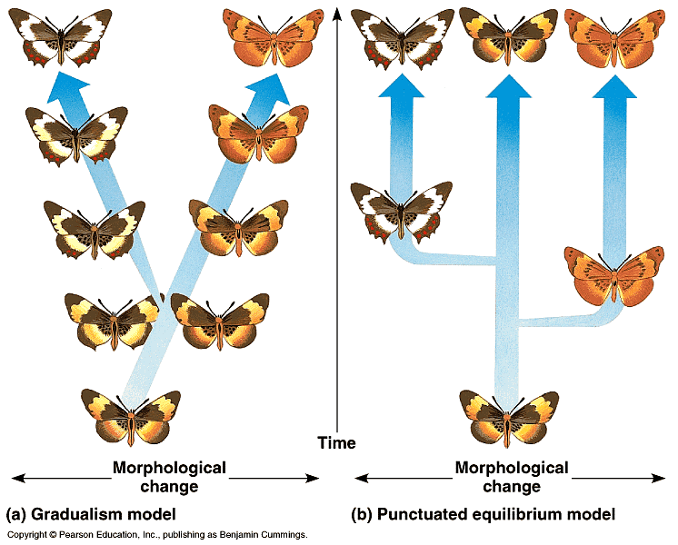
Punctuated equilibria
Tempo of speciation: gradual vs. divergence in rapid bursts; Niles Eldredge and Stephen Jay Gould (1972); helped explain the non-gradual appearance of species in the fossil record

Slide 56
Natural Selection
https://www.hhmi.org/biointeractive/making-fittest-natural-selection-and-adaptation
Rock Pocket Mouse (10 min)

Slide 57
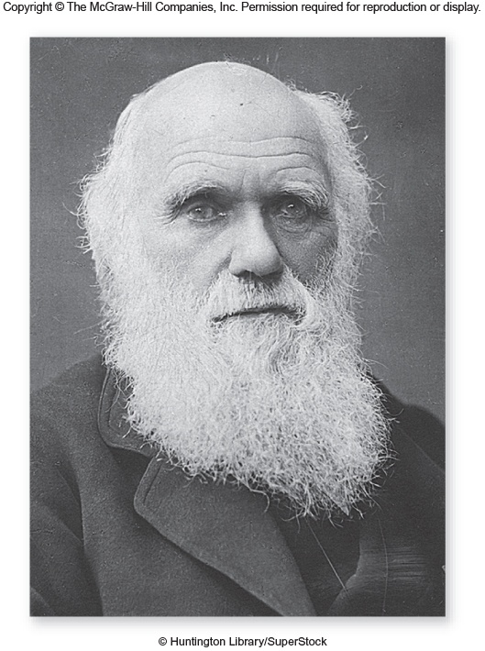

Slide 58
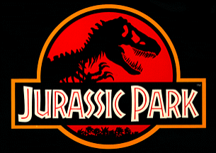
Phylogeny & Systematics

Slide 59
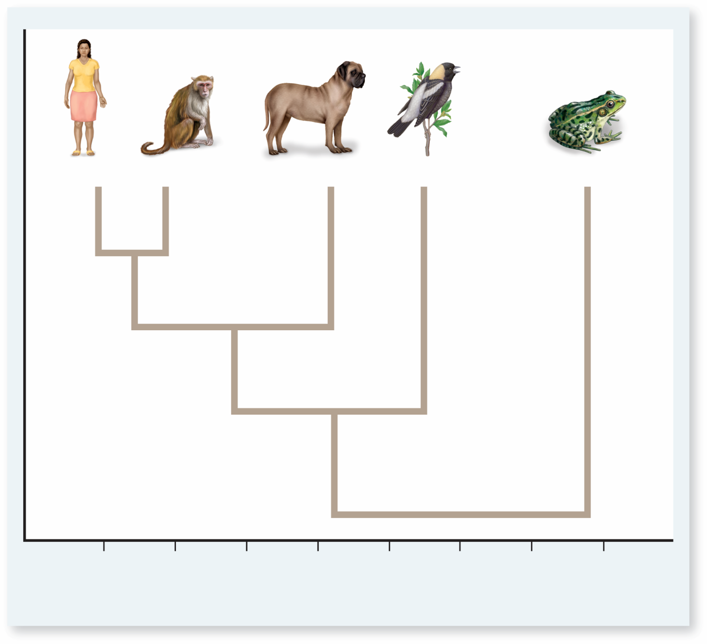
Fig. 1.10
Copyright © The McGraw-Hill Companies, Inc. Permission required for reproduction or display.
Human
Rhesus
Dog
Bird
Frog
0
10
20
30
40
50
60
70
Number of Amino Acid Differences in a Hemoglobin Polypeptide

Slide 60

More than the Birds
https://www.youtube.com/watch?v=fWNJE6t6fZE

Slide 61

Phylogeny: the evolutionary history of a species
Systematics: the study of biological diversity in an evolutionary context
The fossil record: the ordered array of fossils, within layers, or strata, of sedimentary rock
Paleontologists

Slide 62


The fossil record
Sedimentary rock: rock formed from sand and mud that once settled on the bottom of seas, lakes, and marshes
Dating:
1- Relative~ geologic time scale; sequence of species
2- Absolute~ radiometric dating; age using half-lives of radioactive isotopes

Slide 63
Day 9
Extinction
Objectives:
  What types of populations are at the greatest risk for extinction?
  Describe how antibiotic resistance can serve as an example of evolution
Eulogy of the recently extinct writing project

Slide 64

Biogeography: the study of the past and present distribution of species
Pangaea-250 mya √ Permian extinction
Geographic isolation-180 mya √ African/South American reptile fossil similarities √ Australian marsupials

Slide 65

Mass extinction
Permian (250 million years ago): 90% of marine animals; Pangea merge
Cretaceous (65 million years ago): death of dinosaurs, 50% of marine species; low angle comet

Slide 66


Slide 67

Phylogenetics
The tracing of evolutionary relationships (phylogenetic tree)
Linnaeus
Binomial
Genus, specific epithet
Homo sapiens
Taxon (taxa)

Slide 68


Phylogenetic Trees
Clade: each evolutionary branch in a cladogram
Types:
1- Monophyletic single ancestor that gives rise to all species in that taxon and to no species in any other taxon; legitimate cladogram
2- Polyphyletic members of a taxa are derived from 2 or more ancestral forms (example – pachyderms - elephant – rhino – hippo - do not share a common ancestor)
3- Paraphyletic – includes some, but not all descendants of an ancestor (example dinosaurs but not birds

Slide 69




Bony fish include lungfish but not tetrapods

Slide 70

Constructing a Cladogram
Sorting homology vs. analogy...
Homology: likenesses attributed to common ancestry
Analogy: likenesses attributed to similar ecological roles and natural selection
Convergent evolution: species from different evolutionary branches that resemble one another due to similar ecological roles

Slide 71

A Cladogram – The basics

Slide 72

Spot the difference
How would this table differ from the last?

Slide 73

Make Your Own

Slide 74

Warm-up
What are the 2 parts that make up the Latin name of a species?
Using the cladogram, which animals have claws/nails?
Which animals have fur/mammary glands?
To what is the chimp most closely related to?

Slide 75



Is a hippopotamus more closely related to a pig or to a whale? List 3 reasons to defend your answer.

Slide 76


HIPPO WHALE
Based on physical comparisons (particularly dental structure and number of toes) it was originally thought that hippos were most closely related to pigs but DNA analysis indicates that hippos are more closely related to whales!

Slide 77


Evolutionary Link
Whales and hippos had a common water-loving ancestor 50 to 60 million years ago that evolved and split into two groups:
  The pig-like anthracotheres – died out less than 2.5 million years ago, leaving only the hippo as a descendent
  The cetaceans (whales, dolphins, and porpoises)

Slide 78

Cladogram

Slide 79
Cladograms are used to…
Organize organisms based on evolutionary relationships (phylogeny).
In other words… who is related to who and where did we come from…

Slide 80
How are cladograms constructed?
Organisms are grouped together based on their shared derived characteristics (trait modified from the ancestral trait).

Slide 81
Cladogram construction
Given a table of derived characters (traits), create a cladogram

Slide 82
Step 1 – Create a Venn Diagram
How many organisms are you comparing?
  This number will equal the number of circles in your Venn diagram.
Now count the number of characters each organism has.
  This will be the order that you place the organisms in the Venn Diagram.

Slide 83
Venn Diagram
Placenta: Human
Mammary glands: Kangaroo & Human
Two pairs of limbs: Bullfrog, kangaroo & Human
Vertebrae: Shark, bullfrog, kangaroo & humans

Slide 84
Step Two – Convert the Venn Diagram into a Cladogram
Kangaroo
Bullfrog
Human
Shark
Placenta
Mammary Glands
Two pairs of limbs
Vertebrae

Slide 85


Slide 86
Human
Human: hair
Lizard: legs
Trout: Vertebrae
Earthworm

Slide 87
Convert the Venn Diagram into a Cladogram
Lizard
Trout
Human
Earthworm
Hair
Legs
Vertebrae

Slide 88

Independent Practice Problems:

Slide 89


Slide 90
Day 7
Species
Objectives:
  Explain how homeotic genes are involved in developmental patterns and sequences
  Describe how the process of embryonic induction in development results in the correct timing of events.
  Give an example in which an organism’s adaptation to local environment reflects a flexible response to the genome.
  Explain what causes variation in rates of speciation
  Explain how reproductive isolation can lead to speciation
  Give specific examples of isolating mechanisms leading to speciation

Slide 91
Chapter 24
Genome Evolution

Slide 92


Slide 93


Slide 94
Warm-up
What are the 2 parts that make up the Latin name of a species?
Using the cladogram, which animals have claws/nails?
Which animals have fur/mammary glands?
To what is the chimp most closely related to?

Slide 95
Is a hippopotamus more closely related to a pig or to a whale? List 3 reasons to defend your answer.

Slide 96
HIPPO WHALE
Based on physical comparisons (particularly dental structure and number of toes) it was originally thought that hippos were most closely related to pigs but DNA analysis indicates that hippos are more closely related to whales!

Slide 97
Evolutionary Link
Whales and hippos had a common water-loving ancestor 50 to 60 million years ago that evolved and split into two groups:
  The pig-like anthracotheres – died out less than 2.5 million years ago, leaving only the hippo as a descendent
  The cetaceans (whales, dolphins, and porpoises)

Slide 98
Day 5
Fossils
Objective:
  Use phylogenetic trees and cladograms to represent traits that are either derived or lost due to evolution

Slide 99
Cladogram

Slide 100
Cladograms are used to…
Organize organisms based on evolutionary relationships (phylogeny).
In other words… who is related to who and where did we come from…

Slide 101
How are cladograms constructed?
Organisms are grouped together based on their shared derived characteristics (trait modified from the ancestral trait).

Slide 102
Cladogram construction
Given a table of derived characters (traits), create a cladogram

Slide 103
Step 1 – Create a Venn Diagram
How many organisms are you comparing?
  This number will equal the number of circles in your Venn diagram.
Now count the number of characters each organism has.
  This will be the order that you place the organisms in the Venn Diagram.

Slide 104
Venn Diagram
Placenta: Human
Mammary glands: Kangaroo & Human
Two pairs of limbs: Bullfrog, kangaroo & Human
Vertebrae: Shark, bullfrog, kangaroo & humans

Slide 105
Step Two – Convert the Venn Diagram into a Cladogram
Kangaroo
Bullfrog
Human
Shark
Placenta
Mammary Glands
Two pairs of limbs
Vertebrae

Slide 107
Human
Human: hair
Lizard: legs
Trout: Vertebrae
Earthworm

Slide 108
Convert the Venn Diagram into a Cladogram
Lizard
Trout
Human
Earthworm
Hair
Legs
Vertebrae

Slide 109
Independent Practice Problems:

Slide 111
Day 6
Convergence

Slide 112
Day 8
Drift and Radiation
Objectives:
  Describe the role of five major extinctions in rates of speciation
  Describe the evolution of heart chambers in animals
  Describe the rate of speciation caused by reproductive isolation

Slide 113
The 6 craziest extinctions ever
https://www.youtube.com/watch?v=wissIOikrqc&index=30&list=PLvFsG9gYFxY8uSNHPYlruX_w5l6Ir1wyn
5 species we wish still existed
https://www.youtube.com/watch?v=wutj5z1lElU&feature=youtu.be

Slide 114
Day 10
Systemics/Cladistics
Objective:
  Explain why phylogenetic trees and cladograms are described as dynamic

Slide 115
Day 11
Phylogenetics
Objectives:
  Construct phylogenetic trees and cladograms to show relatedness, morphological similarities, and divergence in DNA and protein sequences

Slide 116
Day 12
test

