Slide 1
Unit 8
Molecular Biology
Chapters 14, 15, 16, 17, 19

Slide 2
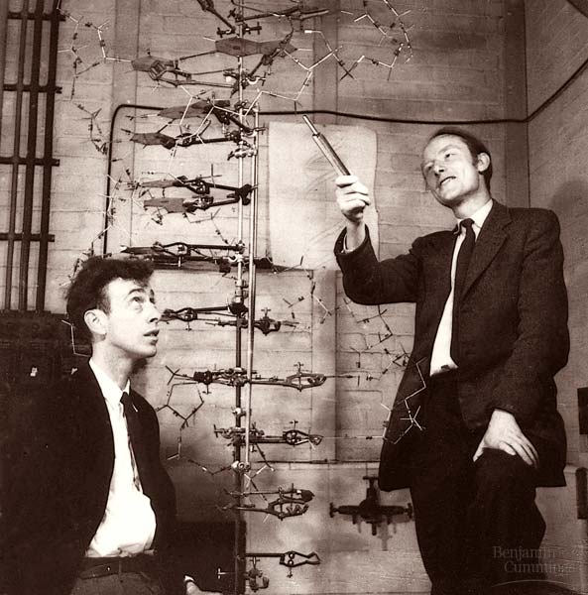
DNA
The Molecular Basis of Inheritance

Slide 3
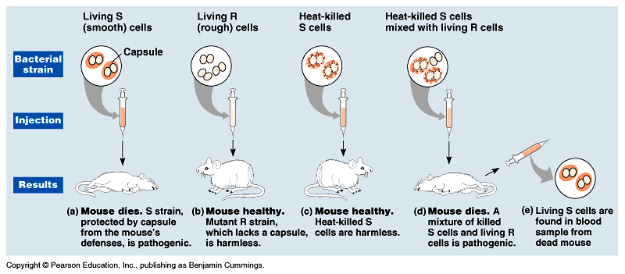
Searching for Genetic Material, I
Mendel: modes of heredity in pea plants
Morgan: genes located on chromosomes
Griffith: bacterial work; transformation: change in genotype and phenotype due to assimilation of external substance (DNA) by a cell
Avery: transformation agent was DNA

Slide 4
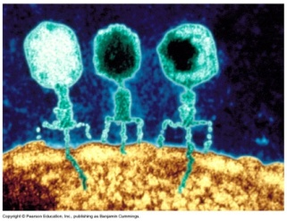
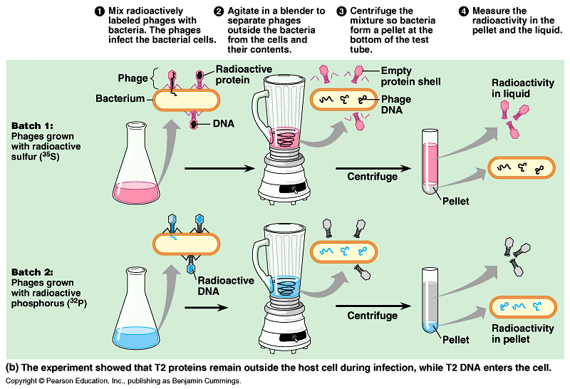
Searching for Genetic Material, II
Hershey and Chase bacteriophages (phages)
DNA, not protein, is the hereditary material sulfur(S) is in protein, phosphorus (P) is in DNA; only P was found in host cell

Slide 5
Hershey and Chase animation
http://glencoe.mcgraw-hill.com/sites/0003292010/student_view0/chapter14/animations_and_videos.html#

Slide 6
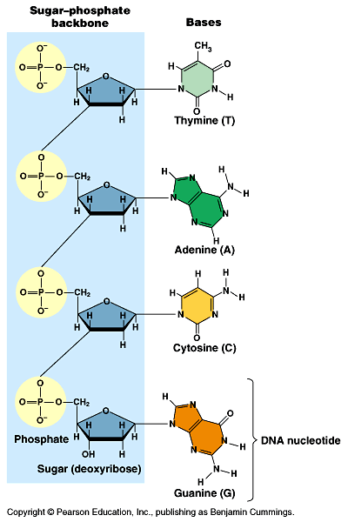
DNA Structure
Chargaff ratio of nucleotide bases (A=T; C=G)
Watson & Crick (Wilkins, Franklin)
  The Double Helix nucleotides: nitrogenous base (thymine, adenine, cytosine,guanine), sugar(deoxyribose); phosphate group

Slide 7
DNA Structure Animation
http://glencoe.mcgraw-hill.com/olcweb/cgi/pluginpop.cgi?it=swf::640::480::/sites/dl/free/0003292010/811325/dna_structure.swf::DNA Structure

Slide 8
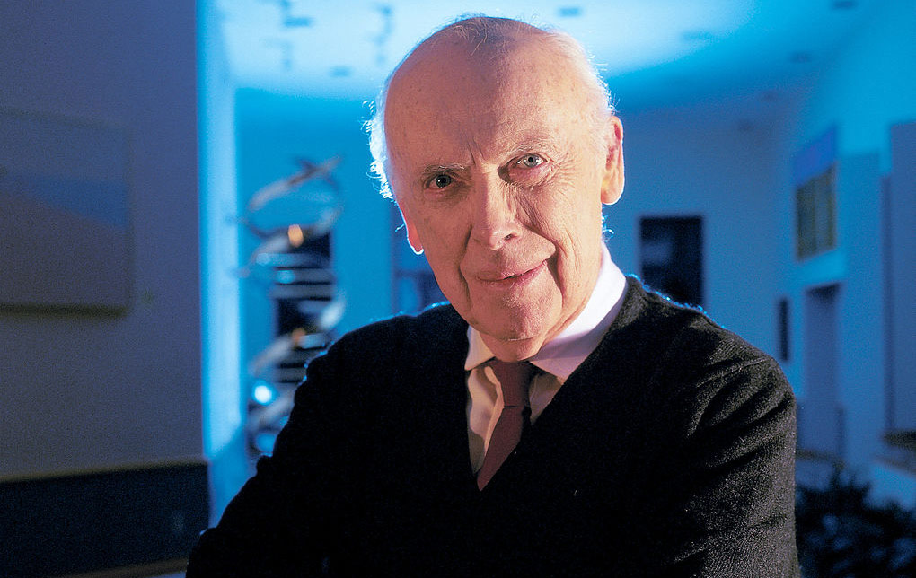
http://ed.ted.com/lessons/james-watson-on-how-he-discovered-dna

Slide 9
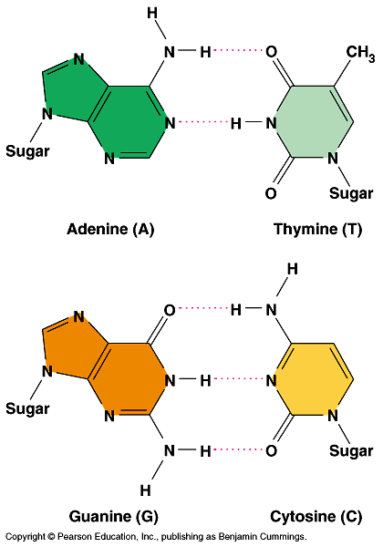
DNA Bonding
Purines: ‘A’ & ‘G’
Pyrimidines: ‘C’ & ‘T’ (Chargaff rules)
‘A’ H+ bonds (2) with ‘T’ and ‘C’ H+ bonds (3) with ‘G’
Van der Waals attractions between the stacked pairs

Slide 10
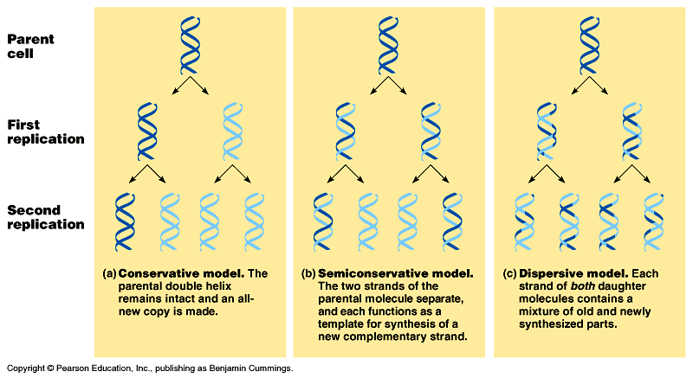
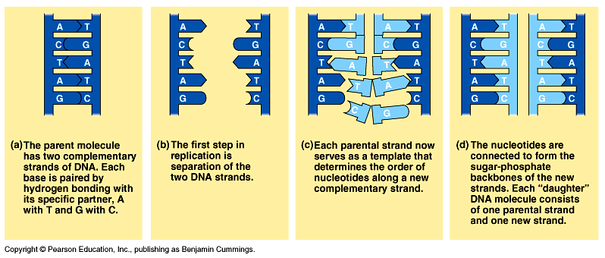
DNA Replication
Watson & Crick strands are complementary; nucleotides line up on template according to base pair rules (Watson)
Meselson & Stahl replication is semiconservative; varying densities of radioactive nitrogen

Slide 11
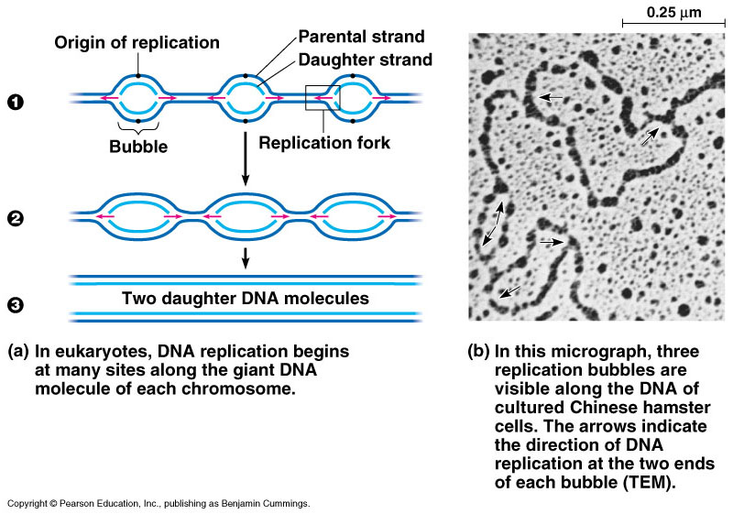
DNA Replication: a closer look
Origin of replication (“bubbles”): beginning of replication
Replication fork: ‘Y’-shaped region where new strands of DNA are elongating
Helicase:catalyzes the untwisting of the DNA at the replication fork
DNA polymerase:catalyzes the elongation of new DNA

Slide 12
DNA Replication
http://glencoe.mcgraw-hill.com/olcweb/cgi/pluginpop.cgi?it=swf::640::480::/sites/dl/free/0003292010/811325/Structural_Basis_of_DNA_Replication.swf::Structural Basis of DNA Replication

Slide 13
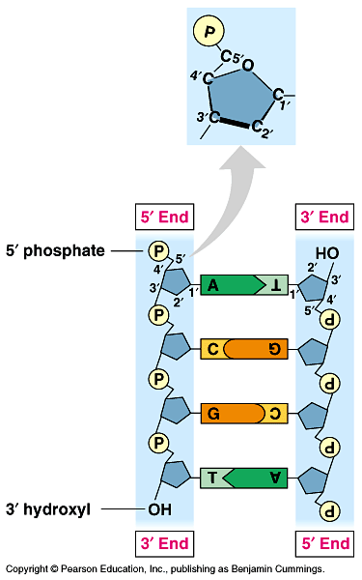
DNA Replication, II
Antiparallel nature: • sugar/phosphate backbone runs in opposite directions (Crick); • one strand runs 5’ to 3’, while the other runs 3’ to 5’; • DNA polymerase only adds nucleotides at the free 3’ end, forming new DNA strands in the 5’ to 3’ direction only

Slide 14
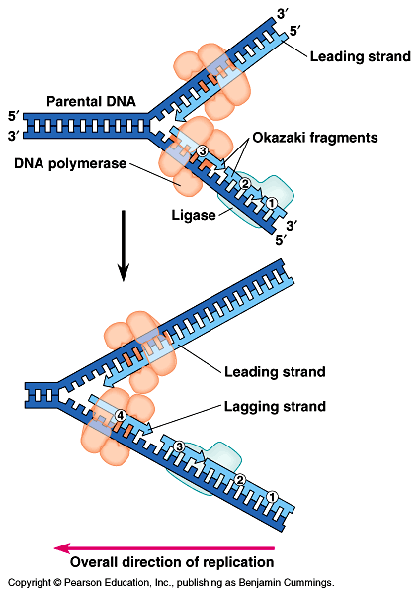
DNA Replication, III
Leading strand: synthesis toward the replication fork (only in a 5’ to 3’ direction from the 3’ to 5’ master strand)
Lagging strand: synthesis away from the replication fork (Okazaki fragments); joined by DNA ligase (must wait for 3’ end to open; again in a 5’ to 3’ direction)
Initiation: Primer (short RNA sequence~w/primase enzyme), begins the replication process

Slide 15
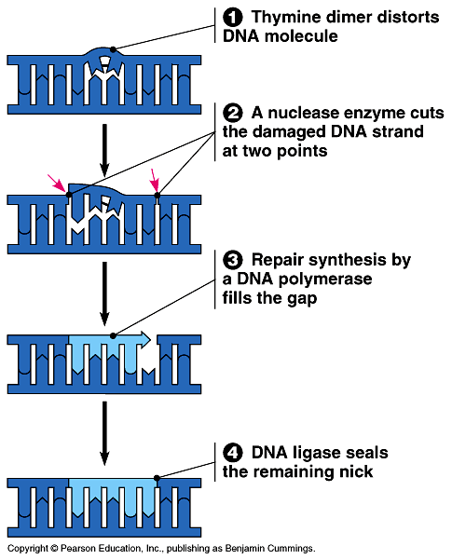
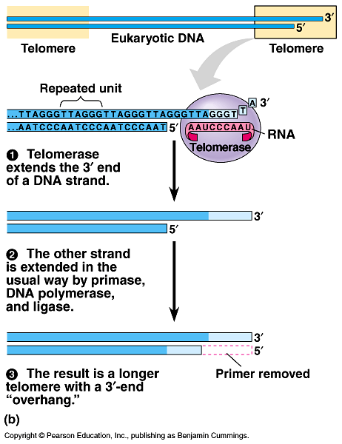
DNA Repair
Mismatch repair: DNA polymerase
Excision repair: Nuclease
Telomere ends: telomerase

Slide 16
DNA Repair
http://glencoe.mcgraw-hill.com/olcweb/cgi/pluginpop.cgi?it=swf::640::480::/sites/dl/free/0003292010/811325/proofreading_function_DNA_Polymerase.swf::Proofreading Function of DNA Polymerase

Slide 17
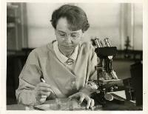
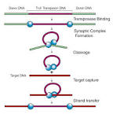
Transposons
Jumping genes
Portable DNA
Increases genetic diversity
Barbara McClintock won a Nobel prize for her work on corn in 1983

Slide 18
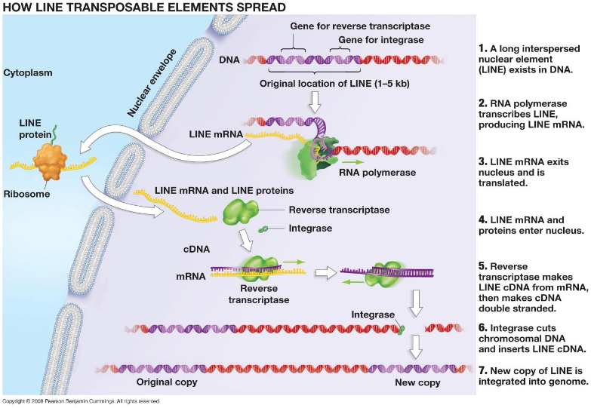
Transposons

Slide 19
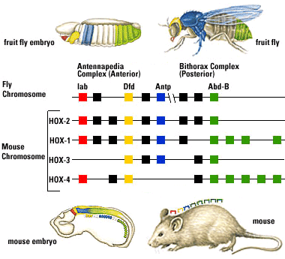
Homeotic Genes
Genes important in development
Especially of body segments along the axis
Changes in these genes can have a large impact on structure of organism

Slide 20
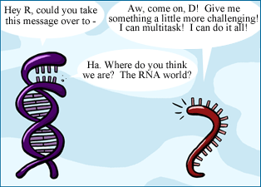
RNA World Hypothesis

Slide 21
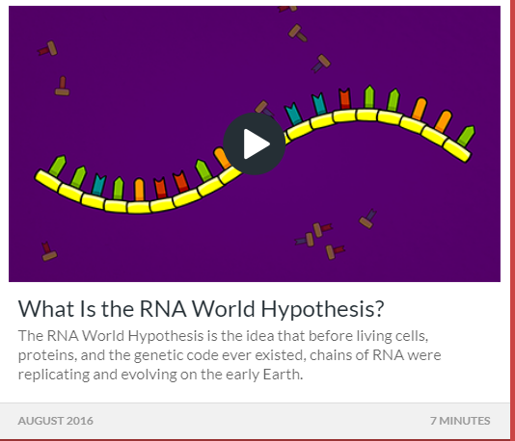
What is the RNA World Hypothesis?
http://statedclearly.com/videos/RNA-World/

Slide 22
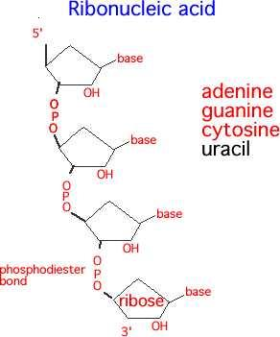
Aim: How does DNA direct the production of proteins in the cell?
Do now? State three ways DNA differs from RNA
1, The sugar is ribose instead of deoxyribose
2. Single stranded
3. Uracil replaces Thymine

Slide 23
Three basic types of RNA
mRNA – carries message from DNA
tRNA – carries amino acid to mRNA
rRNA – makes up the ribosome

Slide 24
snRNA (small nuclear RNA) –make up splicesomes that cut introns out of pre-mRNA this enzymatic activity leads us to believe RNA came before DNA and proteins
snoRNA (small nucleolar RNA) – direct nucleotide modifications

Slide 25
snRNA (small nuclear RNA) –make up splicesomes that cut introns out of pre-mRNA this enzymatic activity leads us to believe RNA came before DNA and proteins
snoRNA (small nucleolar RNA) – direct nucleotide modifications

Slide 26
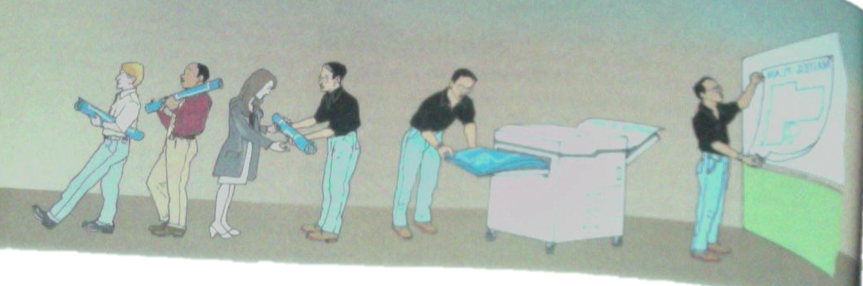
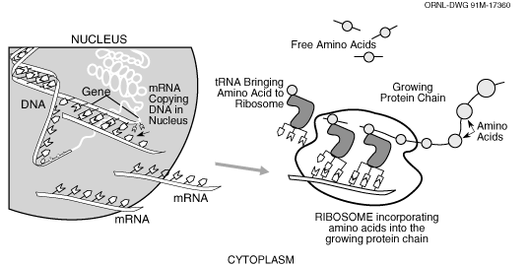
Do now: How are these pictures alike?

Slide 27
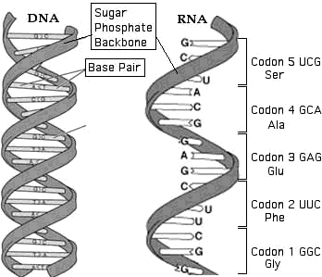
RNA
Ribonucleic Acid
(RNA)
Sugar + Phosphate Backbone
Differs from DNA
  Single Stranded
  Ribose Sugar
  Base Pairs A-U, G-C
  Are there T’s in RNA?
  A, U no T’s in RNA
RNA assists DNA in manufacturing needed proteins

Slide 28
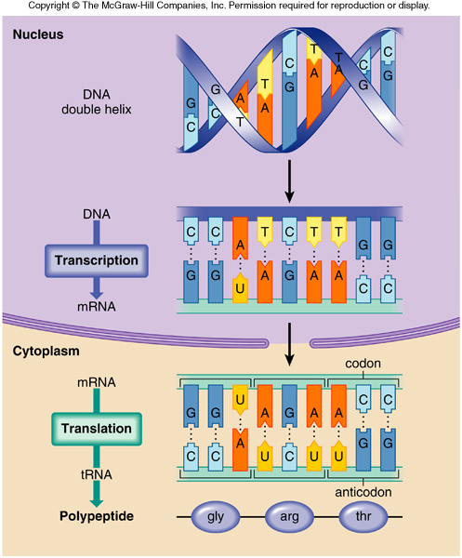
In transcription, a portion of DNA unzips and mRNA composes a strand complementary to the DNA template.
Every three bases of mRNA is known as a CODON.
Next, mRNA exits the nucleus, moving to a ribosome in the cytoplasm
2. In translation , the anticodon of transfer rna
attaches the proper amino acid to make a specific protein.
This universal triplet or three base amino acid code consists of 20 amino acids that make up proteins.

Slide 29
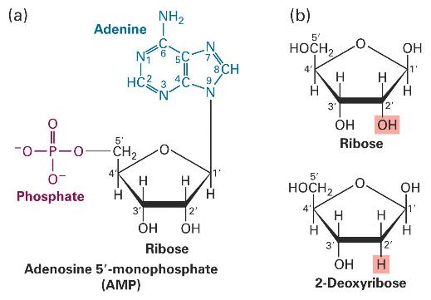
RNA vs. DNA
nucleoside
glycosidic
bond
nucleotide

Slide 30
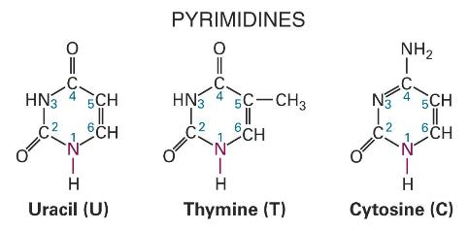
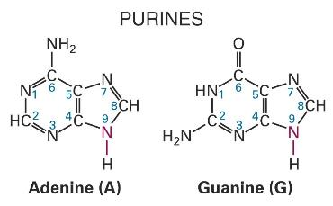
Different bases in RNA and DNA
RNA
only
DNA
only
DNA and RNA

Slide 31
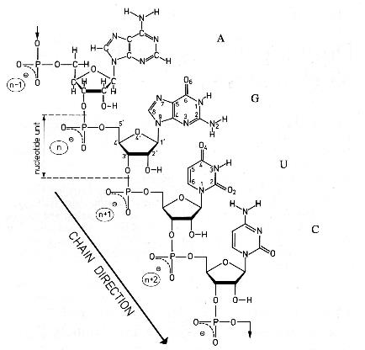
RNA chain is made single stranded!
Chemical schematic One-letter code
dsRNA can
block protein
synthesis and
signal viral
infections
ssDNA can signal DNA damage and promote cell death
Chain is directional. Convention: 5’ 3’.

Slide 32
RNA vs. DNA: who cares?
Unstable
backbone
⁻OH
Stable
backbone
Base-catalyzed RNA cleavage!

Slide 33
-OH, what a difference an O makes!
Different functions of
DNA and RNA
gene1gene2
gene3 . . .
Stores genetic info Stores genetic info
mediates editing,
RNA interference,
. . .
Double helical (B form) Forms complex structures
Supercoiled Enzymes (e.g. ribosome),
Binding sites & scaffolds
Signals
Templates (e.g. t telomeres)

Slide 34
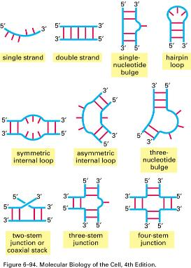
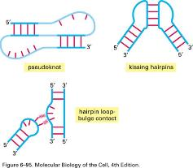
Examples of RNA structural motifs
Stem, bulge, loop 4-helix junction Tetraloop
Pseudoknot
Sheared AA pairs
Purine stacks
Metal binding sites
A-A platform
Tetraloop receptor
A-minor motif
Ribose zipper
. . .
Secondary structures
Tertiary structures

Slide 35
A few examples of RNAs
snRNA (small nuclear RNA) –make up splicesomes that cut introns out of pre-mRNA this enzymatic activity leads us to believe RNA came before DNA and proteins
snoRNA (small nucleolar RNA) – direct nucleotide modifications
RNAi –(interfering RNA) post transcriptional gene silencing, neutralizes expression of targeted RNA molecules

Slide 36
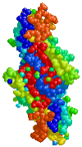
Transcription and Translation
From Gene to Protein

Slide 37
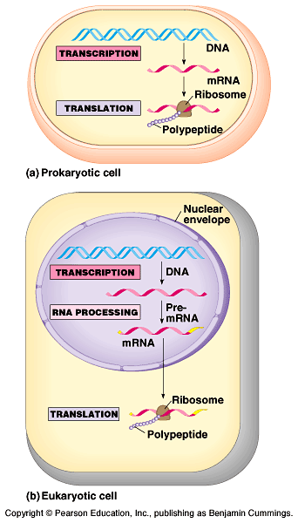
Protein Synthesis: overview
One gene-one enzyme hypothesis (Beadle and Tatum)
One gene-one polypeptide (protein) hypothesis
Transcription: synthesis of RNA under the direction of DNA (mRNA)
Translation: actual synthesis of a polypeptide under the direction of mRNA

Slide 38
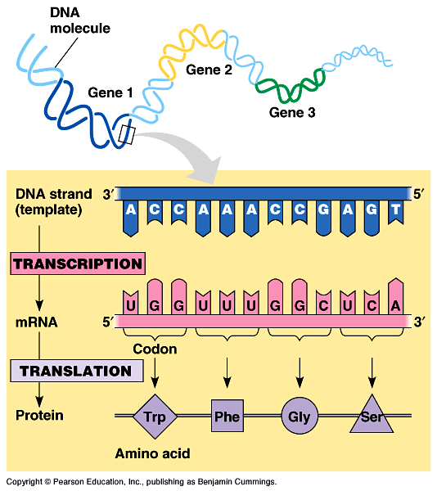
The Triplet Code
The genetic instructions for a polypeptide chain are ‘written’ in the DNA as a series of 3-nucleotide ‘words’
Codons
‘U’ (uracil) replaces ‘T’ in RNA

Slide 39
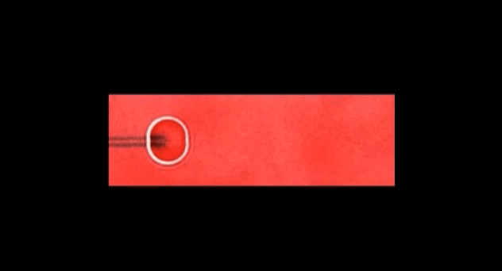
Transcription
DNA micro-machine rolling across a fluorescently labeled RNA surface.

Slide 40
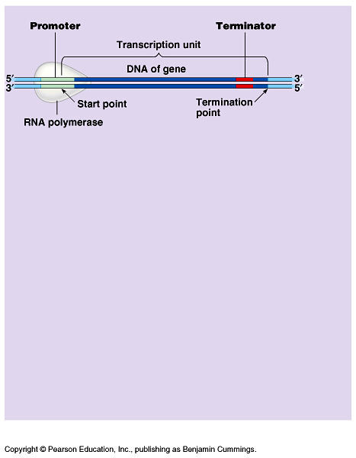
Transcription, I
RNA polymerase: pries DNA apart and hooks RNA nucleotides together from the DNA code
Promoter region on DNA: where RNA polymerase attaches and where initiation of RNA begins
Terminator region: sequence that signals the end of transcription
Transcription unit: stretch of DNA transcribed into an RNA molecule

Slide 41
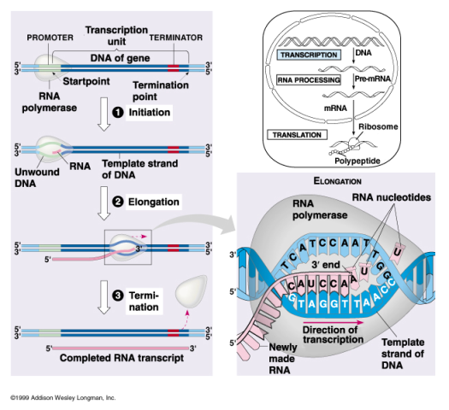
Transcription, II
Initiation~ transcription factors mediate the binding of RNA polymerase to an initiation sequence (TATA box)
Elongation~ RNA polymerase continues unwinding DNA and adding nucleotides to the 3’ end
Termination~ RNA polymerase reaches terminator sequence

Slide 42
Transcription: overview
http://highered.mcgraw-hill.com/sites/9834092339/student_view0/chapter15/transcription.html

Slide 43
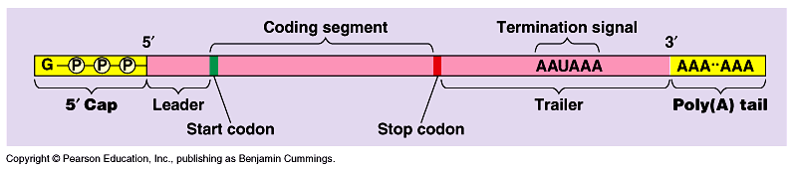
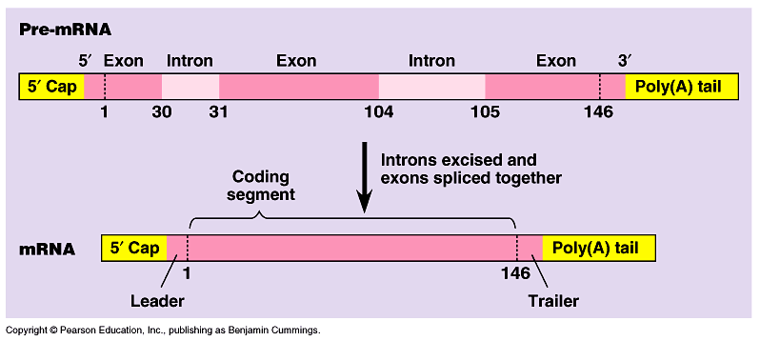
mRNA modification
1) 5’ cap: modified guanine; protection; recognition site for ribosomes
2) 3’ tail: poly(A) tail (adenine); protection; recognition; transport
3) RNA splicing: exons (expressed sequences) kept,introns (intervening sequences) spliced out; spliceosome

Slide 44
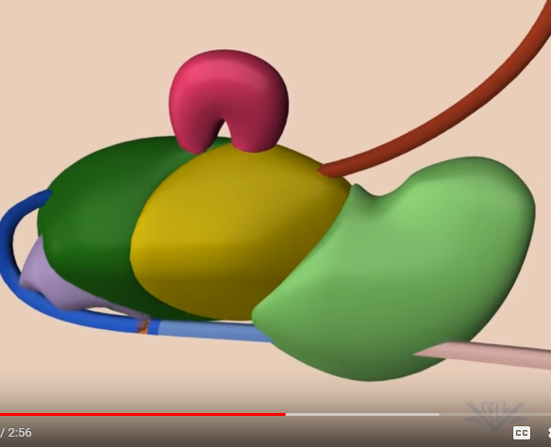
RNA Splicing
https://www.youtube.com/watch?v=FVuAwBGw_pQ

Slide 45
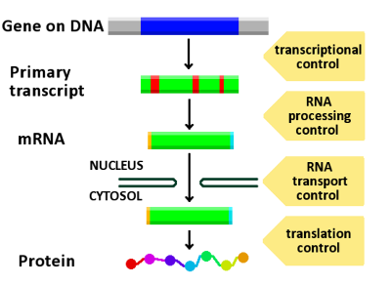
QOD
There are many points along the pathway from DNA to protein during which regulation may happen. List at least three and explain the benefit of each

Slide 46
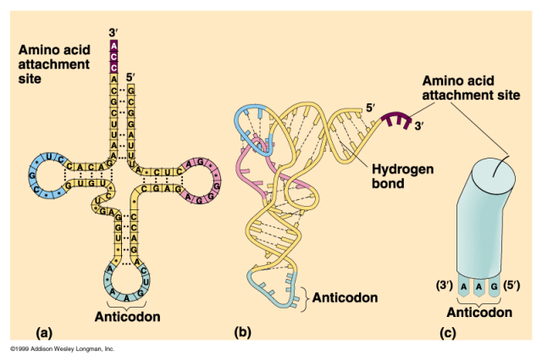
Translation, I
mRNA from nucleus is ‘read’ along its codons by tRNA’s anticodons at the ribosome
tRNA anticodon (nucleotide triplet); amino acid

Slide 47
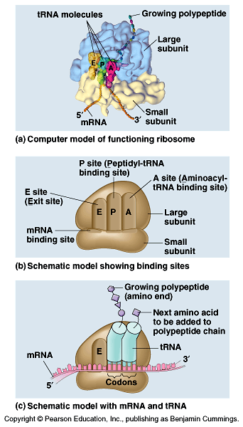
Translation, II
rRNA site of mRNA codon & tRNA anticodon coupling
P site holds the tRNA carrying the growing polypeptide chain
A site holds the tRNA carrying the next amino acid to be added to the chain
E site discharged tRNA’s

Slide 48
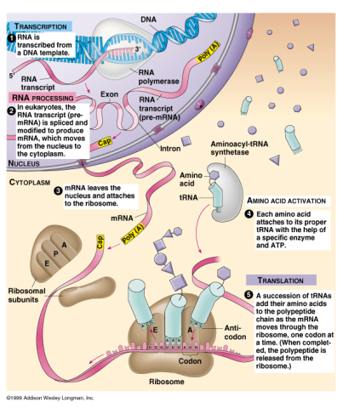
Translation, III
Initiation~ union of mRNA, tRNA, small ribosomal subunit; followed by large subunit
Elongation~ •codon recognition •peptide bond formation •translocation
Termination~ ‘stop’ codon reaches ‘A’ site
Polyribosomes: translation of mRNA by many ribosomes (many copies of a polypeptide very quickly)

Slide 49
Translation
http://highered.mcgraw-hill.com/sites/9834092339/student_view0/chapter15/how_translation_works.html

Slide 50
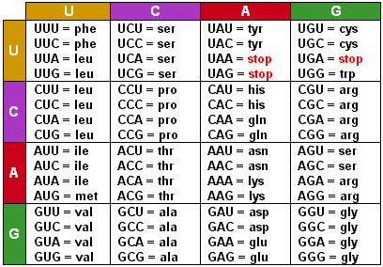
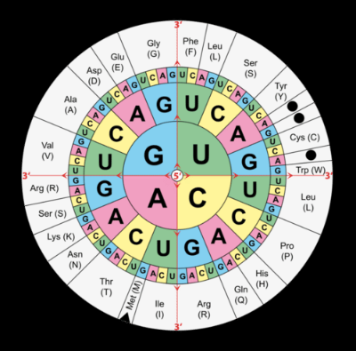

Slide 51
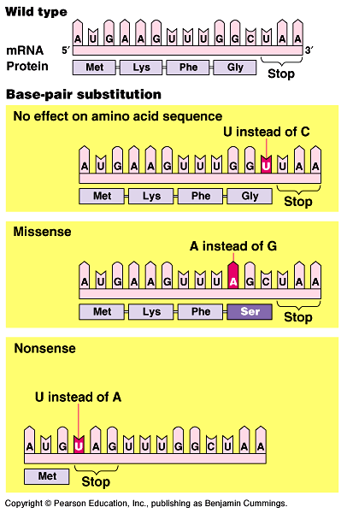
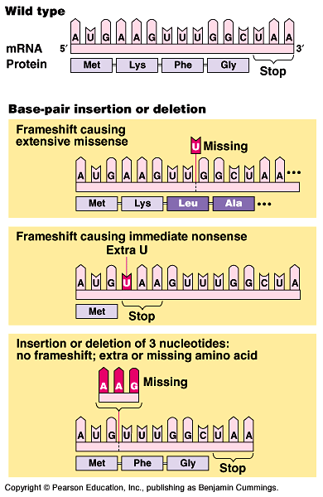
Mutations: genetic material changes in a cell
Point mutations….
Changes in 1 or a few base pairs in a single gene
Base-pair substitutions:
•silent mutations no effect on protein •missense
∆ to a different amino acid (different protein) •nonsense
  ∆ to a stop codon and a nonfunctional protein
Base-pair insertions or deletions: additions or losses of nucleotide pairs in a gene; alters the ‘reading frame’ of triplets~frameshift mutation
Mutagens: physical and chemical agents that change DNA

Slide 52
Mutation by Base Substitution
http://highered.mcgraw-hill.com/sites/9834092339/student_view0/chapter15/mutation_by_base_substitution.html

Slide 53
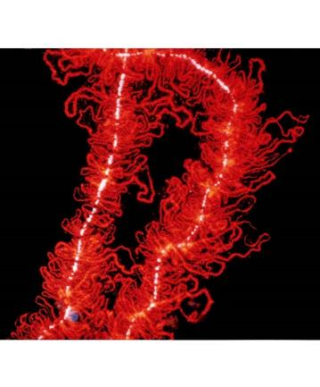
Chapter 16~ Control of Gene Expression

Slide 54
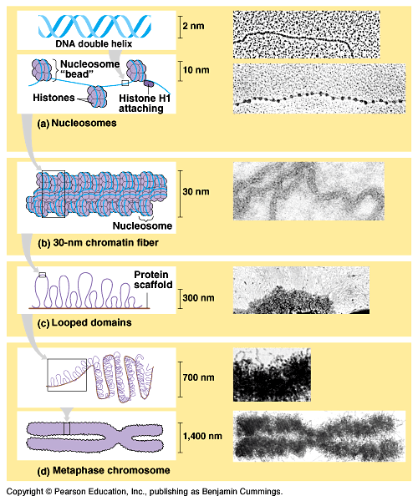
Chromatin
complex of DNA and proteins
DNA Packing •histone protein (+ charged amino acids ~ phosphates of DNA are - charged)
Nucleosome •”beads on a string”; basic unit of DNA packing
Heterochromatin •highly condensed interphase DNA (can not be transcribed)
Euchromatin •less compacted interphase DNA (can be transcribed)

Slide 55

Histone Packing
https://www.youtube.com/watch?v=CW6Zg88Vqx0&feature=related

Slide 56
DNA Packing
http://www.dnalc.org/resources/3d/07-how-dna-is-packaged-basic.html

Slide 57

DNA organization
http://blogs.discovermagazine.com/d-brief/2018/02/22/dna-looping-video/#.WpBaGoPwbcc

Slide 58

Molecular Biology of Cancer
Oncogene •cancer-causing genes
Proto-oncogene •normal cellular genes
How? 1-movement of DNA; chromosome fragments that have rejoined incorrectly 2-amplification; increases the number of copies of proto-oncogenes 3-proto-oncogene point mutation; protein product more active or more resistant to degradation
Tumor-suppressor genes •changes in genes that prevent uncontrolled cell growth (cancer growth stimulated by the absence of suppression)

Slide 59



Phenotypic Variation
Genotype isn’t everything

Slide 60


Hydrangea Color
Depends on the pH of the soil in which it is grown

Slide 61


Turtle Gender
Depends on incubation temperature

Slide 62


Arctic Fox
Fur color changes with season

Slide 63
Evolutionary Significance?
What is the advantage of variability in phenotype

Slide 64
Lactose Intolerance
https://www.youtube.com/watch?v=09QIVM_JunQ
From big band theory

Slide 65

Science of Milk
https://www.youtube.com/watch?v=xmNzUEmFZMg

Slide 66

Lac Operon
https://www.youtube.com/watch?v=CW6Zg88Vqx0&feature=related

Slide 67

Lac Operon
Inducible operon
Genes to digest lactose only need to be produced when lactose is present
Regulatory gene makes repressor.
Repressor bound to operator blocks RNA polymerase and prevents transcription of genes
When lactose is present, it binds to repressor and inactivates it
RNA polymerase enzyme can now bind to promoter region and transcribe all three genes (lac Z, lac Y, lac A)
When lactose has been digested, the repressor once again becomes active and binds to operator to turn off transcription

Slide 68


Operon
Groups of genes controlled as a unit
PROG
  Promoter
  Regulator
  Operator
  Gene
  Related genes are included with regulatory region (promoter and operator with repressor or inducer)

Slide 69


Trp Operon
Repressible operon
Genes to make tryptophan amino acid only need to be active when tryptophan is not present
Regulatory gene makes repressor
In the absence of tryptophan, repressor does not bind and transcription proceeds
These proteins are able to make tryptophan from other amino acids
When tryptophan is present, it bind to repressor and allows it to bind to operator region, preventing transcription of the genes

Slide 70
Eukaryotic Gene Regulation
https://www.hhmi.org/biointeractive/making-fittest-evolving-switches-evolving-bodies
HHMI Short film (16 minutes)

Slide 71

DNA Technology & Genomics

Slide 72

Recombinant DNA
Def: DNA in which genes from 2 different sources are linked
Genetic engineering: direct manipulation of genes for practical purposes
Biotechnology: manipulation of organisms or their components to perform practical tasks or provide useful products

Slide 73

Restriction Enzymes
What would happen if you used cut two different DNA samples with the same restriction enzyme

Slide 74

Bacterial plasmids in gene cloning

Slide 75

DNA Cloning
Restriction enzymes (endonucleases): in nature, these enzymes protect bacteria from intruding DNA; they cut up the DNA (restriction); very specific
Restriction site: recognition sequence for a particular restriction enzyme
Restriction fragments: segments of DNA cut by restriction enzymes in a reproducable way
Sticky end: short extensions of restriction fragments
DNA ligase: enzyme that can join the sticky ends of DNA fragments
Cloning vector: DNA molecule that can carry foreign DNA into a cell and replicate there (usually bacterial plasmids)

Slide 76

Steps for eukaryotic gene cloning
Isolation of cloning vector (bacterial plasmid) & gene-source DNA (gene of interest)
Insertion of gene-source DNA into the cloning vector using the same restriction enzyme; bind the fragmented DNA with DNA ligase
Introduction of cloning vector into cells (transformation by bacterial cells)
Cloning of cells (and foreign genes)
Identification of cell clones carrying the gene of interest

Slide 77

DNA Analysis & Genomics
PCR (polymerase chain reaction)
Gel electrophoresis
Restriction fragment analysis (RFLPs)
Southern blotting
DNA sequencing
Human genome project

Slide 78

Polymerase chain reaction (PCR)
Amplification of any piece of DNA without cells (in vitro)
Materials: heat, DNA polymerase, nucleotides, single-stranded DNA primers
Applications: fossils, forensics, prenatal diagnosis, etc.

Slide 79

DNA Analysis
Gel electrophoresis: separates nucleic acids or proteins on the basis of size or electrical charge creating DNA bands of the same length

Slide 80

Restriction fragment analysis
Restriction fragment length polymorphisms (RFLPs)
Southern blotting: process that reveals sequences and the RFLPs in a DNA sequence
DNA Fingerprinting

Slide 81

PCR
https://www.youtube.com/watch?v=q-40l8nmsis&feature=related

Slide 82

PCR
https://www.youtube.com/watch?v=6sW7x4NLodY&feature=related

Slide 83
DNA Analysis
Gel electrophoresis: separates nucleic acids or proteins on the basis of size or electrical charge creating DNA bands of the same length

Slide 84


Slide 85
Restriction fragment analysis
Restriction fragment length polymorphisms (RFLPs)
Southern blotting: process that reveals sequences and the RFLPs in a DNA sequence
DNA Fingerprinting

Slide 86

DNA Sequencing
Determination of nucleotide sequences (Sanger method, sequencing machine)
Genomics: the study of genomes based on DNA sequences
Human Genome Project

Slide 87

Practical DNA Technology Uses
Diagnosis of disease
Human gene therapy
Pharmaceutical products (vaccines)
Forensics
Animal husbandry (transgenic organisms)
Genetic engineering in plants
Ethical concerns?

Slide 88
Gene Therapy
https://www.hhmi.org/biointeractive/genes-as-medicine
Short film from HHMI (17 minutes)

Slide 89

CRISPR-cas9
https://www.youtube.com/watch?v=k99bMtg4zRk

Slide 90

~ The Genetic Basis of Development

Slide 91


From fertilized egg to multicellular organism
Cell Division: increase in cell number
Differentiation: cells becoming specialized in structure and function
Morphogenesis; physical processes giving an organism shape

Slide 92

Morphogenesis: plants vs. animals
Animals:
movements of cells and tissues are necessary for 3-D form of the organism
ongoing development in adults restricted to differentiation of cells continually replenished throughout lifetime
Plants:
morphogenesis and growth of overall size occur throughout lifetime of plant; apical meristems (perpetually embryonic regions), responsible for plant’s continual growth

Slide 93


Differential gene expression
Differences between cells come from differences in gene expression (genes turned on or off), not from differing genomes.
Evidence:
1- Genomic equivalence: all the cells of an organism have the same genes
2- Totipotency: cells that can retain the zygote’s potential to form all parts of the mature organism (plant cells; cloning)
3- Determination: restriction of developmental potential causing the possible fate of each cell to become more limited as the embryo develops; noted by the appearance of mRNA

Slide 94

Determination--->Differentiation
Determination: as the embryo develops the possible fate of each cell becomes more limited
Differentiation: specialization of cells dependent on the control of gene expression
Induction: the ability of one group of embryonic cells to influence the development of another; cytoplasmic determinants that regulate gene expression
Homeotic genes: genes that control the overall body plan of animals by controlling the developmental fate of groups of cells

Slide 95

Hox Genes
A group of related genes that controls the body plans organisms
Mechanism for evolution in how they are expressed
Same gene in new location becomes a new organ

Slide 96

Genetic cell death
Apoptosis programmed cell death (“suicide genes”)
1. Programmed cell death is as needed for proper development as mitosis is.
Ex: Reabsorption of the tadpole tail; formation of the fingers and toes of the fetus requires the removal of the tissue between them; sloughing off of the endometrium at the start of menstruation; formation of the proper connections (synapses) between neurons in the brain requires that surplus cells be eliminated.

Slide 97

Apoptosis, Pt. II
2. Programmed cell death is needed to destroy cells that represent a threat to the integrity of the organism.
Ex: Cells infected with viruses; waning cells of the immune system; cells with DNA damage; cancer cells

