Slide 1
Cell Division
Unit 5

Slide 2
Signal Transduction
https://www.youtube.com/watch?v=qybUFnY7Y8w

Slide 3
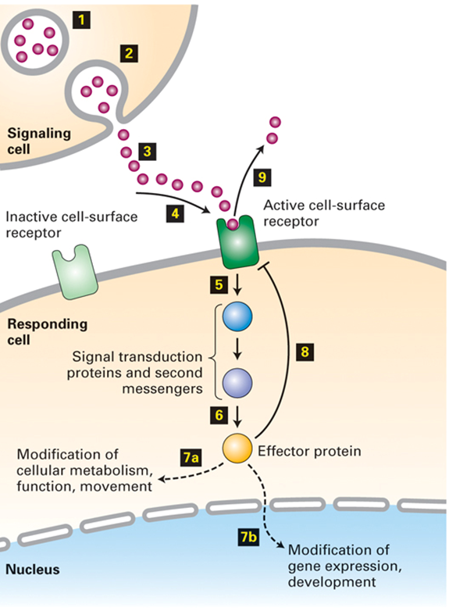
General Principles of Signal Transduction
Signal transduction refers to the overall process of converting extracellular signals into intracellular responses
Key players in signal transduction are:
signaling molecules
receptors
signal transduction proteins and second messengers
effector proteins

Slide 4
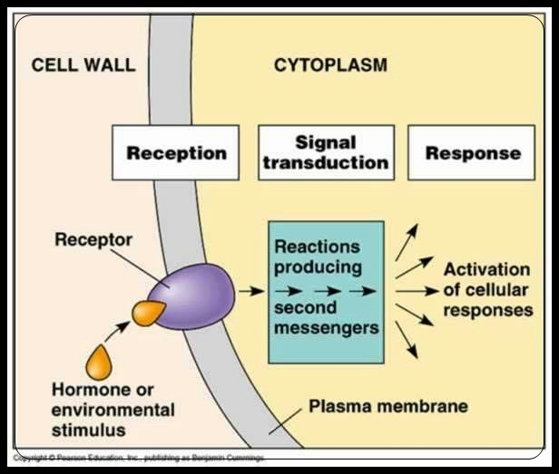
Cells respond to signals by changing either:
activity of existing enzymes (fast) and/or the
levels of expression of enzymes and cell components (slower) by gene regulation
Receptors and signal transduction systems have evolved to detect and respond to hormones, growth factors, neurotransmitters, pheromones, oxygen, nutrients, light, touch, heat, etc.
There are an enormous number of signal molecules and receptors in cells. In contrast, there are relatively few types of intracellular signal transduction systems.

Slide 5
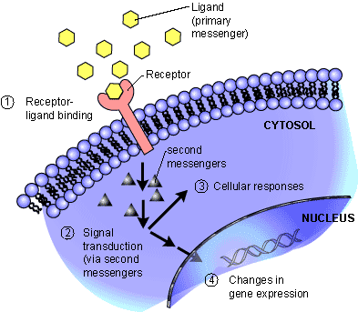
Receptors
Cell surface receptors bind to their ligands (signaling molecules) via their extracellular domains

Slide 6
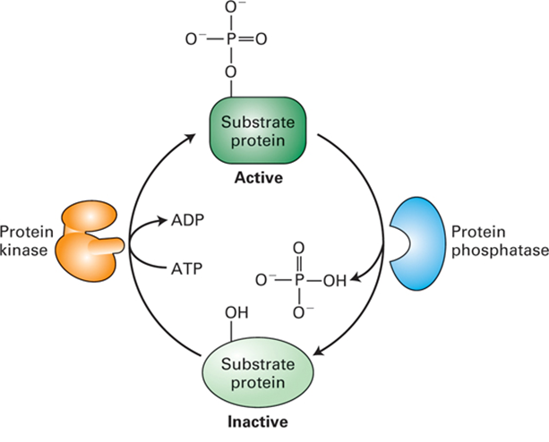
Kinases and Phosphates
Kinases use ATP to phosphorylate amino acid side-chains in target proteins.
Kinases typically are specific for tyrosine or serine/threonine sites. Phosphatases hydrolyze phosphates off of these residues. Kinases and phosphatases act together to switch the function of a target protein on or off
Activation of many cell-surface receptors leads directly or indirectly to changes in kinase or phosphatase activity.

Slide 7
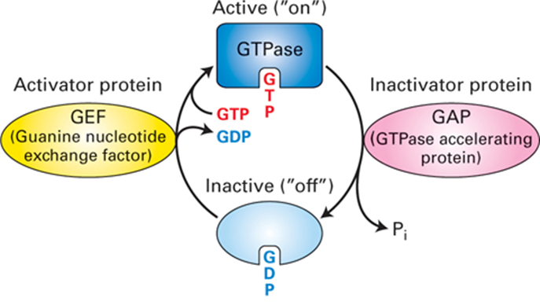
GTPase switches
GTPase switch protein also play important roles in intracellular signal transduction GTPases are active when bound to GTP and inactive when bound to GDP.

Slide 8
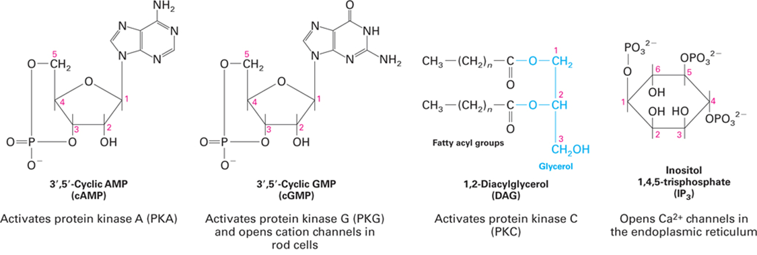
Second Messenger
While there are a large number of extracellular receptor ligands ("first messengers"), there are relatively few small molecules used in intracellular signal transduction ("second messengers").
Second messengers are small molecules that diffuse rapidly through the cytoplasm to their protein targets. Another advantage of second messengers is that they facilitate amplification of an extracellular signal.

Slide 9
Response
As a result of the action of the second messenger, the cell will respond in some way
Rearrange cytoskeleton (move)
Activate genes
Produce mRNA

Slide 10
In Conclusion

Slide 11
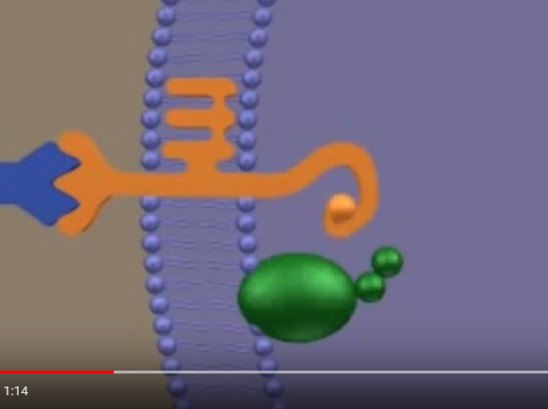
Signal Transduction
https://www.youtube.com/watch?v=tMMrTRnFdI4

Slide 12
QOD #1
Work with a partner to come up with 3 specific examples of signal transduction pathways in living organisms.

Slide 15
Chapter 10 The Cell Cycle

Slide 16
Mitosis in Newt Lung

Slide 17
Every cell in the human body regenerates on average every seven years. Like snakes, in our own way we shed our skin. Biologically we are brand new people. We may look the same, we probably do, the change isn't visible at least in most of us, but we are all changed completely forever.
Meredith
https://www.youtube.com/watch?v=XFZg_Q525X4&list=PL4A385F3C2FAAC74A#t=5.841

Slide 18
QOD 2
List the stages in Mitosis (using your favorite mnemonic device)
Now match each phase to one of the larger divisions of: replication, alignment, and separation

Slide 19
Cell size
As cell size increases, the surface area to volume ratio decreases
Rates of chemical exchange may then be inadequate for cell size
Cell size, therefore, remains small

Slide 20
Asexual Reproduction in Garlic
Many plants use asexual propagation

Slide 21
Cell Division: Key Vocabulary
Genome: cell’s genetic information
Somatic cells (body cells)
Gametes (reproductive cells): sperm and egg cells
Chromosomes: DNA molecules
Diploid (2n): 2 sets of chromosomes
Haploid (1n): 1 set of chromosomes
Chromatin: DNA-protein complex
Chromatids: replicated strands of a chromosome
Centromere: narrowing “waist” of sister chromatids
Mitosis: nuclear division
Cytokinesis: cytoplasm division
Meiosis: gamete cell division

Slide 22
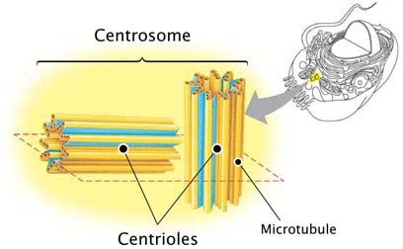
Centrosome vs centriole

Slide 23
Cell Division: Key Roles
Genome: cell’s genetic information
Somatic (body cells) cells
Gametes (reproductive cells): sperm and egg cells
Chromosomes: DNA molecules
Diploid (2n): 2 sets of chromosomes
Haploid (1n): 1 set of chromosomes
Chromatin: DNA-protein complex
Chromatids: replicated strands of a chromosome
Centromere: narrowing “waist” of sister chromatids
Mitosis: nuclear division
Cytokinesis: cytoplasm division
Meiosis: gamete cell division

Slide 24
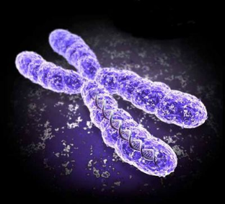
Chromosome anatomy
Draw a chromosome and label the following parts:
Telomere
Centromere
Gene
Chromatid
Chromatin
Chromosome
(kinetochore)
Next to each label, write a brief description of each part

Slide 25
Chromosome Coiling
In order to align and separate, chromatin must coil and condense. Draw or make a partially coiled chromosome and label each of the following parts:
Histone
Nucleosome
Scaffold
Supercoil
Next to each part, include a brief description

Slide 26
Three main steps in cell division
Replication
Alignment
Separation

Slide 27
The Cell Cycle
Interphase (90% of cycle)
• G1 phase-growth
• S phase-synthesis of DNA
• G2 phase- preparation for cell division
Mitotic phase
Mitosis-nuclear division
Cytokinesis- cytoplasm division

Slide 28
Nematode Cell Division

Slide 29
Mitosis
Prophase
Prometaphase
Metaphase
Anaphase
Telophase

Slide 30
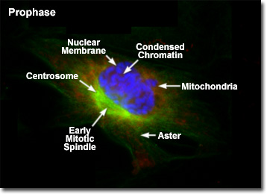
Prophase
Chromosomes visible
Nucleoli disappear
Sister chromatids
Mitotic spindle forms
Centrosomes move

Slide 31
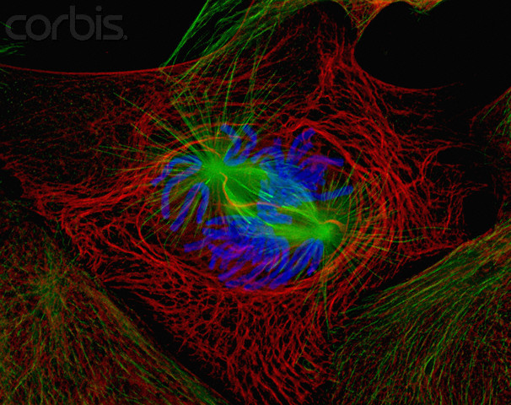
Prometaphase
Nuclear membrane fragments
Spindle interaction with chromosomes
Kinetochore develops

Slide 32
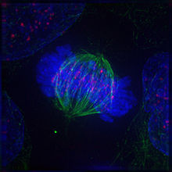
Metaphase
Centrosomes at opposite poles
Centromeres are aligned
Kinetochores of sister chromatids attached to microtubules (spindle)

Slide 33
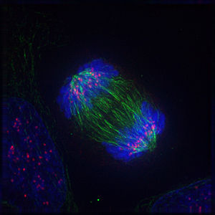
Anaphase
Paired centromeres separate; sister chromatids liberated
Chromosomes move to opposite poles
Each pole now has a complete set of chromosomes

Slide 34
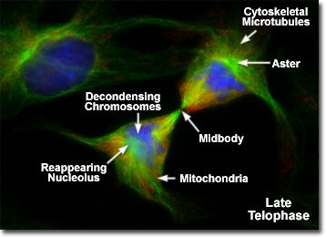
Telophase
Daughter nuclei form
Nuclear envelopes arise
Chromatin becomes less coiled
Two new nuclei complete mitosis

Slide 35
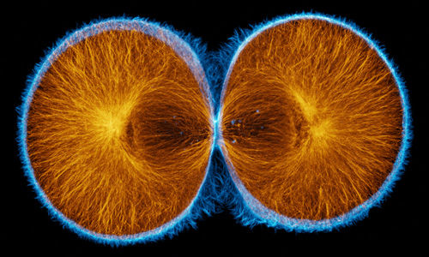
Cytokinesis
Cytoplasmic division
Animals:
cleavage furrow
Plants:
cell plate

Slide 36
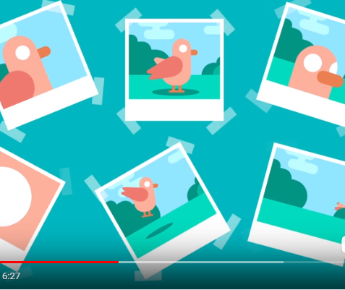
What Are you
Are you your body? And if so, how exactly does this work? Kurzgesagt takes on the challenge of asking how many of those cells can you take away before you stop being you? And does that question even make sense?
https://ed.ted.com/featured/wUCVOy93

Slide 37
QOD 3
List three factors which control cell division
Explain what the results of a failure in the cell division pathway might be

Slide 38
Cell Cycle regulation
Growth factors
Density-dependent inhibition
Anchorage dependence

Slide 39
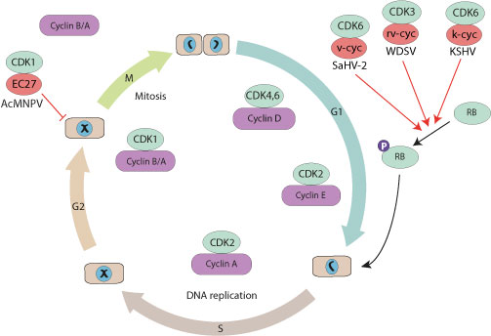
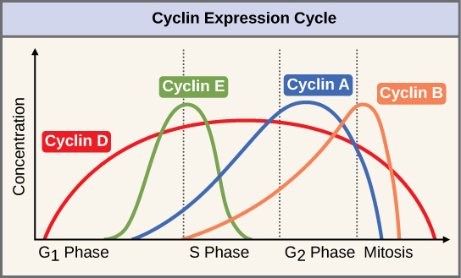
Cyclin and CDK
Cyclins control the cell cycle by binding to CDK (cyclin dependent kinases)
This complex signals passage from one stage to the next

Slide 40
Cancer
http://www.hhmi.org/biointeractive/angiogenesis
Transformation
Tumor: benign or malignant
Metastasis

Slide 41
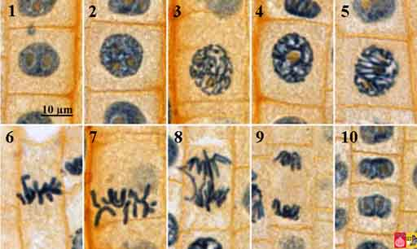
Onion Root Tip Mitosis

Slide 42
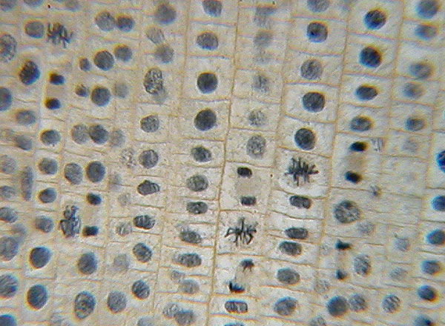
Field 1

Slide 43
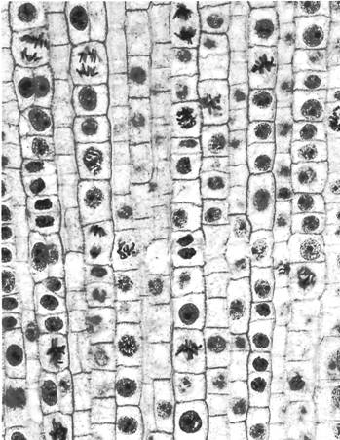
Field 2

Slide 44
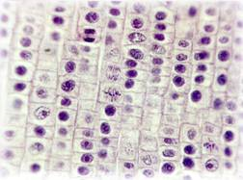
Field 3

Slide 45
Chapter 53 ~
Animal Reproduction

Slide 46
QOD
QOD – List three ways meiosis contributes to genetic diversity

Slide 47
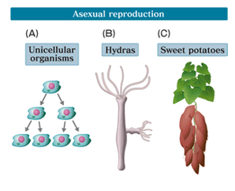
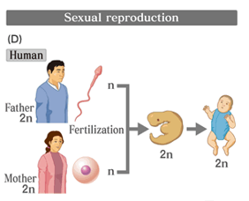
Overview
Asexual (one parent)
fission (parent separation)
budding (corals)
gemmules (porifera)
fragmentation & regeneration (inverts)
Sexual (fusion of haploid gametes)
gametes (sex cells)
zygote (fertilized egg)
ovum (unfertilized egg)
spermatozoon (male gamete)

Slide 48
Reproductive cycles
Parthenogenesis
unfertilized egg development; haploid, sterile adults (honeybees)
Hermaphroditism
both male & female reproductive systems; sessile & burrowing organisms (earthworms)
Sequential hermaphroditism reversal of gender during lifetime)

Slide 49
Mechanisms of sexual reproduction
Fertilization
(union of sperm and egg) • external • internal
Pheromones
chemical signals that influence the behavior of others (mate attractants)

Slide 50
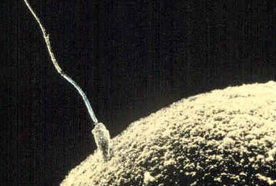
Star Wars and Sperm
https://www.popsci.com/star-wars-sperm-whips

Slide 51
Spermatogenesis
Puberty until death!
Seminiferous tubules~ location
Primordial germ cell (2N)~ differentiate into….
Spermatogonium (2N)~ sperm precursor
Repeated mitosis into….
Primary spermatocyte (2N)
1st meiotic division
Secondary spermatocyte (1N)
2nd meiotic division
Spermatids (1N)~Sertoli cells….
Sperm cells (1N)

Slide 52
Oogenesis
As embryo until menopause...
Ovaries
Primordial germ cells (2N)
Oogonium (2N)
Primary oocyte (2N)
Between birth & puberty; prophase I of meiosis
Puberty; FSH; completes meiosis I
Secondary oocyte (1N); polar body
Meiosis II; stimulated by fertilization
Ovum (1N); 2nd polar body

Slide 53
The female pattern
Estrous cycles/estrus (many mammals)
Menstrual cycle (humans and many other primates):
Ovarian/Menstrual cycles~ •follicular phase~follicle growth •ovulation~ oocyte release •luteal phase~ hormone release

Slide 54
Embryonic & fetal development
Gestation~ pregnancy
1st trimester:
organogenesis
fetus (week 8; all adult features)
HCG hormone (menstruation override; pregnancy test detection)
Parturition~birth
Labor~uterine contractions
Lactation~prolactin & oxytocin

Slide 55
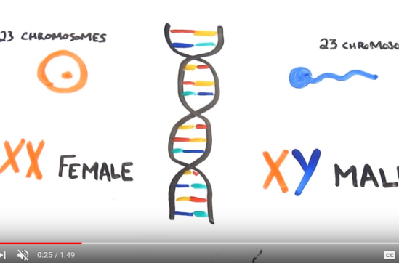
We are all Females
https://www.youtube.com/watch?v=z1Kdoja3hlk

Slide 56
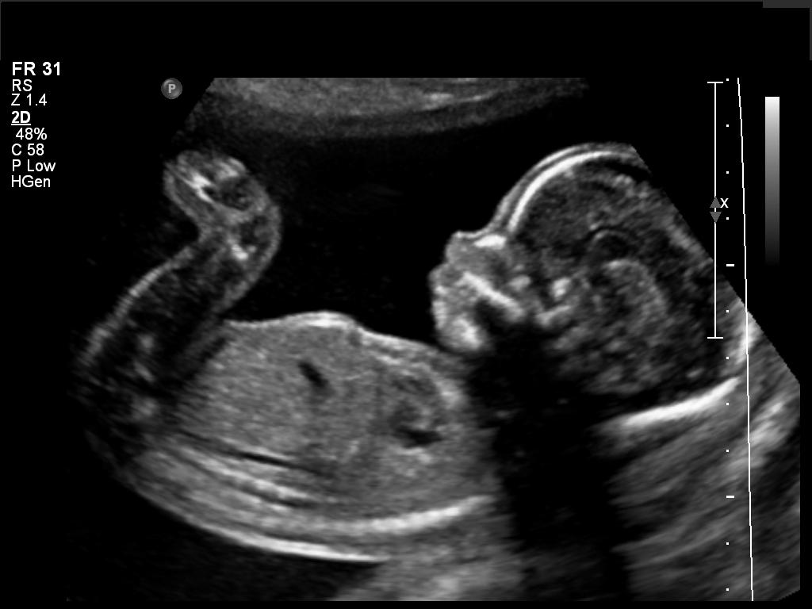
Modern technologies

Slide 57
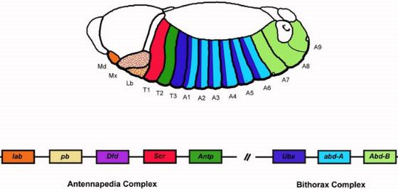
Homeotic (HOX) genes
Group of genes which control the body plan of organisms
They determine which appendages will form during development
They work by making transcription factors
Transcription factors bind to DNA to activate or deactivate certain regions
The human genome contains about 2,600 transcription factors

