Slide 1
Biochemistry
Unit 3

Slide 2
Day 1 Unit 3
Introduction to atoms

Slide 3
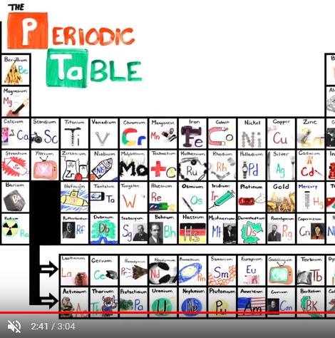
Periodic Table Song
https://www.youtube.com/watch?v=VgVQKCcfwnU&list=PLM753k_ttL_fdRnhqH6eqmakR-Z_r8K6W

Slide 4
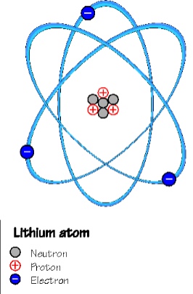
Chemical Context of Life
Matter (space & mass)
Element; compound
The atom
Atomic number (# of protons); mass number (protons + neutrons)
Isotopes (different # of neutrons); radioactive isotopes (nuclear decay)
Energy (ability to do work); energy levels (electron states of potential energy)

Slide 5
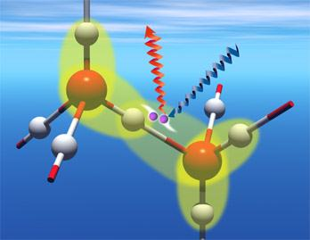
Chemical Bonding
Covalent
Double covalent
Nonpolar covalent
Polar covalent
Ionic
Hydrogen
van der Waals

Slide 6
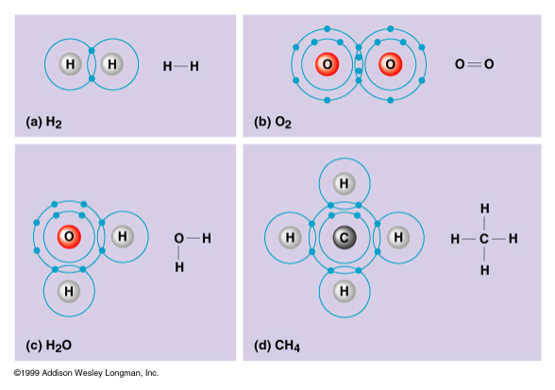
Covalent Bonding
Sharing pair of valence electrons
Number of electrons required to complete an atom’s valence shell determines how many bonds will form
Ex: Hydrogen & oxygen bonding in water; methane

Slide 7
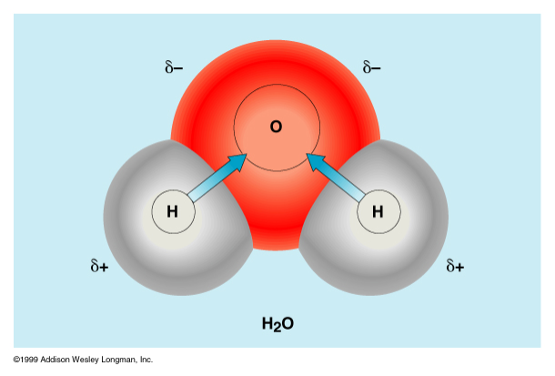
Polar/nonpolar covalent bonds
Electronegativity attraction for electrons
Nonpolar covalent •electrons shared equally •Ex: diatomic H and O
Polar covalent •one atom more electronegative than the other (charged) •Ex: water

Slide 8
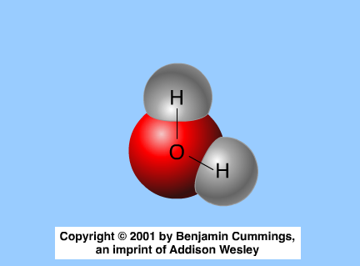
Polar/nonpolar bonds

Slide 9
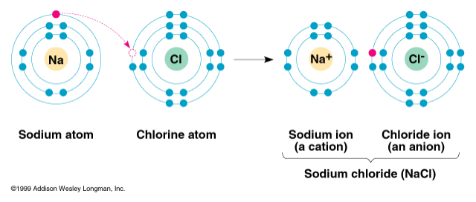
Ionic bonding
High electronegativity difference strips valence electrons away from another atom
Electron transfer creates ions (charged atoms)
Cation (positive ion); anion (negative ion)
Ex: Salts (sodium chloride)

Slide 10
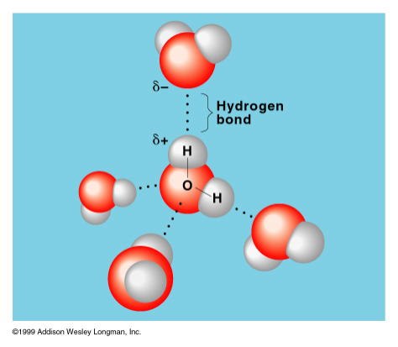
Hydrogen Bonds
Hydrogen atom covalently bonded to one electronegative atom is also attracted to another electronegative atom (oxygen or nitrogen)

Slide 11
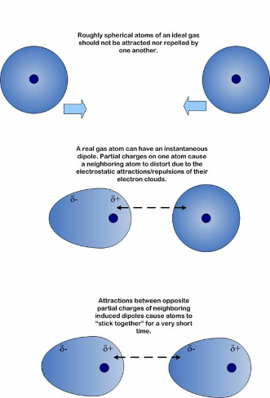
Van der Waals Interactions
Weak interactions between molecules or parts of molecules that are brought about by localized change fluctuations
Due to the fact that electrons are constantly in motion and at any given instant, ever-changing “hot spots” of negative or positive charge may develop

Slide 12
Day 4 Unit 3
pH of common household substances lab

Slide 13
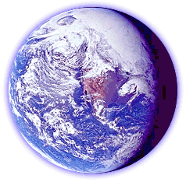
Water
Polar - opposite ends, opposite charges
Cohesion - H+ bonds holding molecules together
Adhesion - H+ bonds holding molecules to another substance
Surface tension - measurement of the difficulty to break or stretch the surface of a liquid
Specific heat - amount of heat absorbed or lost to change temperature by 1oC
Heat of vaporization - quantity of heat required to convert 1g from liquid to gas states
Density……….

Slide 14
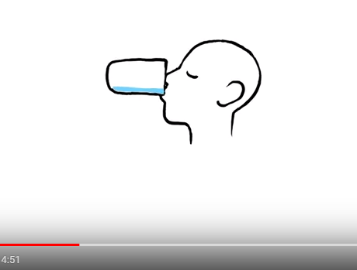
What Happens if we Don’t Drink Water
https://www.youtube.com/watch?v=9iMGFqMmUFs

Slide 15
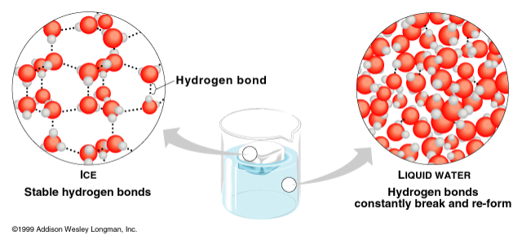
Density
Less dense as solid than liquid
Due to hydrogen bonding
Crystalline lattice keeps molecules at a distance

Slide 16
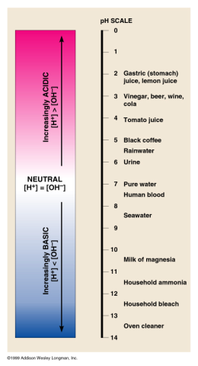
Acid/Base & pH
Dissociation of water into a hydrogen ion and a hydroxide ion
Acid: increases the hydrogen concentration of a solution
Base: reduces the hydrogen ion concentration of a solution
pH: “power of hydrogen”
Buffers: substances that minimize H+ and OH- concentrations (accepts or donates H+ ions)

Slide 17
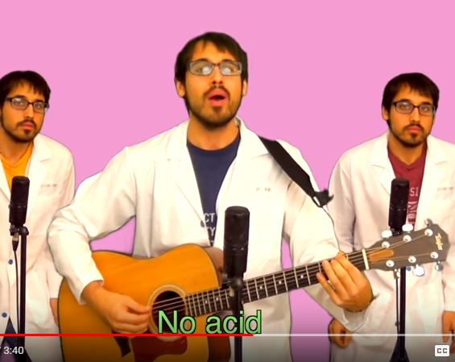
All About the Base (No Acid)
https://www.youtube.com/watch?v=IAJsZWhj6GI

Slide 18
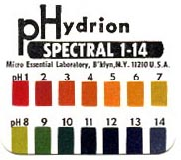
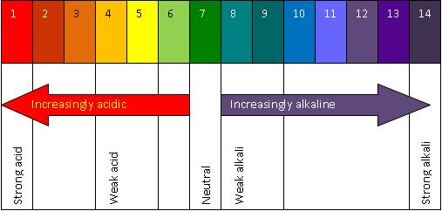

Slide 19
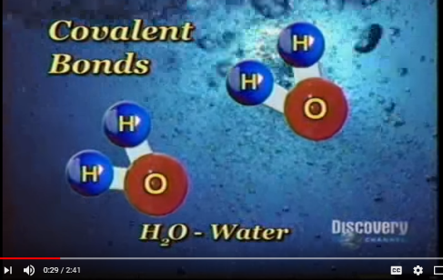
Properties of Acids and Bases
https://www.youtube.com/watch?v=GYzH_NiIAaY

Slide 20
Day 2 Unit 3
Organic chemistry and polymerization reactions
H/W, bring in liquid for pH lab

Slide 21
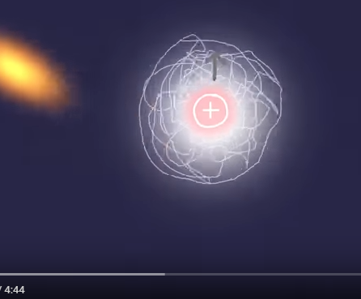
The Molecular Shape of you
https://www.youtube.com/watch?v=f8FAJXPBdOg&t=217s

Slide 22
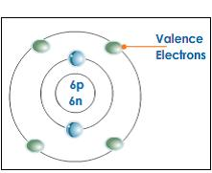
Organic Macromolecules
Carbohydrates
Proteins
Lipids
Nucleic Acids

Slide 23
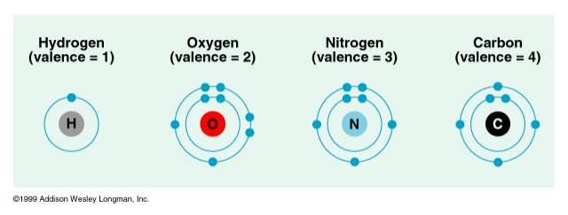
Organic chemistry
Biological thought:
Vitalism (life force outside physical & chemical laws) Berzelius
Mechanism (all natural phenomena are governed by physical & chemical laws) Miller
Carbon
  tetravalence
  Tetrahedron shape determines function

Slide 24
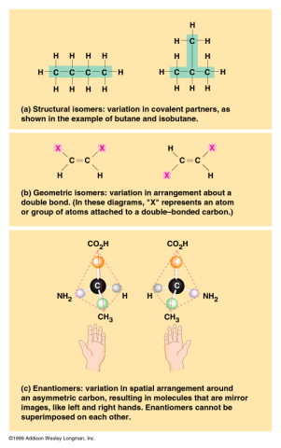
Hydrocarbons
Only carbon & hydrogen (petroleum; lipid ‘tails’)
Covalent bonding; nonpolar
High energy storage
Isomers (same molecular formula, but different structure & properties)
structural~differing covalent bonding arrangement
geometric~differing spatial arrangement
enantiomers~mirror images pharmacological industry (thalidomide)

Slide 25

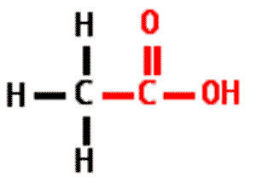
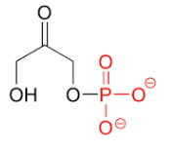
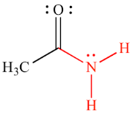
Functional Groups, II
Sulfhydryl Group sulfur bonded to H thiols
Phosphate Group phosphate ion; covalently attached by 1 of its O to the C skeleton;
Carboxyl Group O double bonded to C to hydroxyl; carboxylic acids; covalent bond between O and H; polar; dissociation, H ion
Amino GroupN to 2 H atoms; amines, acts as a base (+1)

Slide 26
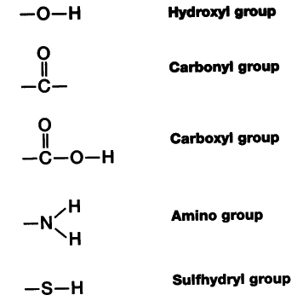

Slide 27
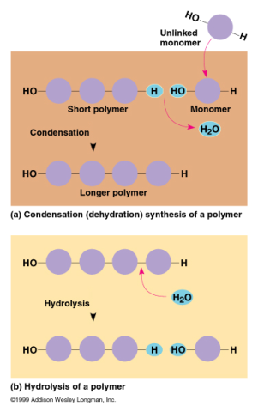
Polymers
Covalent monomers
Condensation reaction (dehydration reaction): One monomer provides a hydroxyl group while the other provides a hydrogen to form a water molecule
Hydrolysis: bonds between monomers are broken by adding water (digestion)

Slide 28
Day 5
Carbohydrate modeling
Carbohydrate notes

Slide 29
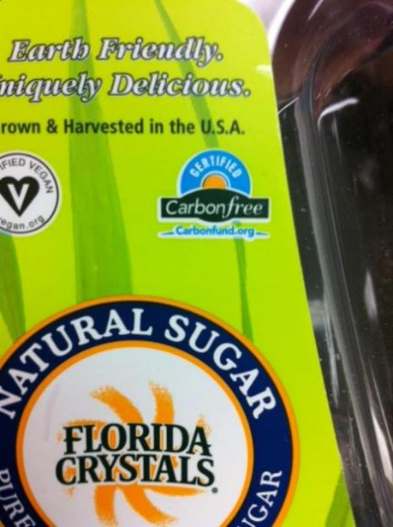
Carbon free sugar – really?

Slide 30
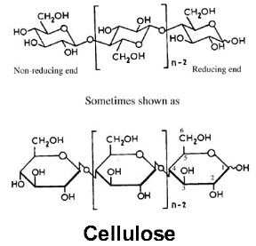
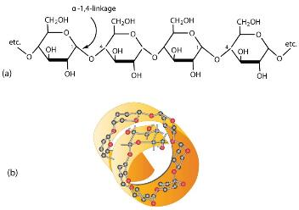
QOD
How do the structural differences between cellulose and starch allow them to carry out their very different functions?

Slide 31
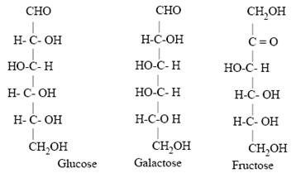

Slide 32
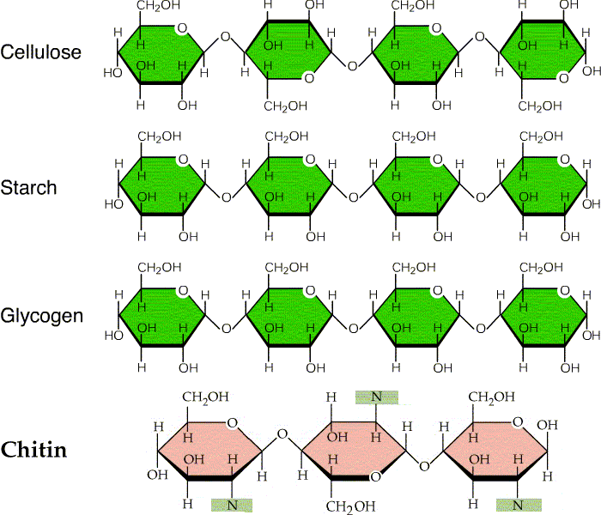

Slide 33
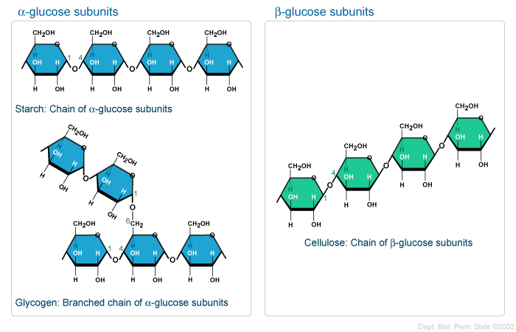

Slide 34
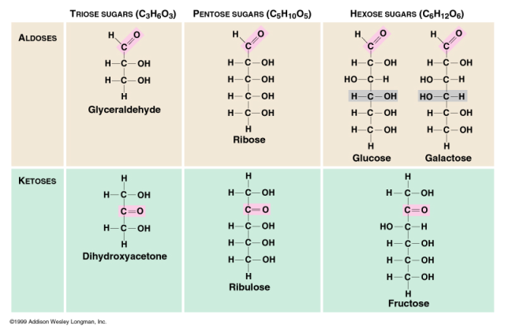
Carbohydrates, I
Monosaccharides CH2O formula;
  multiple hydroxyl (-OH) groups and 1 carbonyl (C=O) group:
  aldehyde (aldoses) sugar ketone sugar
  cellular respiration; raw material for amino acids and fatty acids

Slide 35
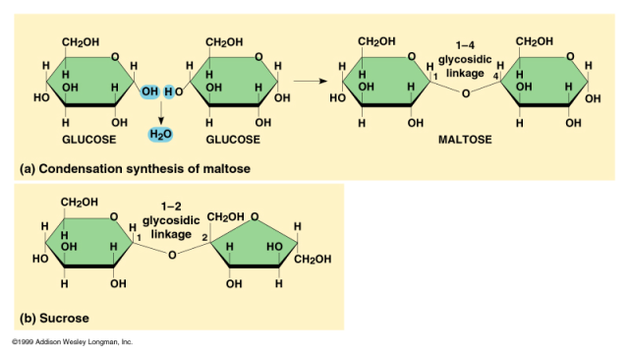
Carbohydrates, II
Disaccharide - glycosidic linkage (covalent bond) between 2 monosaccharides;
  covalent bond by dehydration reaction
Sucrose (table sugar) most common disaccharide

Slide 36
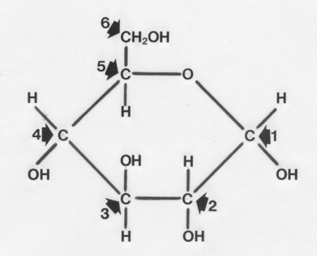

Slide 37
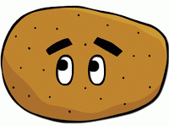
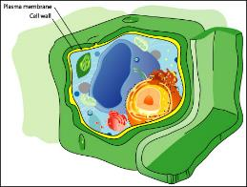
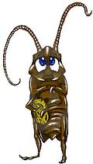
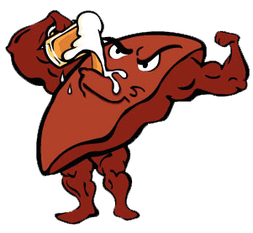
Carbohydrates, Polysaccharides
Storage:
Starch: Plants
Glycogen: Animals
Structural:
Cellulose: Cell walls of plants
Chitin: exoskeletons, cell walls of fungi

Slide 38
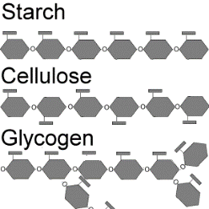
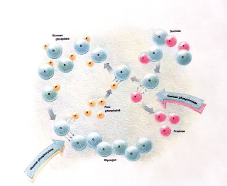
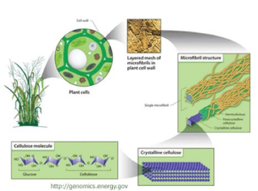
Polysaccharides

Slide 40
October 1, 2015
Unit 3 Day 4
Lipid Modeling
Lipid notes

Slide 41
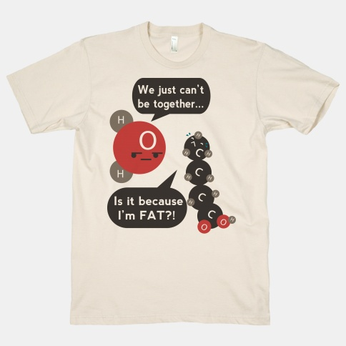

Slide 42
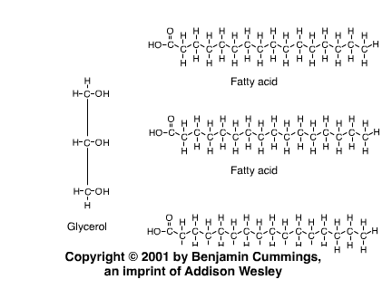
Lipids, II

Slide 43
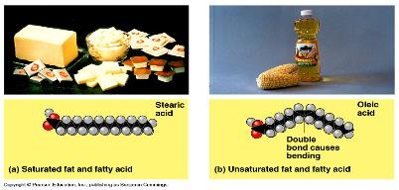
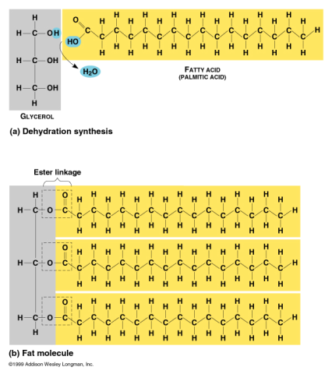
Lipids
Glycerol backbone and fatty acid tails
Hydrophobic; H bonds in water exclude fats
Twice as many calories as carbs or proteins
Ester linkage: 3 fatty acids to 1 glycerol
(dehydration synthesis)
Triacyglycerol (triglyceride)

Slide 44
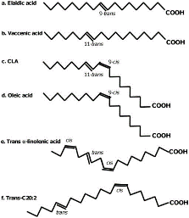
Trans fats
Saturated vs. unsaturated fats;
single vs. double bonds
Partially hydrogenated oils
Margarine vs butter
Asap science:
http://www.youtube.com/watch?v=KG_ybdk1VaE

Slide 45
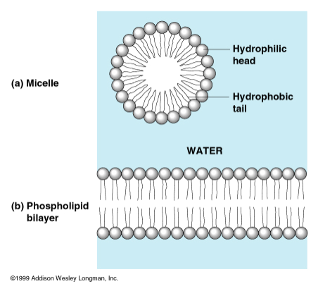
Phospholipids
2 fatty acids instead of 3 (phosphate group)
‘Tails’ hydrophobic; ‘heads’ hydrophilic
Micelle (phospholipid droplet in water)
Bilayer (double layer); cell membranes

Slide 46
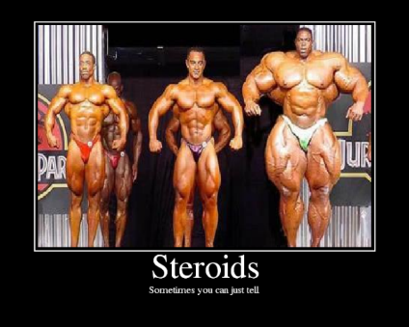
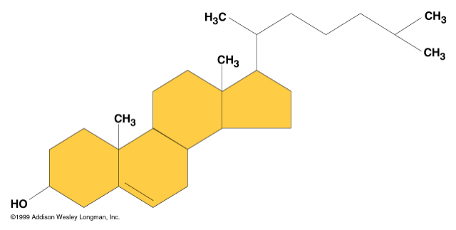
Steroids
Lipids with 4 fused carbon rings
Ex: cholesterol: cell membranes; precursor for other steroids
    (sex hormones)

Slide 47

Steroidogenesis

Slide 48

Saturated vs Unsaturated Lipids t-chart
Basic properties of lipids on top
Structure and function of saturated and unsaturated lipids

Slide 49

Lipid Joke
Q: Why did the parrot wear a raincoat
A: He wanted to be polyunsaturated

Slide 51
Both
DNA
RNA

Slide 52

Nucleic Acids, I
Deoxyribonucleic acid (DNA)
Ribonucleic acid (RNA)
DNA->RNA->protein
Polymers of nucleotides (polynucleotide): nitrogenous base pentose sugar phosphate group
Nitrogenous bases: pyrimidines~cytosine, thymine, uracil purines~adenine, guanine

Slide 53

Nucleic Acids, II
Pentoses:
  ribose (RNA)
  deoxyribose (DNA)
  nucleoside (base + sugar)
Polynucleotide:
  phosphodiester linkages (covalent); phosphate + sugar

Slide 54

Directionality
5’ and 3’ carbons on the sugar of DNA gives it directionality
Processes happen in specific directions.

Slide 55

Nucleic Acids, III
Inheritance based on DNA replication
Double helix (Watson & Crick - 1953)
H bonds~ between paired bases van der Waals~ between stacked bases
A to T; C to G pairing
Complementary

Slide 56
Day 6
Protein Modeling
Enzyme modeling
Notes on Proteins

Slide 57

Actin Protein Filament
QOD
Proteins have several levels of structure. In 3-5 words, describe each level and what type of bonds stabilize this level

Slide 58

Proteins
Importance:
  basic structural component of nearly everything organisms
  50% dry weight of cells; most structurally sophisticated molecules known
Monomer: amino acids
  (there are 20)
  carboxyl (-COOH) group
  amino group (NH2),
  H atom,
  variable group (R)….

Slide 59

Peptide Bond
Dehydration synthesis reaction that bonds to amino acids together to form a dipeptide
Repeated again and again it will yield a polypeptide which is a protein

Slide 60


Primary Structure
Conformation: Linear structure
Molecular Biology: each type of protein has a unique primary structure of amino acids
Amino acid substitution: hemoglobin; sickle-cell anemia

Slide 61

Secondary Structure
Conformation: coils & folds (hydrogen bonds)
Alpha Helix: coiling
  keratin
Pleated Sheet:parallel
  silk

Slide 62

Tertiary Structure
Conformation: irregular contortions from R group bonding
  Hydrophobic
  disulfide bridges
  hydrogen bonds
  ionic bonds

Slide 63

Quaternary Structure
Conformation: 2 or more polypeptide chains aggregated into 1 macromolecule
  collagen (connective tissue)
  hemoglobin

Slide 64
Day 7
Work on organic foldable
You may use this, along with any other notes you have taken on Friday’s quiz (no textbooks or electronics)
There is a sample foldable available – use it to understand how to fold and staple yours

Slide 65
Day 8
Four FRQs – work collaboratively to prepare rubrics, write and grade 4 FRQs – directions are on the handout in the folder for day 8

Slide 66
Day 9
Math worksheet on Gibbs free energy
Work on foldable if you finish early
If everyone finishes early you may start the movie

Slide 67
Day 10
Quiz on organic chemistry – you may use the foldable along with any notes you have taken. No electronics or textbooks please.
Watch the movie when everyone is done

