Slide 1
AP Biology
Daily Agenda Slides
Animals
Unit 12

Slide 2
Endocrine System

Slide 3
Regulatory systems
Hormone~ chemical signal secreted into body fluids (blood) communicating regulatory messages
Target cells~ body cells that respond to hormones
Endocrine system/glands~ hormone secreting system/glands (ductless); exocrine glands secrete chemicals (sweat, mucus, enzymes) through ducts
Neurosecretory cells~ actual cells that secrete hormones
Feedback mechanisms ~ negative and positive

Slide 4
Mode of Action: Chemical Signaling
1- Plasma membrane reception •signal-transduction pathways (neurotransmitters, growth factors, most hormones)
2- Cell nucleus reception •steroid hormones, thyroid hormones, some local regulators

Slide 5
Vertebrate Endocrine System
There are many glands in the body, they each secrete specific hormones that cause reactions throughout the body.
Some even excrete hormones that stimulate other glands to secrete more hormones
Biological signaling is complex
Hormones act within an organism while pheromones act between organisms

Slide 6
The pancreas
Islets of Langerhans
Alpha cells:
•glucagon~ raises blood glucose levels
Beta cells:
•insulin~ lowers blood glucose levels
Type I diabetes mellitus (insulin-dependent; autoimmune disorder)
Type II diabetes mellitus (non-insulin-dependent; reduced responsiveness in insulin targets)

Slide 7
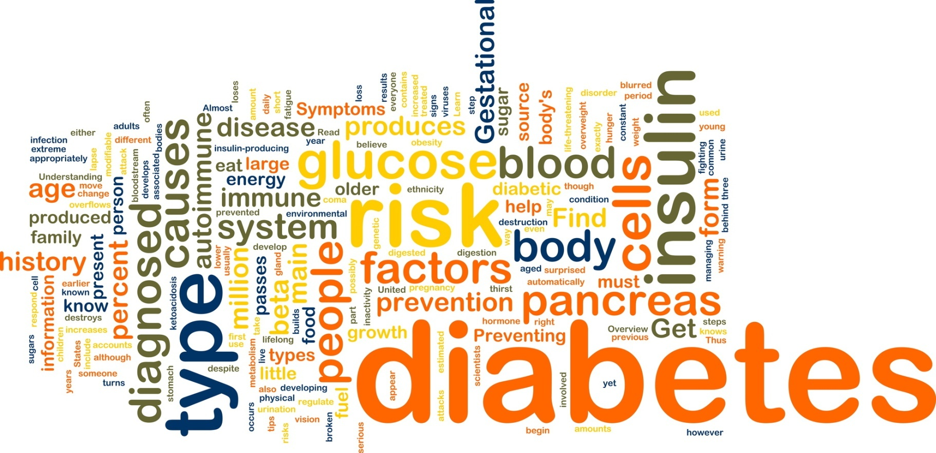

Slide 8
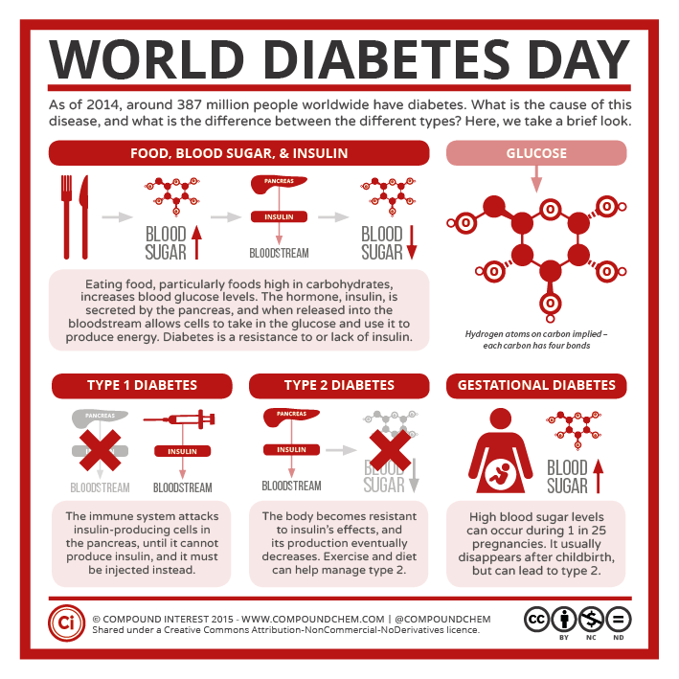

Slide 9
Diagnosis: Diabetes
You will take the roll of a team of doctors with a newly diagnosed patient who has diabetes

Slide 10
You will need to
Review the diagnosis procedure
How the disease works
Symptoms
Tests
Risk factors
Describe your treatment plan
Monitoring
Diet
exercise
Set up a follow up visit

Slide 11
Your Patient #1
Ethan is a 4 year old child with juvenile diabetes Type I
He is an active, happy child and wants to continue to play soccer

Slide 12
Your Patient #2
Allen 33, he is overweight and suffers from Type II diabetes .
He has been heavy since childhood and had a sedentary job.

Slide 13
Your Patient #3
Maria in in her 28th week of pregnancy and has gestational diabetes.
She was healthy before her pregnancy and is 27 years old

Slide 14
Chapter 49 ~ Sensory and Motor Mechanisms

Slide 15
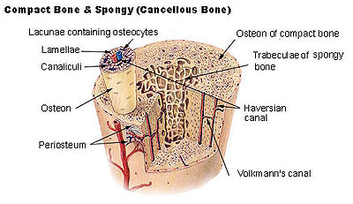
Osteon

Slide 17
Vertebrate Skeletal Muscle
Contract/relax: antagonistic pairs w/skeleton
Muscles: bundle of….
Muscle fibers: single cell w/ many nuclei consisting of….
Myofibrils: longitudinal bundles composed of….
Myofilaments: •Thin~ 2 strands of actin protein and a regulatory protein •Thick~ myosin protein
Sarcomere: repeating unit of muscle tissue, composed of….
Z lines~sarcomere border
I band~only actin protein
A band~actin & myosin protein overlap
H zone~central sarcomere; only myosin

Slide 18
Sliding-filament model
Theory of muscle contraction
Sarcomere length reduced
Z line length becomes shorter
Actin and myosin slide past each other (overlap increases)

Slide 19
Actin-myosin interaction
1- Myosin head hydrolyzes ATP to ADP and inorganic phosphate (Pi); termed the “high energy configuration”
2- Myosin head binds to actin; termed a “cross bridge”
3- Releasing ADP and (Pi), myosin relaxes sliding actin; “low energy configuration”
4- Binding of new ATP releases myosin head
Creatine phosphate~ supplier of phosphate to ADP

Slide 20
Muscle contraction regulation, I
Relaxation: tropomyosin blocks myosin binding sites on actin
Contraction: calcium binds to toponin complex; tropomyosin changes shape, exposing myosin binding sites

Slide 21
Muscle contraction regulation, II
Calcium (Ca+)~ concentration regulated by the….
Sarcoplasmic reticulum~ a specialized endoplasmic reticulum
Stimulated by action potential in a motor neuron
T (transverse) tubules~ travel channels in plasma membrane for action potential
Ca+ then binds to troponin

Slide 22
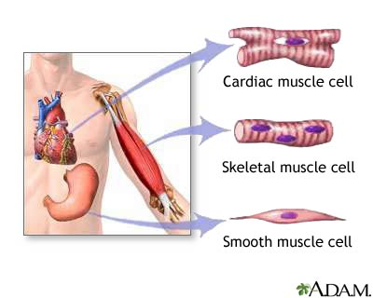
Muscle Types

Slide 23
Chapter 49 Respiratory System

Slide 26
Circulation and Gas Exchange

Slide 27
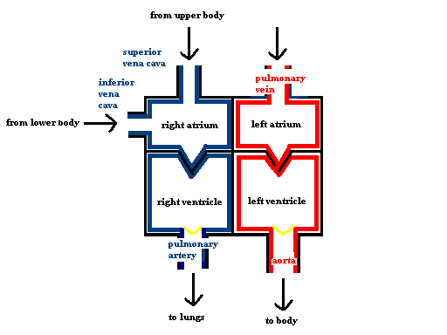
Circulatory Pathway of Mamals

Slide 28
QOD
Sponges (porifera)
Flat worms (platyhelminthes)
Round worms (nematoda)
Segmented worms (annelida)
Stinging celled (cnidaria)
Squishy (mollusca)
Hard shelled (arthropods)
Spiny skinned (echinoderm)
With a spine (chordata):
fish
amphibian
reptile
mammal
Use 3-6 words to describe the circulatory system of each animal as it moves from simpler to more complex.

Slide 29
Circulation system evolution, I
Gastrovascular cavity (cnidarians, flatworms)
Open circulatory •hemolymph (blood & interstitial fluid) •sinuses (spaces surrounding organs)
Closed circulatory: blood confined to vessels
Cardiovascular system •heart (atria/ventricles) •blood vessels (arteries, arterioles, capillary beds, venules, veins) •blood (circulatory fluid)

Slide 30
Circulation system evolution, II
Fish: 2-chambered heart; single circuit of blood flow
Amphibians: 3-chambered heart; 2 circuits of blood flow- pulmocutaneous (lungs and skin); systemic (some mixing)
Mammals: 4-chambered heart; double circulation; complete separation between oxygen-rich and oxygen poor blood

Slide 31
The mammalian heart
Cardiac cycle: sequence of filling and pumping
Systole- contraction
Diastole- relaxation
Cardiac output: volume of blood per minute
Heart rate- number of beats per minute
Stroke volume- amount of blood pumped with each contraction
Pulse: rhythmic stretching of arteries by heart contraction

Slide 32
The heartbeat
Sinoatrial (SA) node (“pacemaker”): sets rate and timing of cardiac contraction by generating electrical signals
Atrioventricular (AV) node: relay point (0.1 second delay) spreading impulse to walls of ventricles
Electrocardiogram (ECG or EKG)

Slide 33
Blood vessel structural differences
Capillaries •endothelium; basement membrane
Arteries •thick connective tissue; thick smooth muscle; endothelium; basement membrane
Veins •thin connective tissue; thin smooth muscle; endothelium; basement membrane

Slide 34
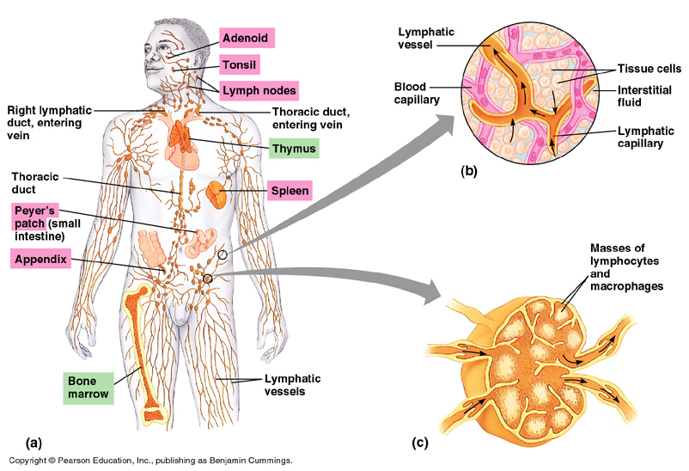
The lymphatic system
Lymphatic system: system of vessels and lymph nodes, separate from the circulatory system, that returns fluid and protein to blood
Lymph: colorless fluid, derived from interstitial fluid
Lymph nodes: filter lymph and help attack viruses and bacteria
Body defense / immunity

Slide 35
Blood
Plasma: liquid matrix of blood in which cells are suspended (90% water)
Erythrocytes (RBCs): transport O2 via hemoglobin
Leukocytes (WBCs): defense and immunity
Platelets: clotting
Stem cells: pluripotent cells in the red marrow of bones
Blood clotting: fibrinogen (inactive)/ fibrin (active); hemophilia; thrombus (clot)

Slide 36
Cardiovascular disease
Cardiovascular disease (>50% of all deaths)
Heart attack- death of cardiac tissue due to coronary blockage
Stroke- death of nervous tissue in brain due to arterial blockage
Atherosclerosis: arterial plaques deposits
Arteriosclerosis: plaque hardening by calcium deposits
Hypertension: high blood pressure
Hypercholesterolemia: LDL, HDL

Slide 37
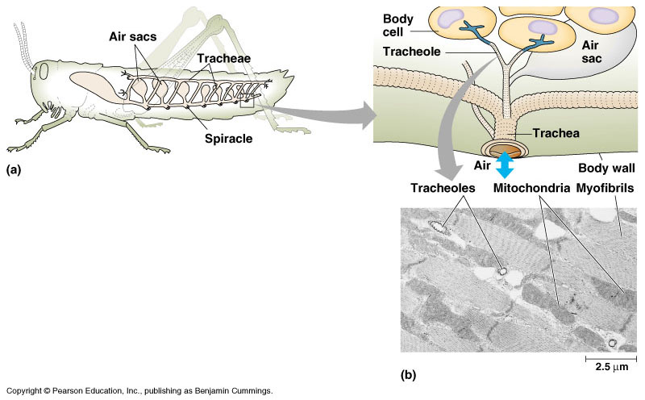
Gas exchange
CO2 <---> O2
Aquatic:
gills
ventilation
countercurrent exchange
Terrestrial:
tracheal systems
lungs

Slide 38
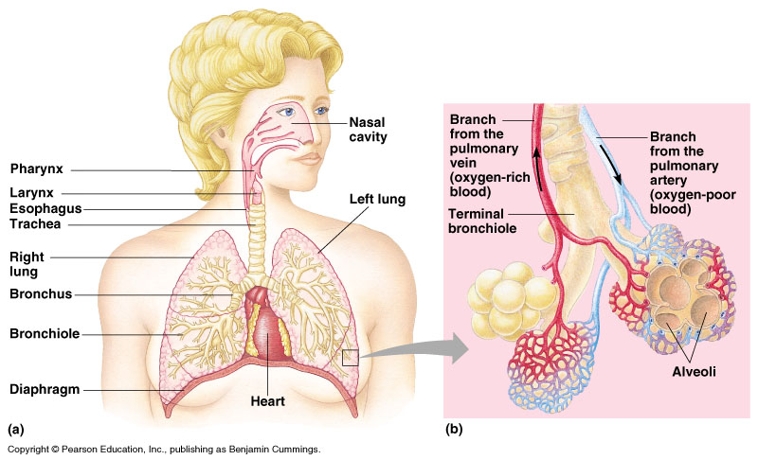
Mammalian respiratory systems
Larynx (upper part of respiratory tract)
Vocal cords (sound production)
Trachea (windpipe)
Bronchi (tube to lungs)
Bronchioles
Alveoli (air sacs)
Diaphragm (breathing muscle)

Slide 39
Breathing
Positive pressure breathing: pushes air into lungs (frog)
Negative pressure breathing: pulls air into lungs (mammals)
Inhalation: diaphragm contraction; Exhalation: diaphragm relaxation
Tidal volume: amount of air inhaled and exhaled with each breath (500ml)
Vital capacity: maximum tidal volume during forced breathing (4L)
Regulation: CO2 concentration in blood (medulla oblongata)

Slide 40
Respiratory pigments: gas transport
Oxygen transport-
Hemocyanin: found in hemolymph of arthropods and mollusks (Cu)
Hemoglobin: vertebrates (Fe)
Carbon dioxide transport-
Blood plasma (7%)
Hemoglobin (23%)
Bicarbonate ions (70%)
Deep-diving air-breathers-
Myoglobin: oxygen storing protein

Slide 41
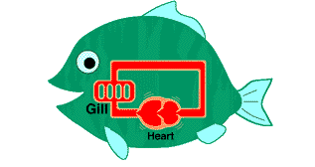
Human Systems Project
Choose a human system
Prepare a video, song, or presentation which provides the following information:
Role of this system in maintaining animal life
Functional unit
Detailed description of how the system functions in humans
Comparative description of how the system functions in simpler animals

Slide 42
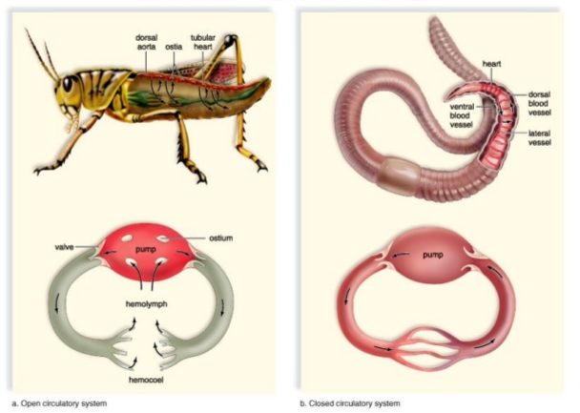
Open vs Closed Circulatory System

Slide 43
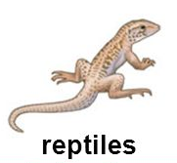
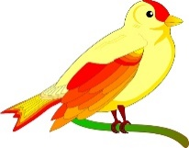
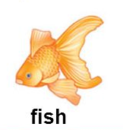
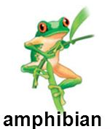
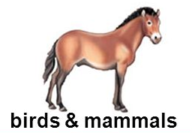
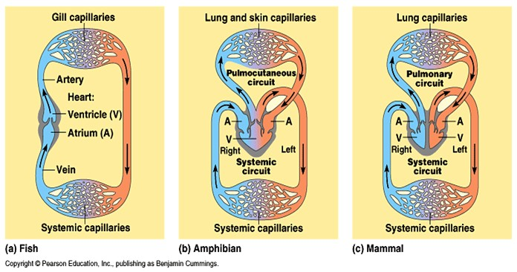

Slide 44
Double circulation
From right ventricle to lungs via pulmonary arteries through semilunar valve (pulmonary circulation)
Capillary beds in lungs to left atrium via pulmonary veins
Left atrium to left ventricle (through atrioventricular valve) to aorta
Aorta to coronary arteries; then systemic circulation
Back to heart via two venae cavae (superior and inferior); right atrium

Slide 45
Describe the pathway of an oxygen molecule as it goes from the air inhaled through to its delivery to a muscle cell. And the exhalation of CO2

Slide 46
Chapter 33 and 34
Invertebrates

Slide 47
Parazoa
Invertebrates: animals without backbones
Closest lineage to protists
Loose federation of cells (unspecialized); no tissues
Phy.: Porifera (sponges)

Slide 48
Phylum: Porifera (“pore bearer”)
Sessile (attached to bottom)
Spongocoel (central cavity)
Osculum (large opening)
Choanocytes (flagellated collar cells)
Hermaphroditic (produce both sperm and eggs)

Slide 49
The Radiata, I
Diploblastic
Radial symmetry
Phy: Cnidaria (hydra, jellies, sea anemones, corals)
No mesoderm; GVC gastrovascular cavity (sac with a central digestive cavity)
Hydrostatic skeleton (fluid held under pressure)
Polyps and medusa
Cnidocytes (cells used for defense and prey capture)
Nematocysts (stinging capsule)

Slide 50
The Radiata, II
Phy: Ctenophora (comb jellies)
8 rows of comblike plates of fused cilia (largest animals that use cilia for locomotion)
Tentacles with colloblasts (adhesive structures that capture prey)

Slide 51
Eumetazoa: The Acoelomates
Phy: Platyhelminthes (flatworms, flukes, tapeworms)
Bilateral; no body cavity
Predators, scavengers, parasites
Triplobastic; mesoderm but, GVC with only one opening
Some cephalization
Many pathogens (Schistosoma, Cestodidias)

Slide 52
Eumetazoa: Pseudocoelomates, I
Body cavity partially derived from mesodermally derived tissue
Phy: Rotifera
1st with a complete digestive tract
Hydrostatic skeleton
Parthenogenesis: type of reproduction in which females produce offspring from unfertilized eggs

Slide 53
Eumetazoa: Pseudocoelomates, II
Phy: Nematoda (roundworms)
Very widespread group of animals (900,000 sp. ?)
Cuticle (tough exoskeleton)
Decomposition and nutrient cycling
Complete digestive track; no circulatory system
Trichinella spiralis

Slide 54
The Coelomates: Protostomes, I
Phylogenetics debated….
Phy: Nemertea (proboscis and ribbon worms)
Complete digestion and closed circulatory system (blood)
Phy: the lophophorates (sea mats, tube worms, lamp shells)
Lophophore: Circular shaped body fold with ciliated tentacles around the mouth

Slide 55
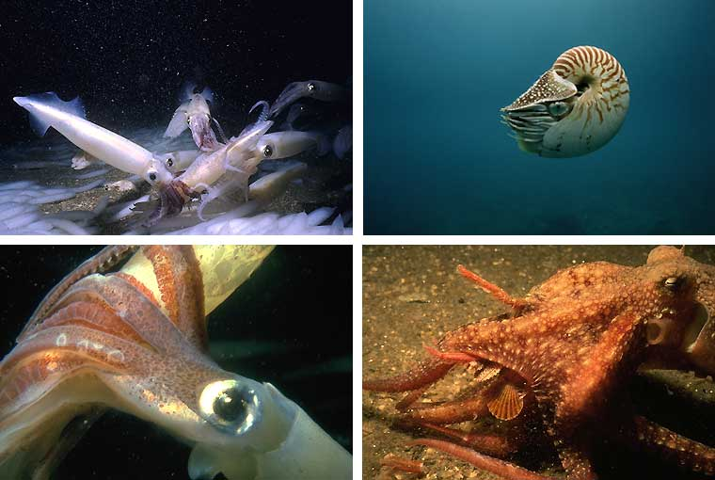
The Coelomates: Protostomes, II
Phy: Mollusca (snails, slugs, squid, octopus, clams, oysters, chiton)
Soft body protected by a hard shell of calcium carbonate
Foot (movement), visceral mass (internal organs); mantle (secretes shell); radula (rasp-like scraping organ)
Ciliated trochophore larvae (related to Annelida?)

Slide 56
The Coelomates: Protostomes, III
Phy: Annelida (earthworms, leeches, marine worms)
True body segmentation (specialization of body regions)
Closed circulatory system
Metanephridia: excretory tubes
“Brainlike” cerebral ganglia
Hermaphrodites, but cross- fertilize

Slide 57
The Coelomates: Protostomes, IV
Phy: Arthropoda trilobites (extinct); crustaceans (crabs, lobsters, shrimps); spiders, scorpions, ticks (arachnids); insects (entomology)
2 out of every 3 organisms (most successful of all phyla)
Segmentation, hard exoskeleton (cuticle)~ molting, jointed appendages; open circulatory system (hemolymph); extensive cephalization

Slide 58
Insect characteristics
Outnumber all other forms of life combined
Malpighian tubules: outpocketings of the digestive tract (excretion)
Tracheal system: branched tubes that infiltrate the body (gas exchange)
Metamorphosis…...
•incomplete: young resemble adults, then molt into adulthood (grasshoppers)
•complete: larval stages (looks different than adult); larva to adult through pupal stage

Slide 59
The Coelomates: Deuterostomes, I
Phy: Echinodermata (sea stars, sea urchins, sand dollars, sea lilies, sea cucumbers, sea daisies)
Spiny skin; sessile or slow moving
Often pentaradial
Water vascular system by hydraulic canals (tube feet)

Slide 60
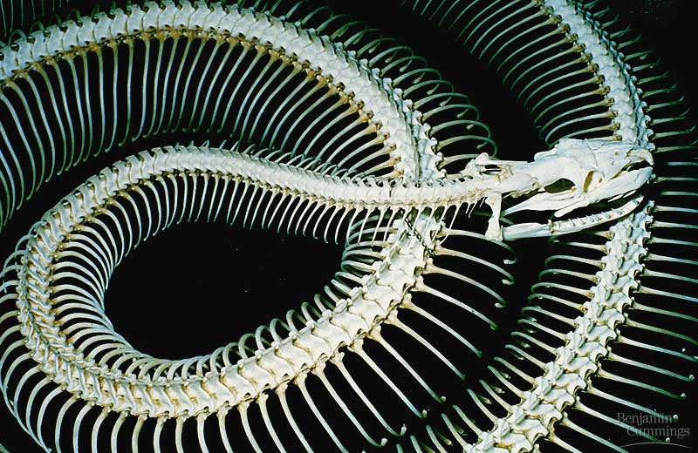
Chapter 34 ~ Vertebrate Evolution and Diversity

Slide 61
Chordates
Notochord: longitudinal, flexible rod located between the digestive and the nerve cord
Dorsal, hollow nerve cord; eventually develops into the brain and spinal cord
Pharyngeal slits; become modified for gas exchange, jaw support, and/or hearing
Muscular, postanal tail

Slide 62
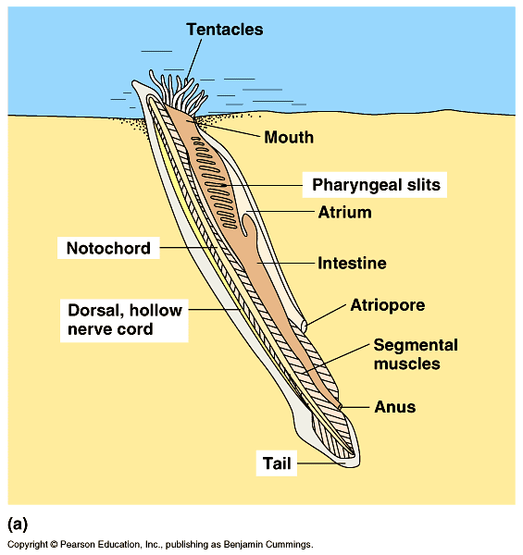
Invertebrate chordates
Both suspension feeders…..
Subphy: Urochordata (tunicates; sea squirt); mostly sessile & marine
Subphy: Cephalochordata (lancelets); marine, sand dwellers
Importance: vertebrates closest relatives; in the fossil record, appear 50 million years before first vertebrate
Paedogenesis: precocious development of sexual maturity in a larva (link with vertebrates?)

Slide 63
Subphylum: Vertebrata
Retain chordate characteristics with specializations….
Neural crest: group of embryonic cells near dorsal margins of closing neural tube
Pronounced cephalization: concentration of sensory and neural equipment in the head
Cranium and vertebral column
Closed circulatory system with a ventral chambered heart

Slide 64
Vertebrate diversity
Phy: Chordata
Subphy: Vertebrata
Superclass: Agnatha~ jawless vertebrates (hagfish, lampreys)
Superclass: Gnathostomata~ jawed vertebrates with 2 sets of paired appendages; including tetrapods (‘4-footed’) and amniotes (shelled egg)

Slide 65
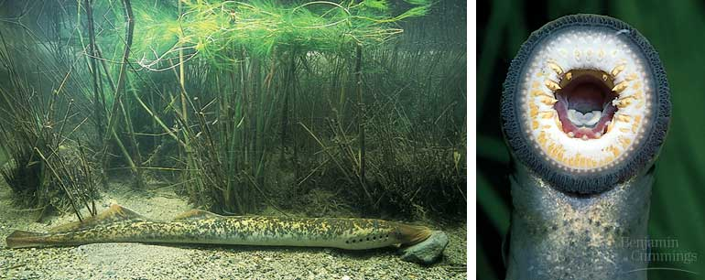
Superclass Agnatha
Jawless vertebrates
Most primitive, living vertebrates
Ostracoderms (extinct); lamprey and hagfish (extant)
Lack paired appendages; cartilaginous skeleton; notochord throughout life; rasping mouth

Slide 66
Superclass Gnathostomata, I
Placoderms (extinct): first with hinged jaws and paired appendages
Class: Chondrichthyes~ Sharks, skates, rays
Cartilaginous fishes; well developed jaws and paired fins; continual water flow over gills (gas exchange); lateral line system (water pressure changes)
Life cycles:
Oviparous- eggs hatch outside mother’s body
Ovoviviparous- retain fertilized eggs; nourished by egg yolk; young born live
Viviparous- young develop within uterus; nourished by placenta

Slide 67
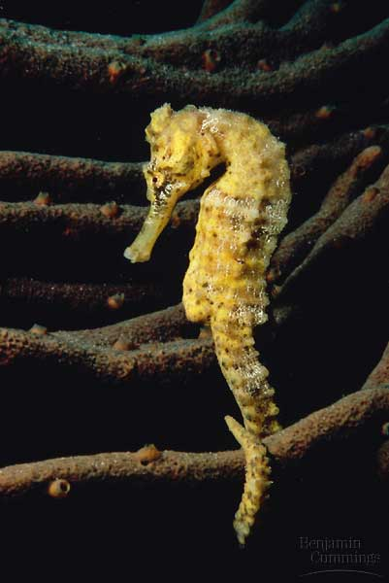
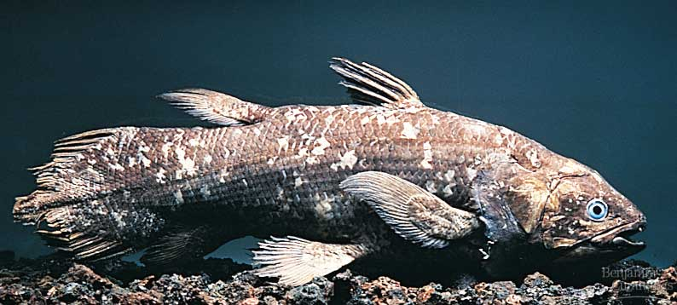
Superclass Gnathostomata, II
Class: Osteichthyes
Ossified (bony) endoskeleton; scales operculum(gill covering); swim bladder (buoyancy)
Most numerous vertebrate
Ray-fined (fins supported by long, flexible rays): bass, trout, perch, tuna, herring
Lobe-finned (fins supported by body skeleton extensions): coelocanth
Lungfishes (gills and lungs): Australian lungfish (aestivation)

Slide 68
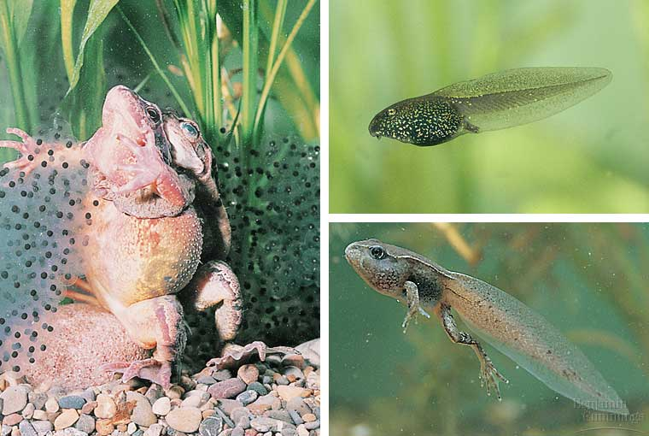
Superclass Gnathostomata, III
Class: Amphibia
1st tetrapods on land
Frogs, toads, salamanders, caecilians
Metamorphosis; lack shelled egg; moist skin for gas exchange

Slide 69
Superclass Gnathostomata, IV
Class: Reptilia
Lizards, snakes, turtles, and crocodilians
Amniote (shelled) egg with extraembryonic membranes (gas exchange, waste storage, nutrient transfer); absence of feathers, hair, and mammary glands; ectothermic; scales with protein keratin (waterproof); lungs; ectothermic (dinosaurs endothermic?)

Slide 70
Superclass Gnathostomata, V
Class: Aves
Birds
Flight adaptations: wings (honeycombed bone); feathers (keratin); toothless; one ovary
Evolved from reptiles (amniote egg and leg scales); endothermic (4-chambered heart)
Archaeopteryx (stemmed from an ancestor that gave rise to birds)

Slide 71
Superclass Gnathostomata, VI
Class: Mammalia
Mammary glands; hair (keratin); endothermic; 4-chambered heart; large brains; teeth differentiation
Evolved from reptilian stock before birds
Monotremes (egg-laying): platypus; echidna
Marsupials (pouch): opossums, kangaroos, koalas
Eutherian (placenta): all other mammals

Slide 72
Order: Primates (evolution)
Characteristics: hands & feet for grasping; large brains, short jaws, flat face; parental care and complex social behaviors
Suborder: Prosimii •lemurs, tarsiers
Suborder: Anthropoidea •monkeys, apes, humans (opposable thumb)
45-50 million years ago
Paleoanthropology: study of human origins
Hominoid: great apes & humans
Hominid (narrower classification): √ australopithecines (all extinct) √ genus Homo (only 1 exant, sapiens)

Slide 73
Human evolution
Misconceptions:
1- Chimp ancestor (2 divergent branches)
2- Step-wise series (coexistence of human species)
3- Trait unison vs. mosaic evolution (bipedalism, upright, enlarged brain)

Slide 74
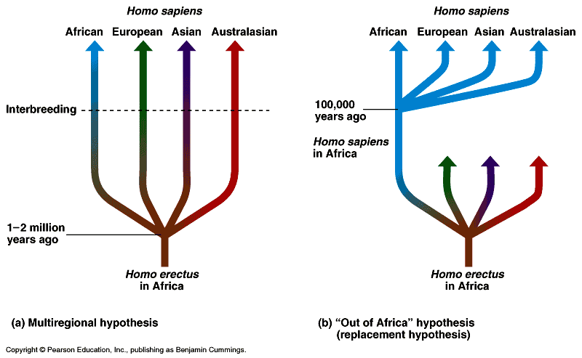
The first humans
Ape-human split (5-7 mya)
Australopithecus; “Lucy” (4.0 mya)
Homo habilis; “Handy Man” (2.5 mya)
Homo erectus; first to migrate (1.8 mya)
Neanderthals (200,000 ya)
Homo sapiens (1.0 mya?)
Multiregional model (parallel evolution)
“Out of Africa” (replacement evolution)

Slide 75
Chapter 49 ~ Sensory and Motor Mechanisms

Slide 76
Osteon

Slide 78
Vertebrate Skeletal Muscle
Contract/relax: antagonistic pairs w/skeleton
Muscles: bundle of….
Muscle fibers: single cell w/ many nuclei consisting of….
Myofibrils: longitudinal bundles composed of….
Myofilaments: •Thin~ 2 strands of actin protein and a regulatory protein •Thick~ myosin protein
Sarcomere: repeating unit of muscle tissue, composed of….
Z lines~sarcomere border
I band~only actin protein
A band~actin & myosin protein overlap
H zone~central sarcomere; only myosin

Slide 79
Sliding-filament model
Theory of muscle contraction
Sarcomere length reduced
Z line length becomes shorter
Actin and myosin slide past each other (overlap increases)

Slide 80
Actin-myosin interaction
1- Myosin head hydrolyzes ATP to ADP and inorganic phosphate (Pi); termed the “high energy configuration”
2- Myosin head binds to actin; termed a “cross bridge”
3- Releasing ADP and (Pi), myosin relaxes sliding actin; “low energy configuration”
4- Binding of new ATP releases myosin head
Creatine phosphate~ supplier of phosphate to ADP

Slide 81
Muscle contraction regulation, I
Relaxation: tropomyosin blocks myosin binding sites on actin
Contraction: calcium binds to toponin complex; tropomyosin changes shape, exposing myosin binding sites

Slide 82
Muscle contraction regulation, II
Calcium (Ca+)~ concentration regulated by the….
Sarcoplasmic reticulum~ a specialized endoplasmic reticulum
Stimulated by action potential in a motor neuron
T (transverse) tubules~ travel channels in plasma membrane for action potential
Ca+ then binds to troponin

Slide 83
Muscle Types

Slide 84
Chapter 49 Respiratory System

Slide 85
Characteristics of a Respiratory Surface
thin walls.
a moist inner surface.
a huge combined surface area.
a rich blood supply- each alveolus is sounded by capillaries

Slide 86
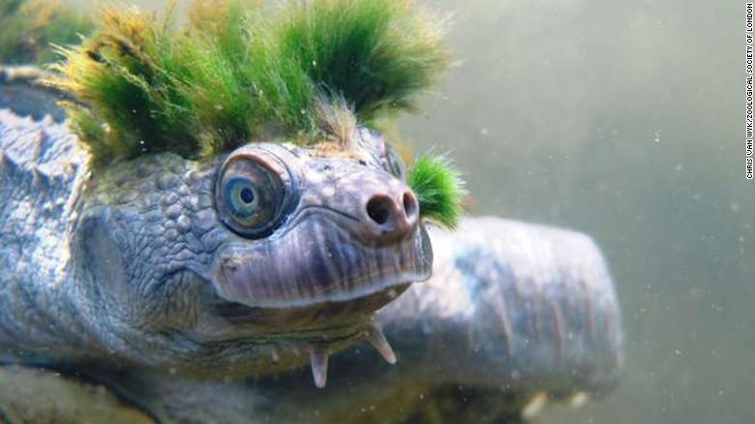
Gas exchange
CO2 <---> O2
Aquatic:
gills
ventilation
countercurrent exchange
Terrestrial:
tracheal systems
lungs

Slide 87
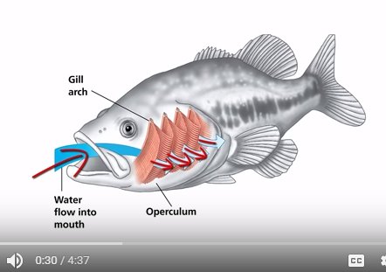
Countercurrent Flow in Fish
https://www.youtube.com/watch?v=bEeTlm5Hlq4&t=4s

Slide 88
Mammalian respiratory systems
Larynx (upper part of respiratory tract)
Vocal cords (sound production)
Trachea (windpipe)
Bronchi (tube to lungs)
Bronchioles
Alveoli (air sacs)
Diaphragm (breathing muscle)

Slide 89
Breathing
Positive pressure breathing: pushes air into lungs (frog)
Negative pressure breathing: pulls air into lungs (mammals)
Inhalation: diaphragm contraction; Exhalation: diaphragm relaxation
Tidal volume: amount of air inhaled and exhaled with each breath (500ml)
Vital capacity: maximum tidal volume during forced breathing (4L)
Regulation: CO2 concentration in blood (medulla oblongata)

Slide 90
Respiratory pigments: gas transport
Oxygen transport-
Hemocyanin: found in hemolymph of arthropods and mollusks (Cu)
Hemoglobin: vertebrates (Fe)
Carbon dioxide transport-
Blood plasma (7%)
Hemoglobin (23%)
Bicarbonate ions (70%)
Deep-diving air-breathers-
Myoglobin: oxygen storing protein

Slide 91
Describe the pathway of an oxygen molecule as it goes from the air inhaled through to its delivery to a muscle cell. And the exhalation of CO2

Slide 92
Human Systems Project
Choose a human system
Prepare a video, song, or presentation which provides the following information:
Role of this system in maintaining animal life
Functional unit
Detailed description of how the system functions in humans
Comparative description of how the system functions in simpler animals

Slide 93
Circulation and Gas Exchange

Slide 94
Circulatory Pathway of Mamals

Slide 95
QOD
Sponges (porifera)
Flat worms (platyhelminthes)
Round worms (nematoda)
Segmented worms (annelida)
Stinging celled (cnidaria)
Squishy (mollusca)
Hard shelled (arthropods)
Spiny skinned (echinoderm)
With a spine (chordata):
fish
amphibian
reptile
mammal
Use 3-6 words to describe the circulatory system of each animal as it moves from simpler to more complex.

Slide 96
Open vs Closed Circulatory System

Slide 97
Circulation system evolution, II
Fish: 2-chambered heart
Amphibians: 3-chambered heart
Mammals: 4-chambered heart

Slide 98
Blood vessel structural differences
Capillaries
small
Gas exchange
Arteries
thick
Oxygenated blood
Veins
thin
Deoxygenated blood
valves

Slide 99
The lymphatic system
Lymphatic system: that returns fluid and protein to blood
Lymph: colorless fluid, derived from interstitial fluid
Lymph nodes: filter lymph and help attack viruses and bacteria
Body defense / immunity

Slide 100
Double circulation
From right ventricle to lungs via pulmonary arteries through semilunar valve (pulmonary circulation)
Capillary beds in lungs to left atrium via pulmonary veins
Left atrium to left ventricle (through atrioventricular valve) to aorta
Aorta to coronary arteries; then systemic circulation
Back to heart via two venae cavae (superior and inferior); right atrium

