Slide 1
AP Biology
Daily Agenda Slides
Diversity and Immunity
Unit 10

Slide 2
Unit 10
Daily Agendas

Slide 3
Day 1
Objectives:
1. Describe the contributions made by Oparin, Haldane, Miller, and Urey toward understanding the origin of organic molecules
3. Explain how genetic regulation by microRNAs play important roles in development
4. Explain why RNA, not DNA, was likely the first genetic material
EQ – How did life begin?
Topic – Origins of Diversity
QOD- Why do scientists believe that spontaneous generation was possible in the early days of earth when it is not now?
Power point – ch 26
Articles
Mayo and the origins of life
What came before DNA?

Slide 4
Chapter 26 ~ Early Earth and The Origin of Life

Slide 5
QOD #1
If cells can only come from other cells, where did the first cell come from?

Slide 6
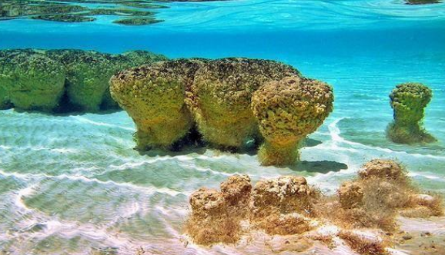
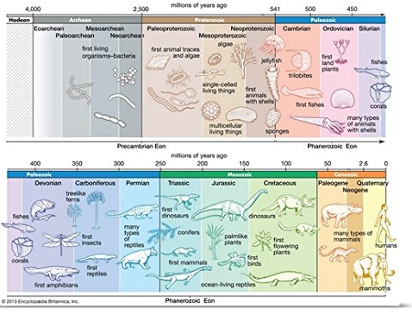
Early history of life
Solar system~ 12 billion years ago (bya)
Earth~ 4.5 bya
Life~ 3.5 to 4.0 bya
Prokaryotes~ 3.5 to 2.0 bya stromatolites
Oxygen accumulation~ 2.7 bya photosynthetic cyanobacteria
Eukaryotic life~ 2.1 bya
Muticelluar eukaryotes~ 1.2 bya
Animal diversity~ 543 mya
Land colonization~ 500 mya

Slide 7
The Origin of Life
Spontaneous generation vs. biogenesis (Pasteur)
The 4-stage Origin of life Hypothesis:
1- Abiotic synthesis of organic monomers
2- Polymer formation
3- Origin of Self-replicating molecules
4- Molecule packaging (“protobionts”)

Slide 8
Organic monomers/polymer synthesis
Oparin /Haldane hypothesis (primitive earth): volcanic vapors (reducing atmosphere) with lightning & UV radiation enhances complex molecule formation (no O2)
Miller/Urey experiment:
water, hydrogen, methane, ammonia
all 20 amino acids, nitrogen bases, & ATP formed
Fox proteinoid formation (abiotic polypeptides) from organic monomers dripped on hot sand, clay or rock
Oparin (coacervates) protobionts (aggregate macromolecules; abiotic) surrounded by a shell of H2O molecules coated by a protein membrane

Slide 9
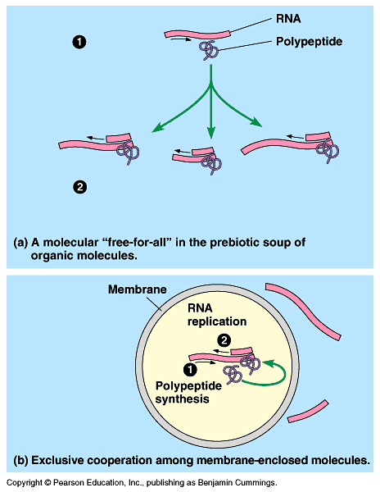
Abiotic genetic replication
First genetic material
Abiotic production of ribonucleotides
Ribozymes (RNA catalysts)
RNA “cooperation”
Formation of short polypeptides (replication enzyme?)
RNA~ DNA template?

Slide 10
Competing Hypotheses
There are many hypotheses about how living organisms could have arisen from non living organic molecules. With a partner, spend the next 5 minutes coming up with as many a you can. You may use resources

Slide 11
Writing Assignment
Each team of 2 should choose 1 unique hypothesis and create a short story describing this process. Please include all listed elements.
Requirements:
Title
Setting (conditions)
Characters (requirements)
Problem (counterarguments)
Solution
illustration

Slide 12
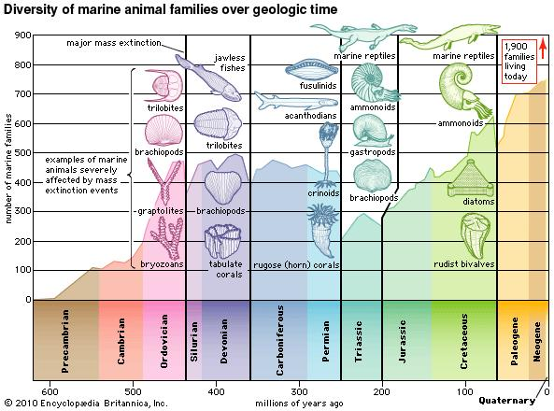

Slide 13
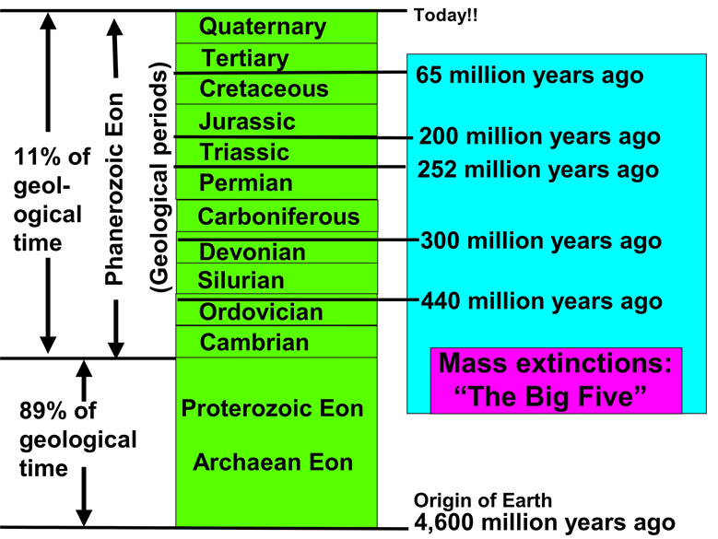

Slide 14
The five greatest mass extinctions
 | Ordivician-silurian | Late Devonian | Permian-triassic | Late Triassic | Final Cretaceous
When Occurred | 439 million years ago | 365 million years ago | 251 million years ago | 199–214 million years ago | 65 million years ago
Casualties | Up to estimated 85% species and 45–60% of marine genuses killed. | 70–80% of all species and 30% of families vanish; marine life more decimated than freshwater and land fauna. | Most devastating of all, eliminating 85–90% of all marine and land vertebrate species, 95% of marine species. End of trilobites and many trees. | More than three quarters of all species and one quarter of families disappear. End of mammal-like reptiles and eel–like conodonts, leaving mainly dinosaurs. | 47% of marine genuses and 18% of land vertebrates wiped out, including the dinosaurs, leaving mainly turtles, lizards, birds, and mammals.
HypothesizedCause(s) | Unusually fast plate movement; glaciation leading to sharp de- clines in sea levels. | Unknown if one cat- astrophic event or several smaller ones–possibly large asteroid or asteroid shower over time; possible glaciation and lethal temperature de- clines; oceanic anoxia (oxygen-lacking) | Possible asteroid; volcanic eruptions; dropping sea levels and oceanic anoxia | Little known but suspected fall in sea level, oceanic anoxia, major increase in rainfall. Possible comet showers or asteroid impact. | Suspected asteroid 10 km. in diameter hitting near Yucatán peninsula, coinciding with Siberian eruptions and dramatic climatic cooling.
SOURCE: Adapted from A. Hallam, and P. B. Wignall, 1997; David Raup, and John J. Sepkosi Jr., 1986; and Lee Siegel, 2000.

Slide 15
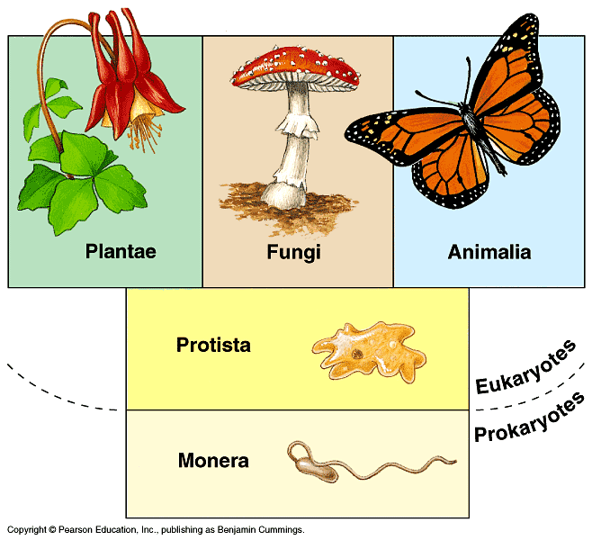
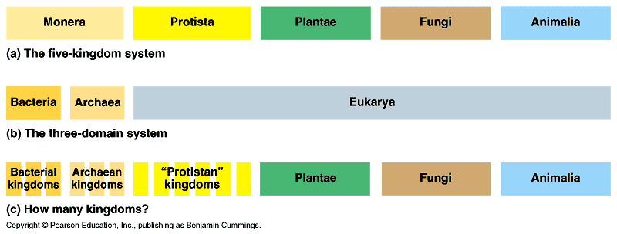
The Major Lineages of Life

Slide 16
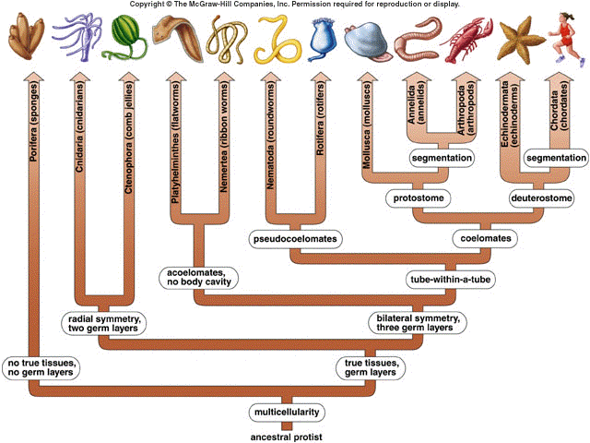

Slide 17
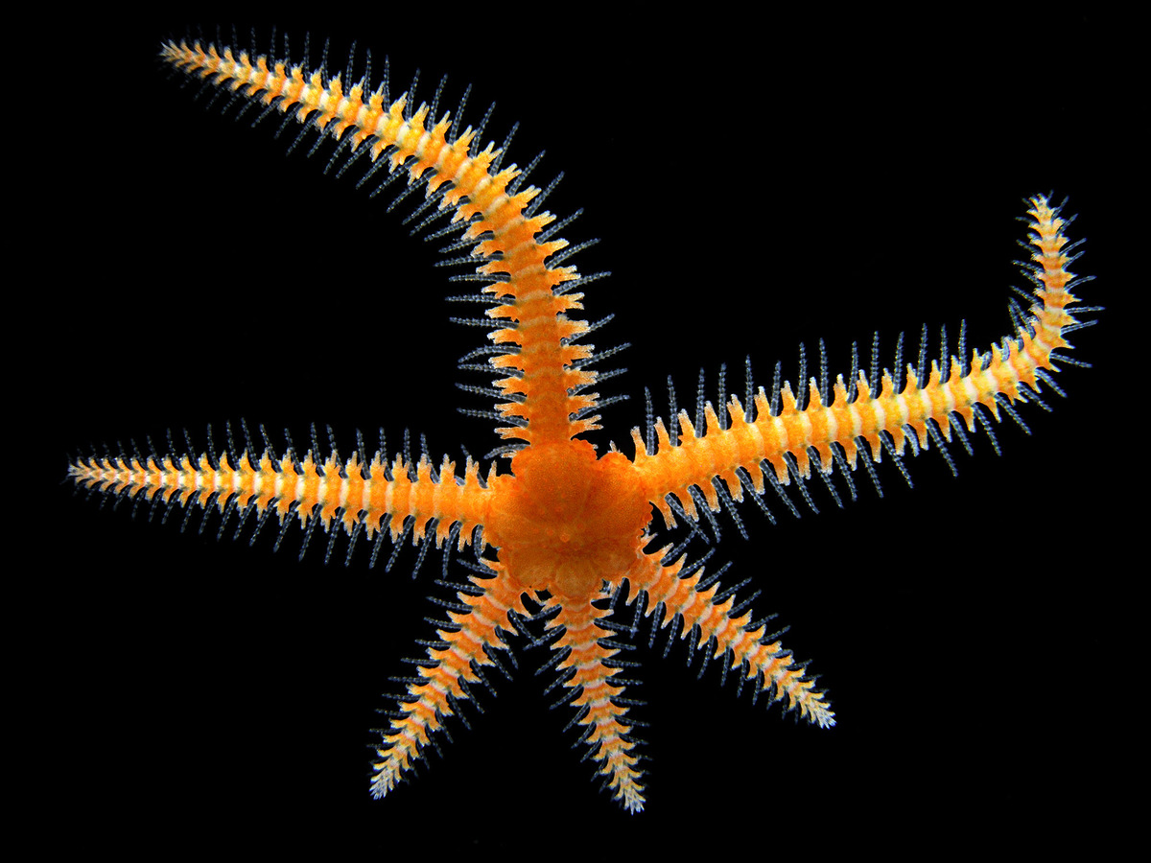
Animal Game

Slide 18
Day 2
Describe the process of phenotypic acquisition in viruses
Describe the results of infection by different viruses in the same host
Explain how genetic information is transmitted during infection by viruses
Explain how the lytic cycle functions in viruses

Slide 19
Microbial Models: The Genetics of Viruses and Bacteria

Slide 20
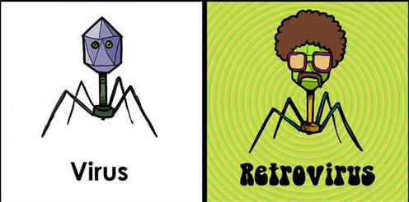

Slide 21
Viral structure
Virus: “poison” (Latin); infectious particles consisting of a nucleic acid in a protein coat
Capsid; (viral envelopes); DNA or RNA
Bacteriophages (phages)

Slide 22
"VirusBaltimoreClassification" by Thomas Splettstoesser (www.scistyle.com) - Own work. Licensed under CC BY-SA 3.0 via Wikimedia Commons - http://commons.wikimedia.org/wiki/File:VirusBaltimoreClassification.svg#mediaviewer/File:VirusBaltimoreClassification.svg

Slide 23
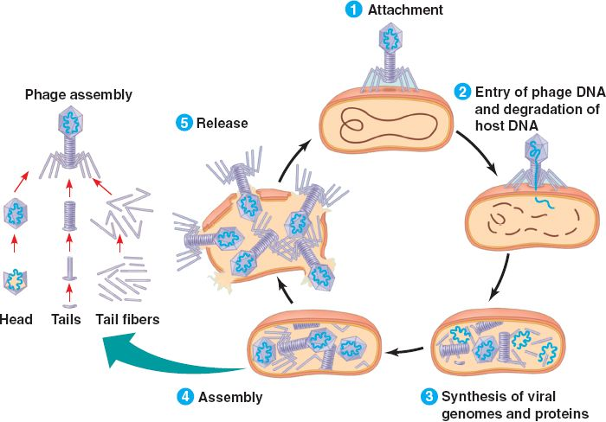
Viral reproduction: Lytic Cycle
The lytic cycle:
attachment
injection
synthesis
assembly
release
Results in death of host cell

Slide 24
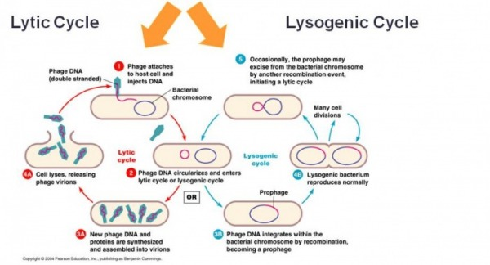
Viral reproduction: Lysogenic Cycle
Genome replicated w/o destroying the host cell
Genetic material of virus becomes incorporated into the host cell DNA (prophage DNA)
Temperate virus (phages capable of using the lytic and lysogenic cycles)
May give rise to lytic cycle
How does this type of life cycle make a virus especially hard to treat?

Slide 25
RNA viruses
Retroviruses: transcribe DNA from an RNA template (RNA--->DNA)
Reverse transcriptase (catalyzing enzyme)
High error rate, no proofreading
Evolves quickly

Slide 26
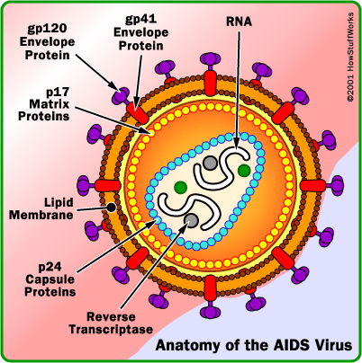
“The viral genome”
Icosahedral (20 sided), enveloped virus of the lentivirus subfamily of retroviruses.
Retroviruses transcribe RNA to DNA.
Two viral strands of RNA found in core surrounded by protein outer coat.
Outer envelope contains a lipid matrix within which specific viral glycoproteins are imbedded.
These knob-like structures responsible for binding to target cell.

Slide 27
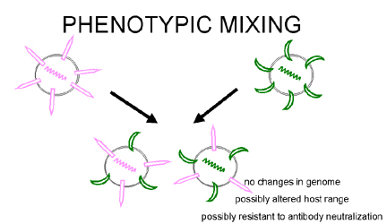
Viral Phenotypic Acquisition
The viral genome is copied into the host DNA and transmitted with the host genome
When two viruses are present at the same time, they share information.
Protein capsules can be swapped.
This can increase virulence and increase the rate of evolution
What evolutionary advantages doe this mixing offer?

Slide 28
Why It’s so Hard to Cure AIDS
https://www.youtube.com/watch?v=0TipTogQT3E

Slide 29
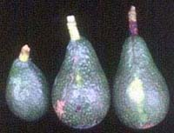
Viroids and prions
Viroids: tiny, naked circular RNA that infect plants; do not code for proteins, but use cellular enzymes to reproduce; stunt plant growth
Prions: “infectious proteins”; “mad cow disease”; trigger chain reaction conversions; a transmissible protein

Slide 30
Bacterial genetics
Nucleoid: region in bacterium densely packed with DNA (no membrane)
Plasmids: small circles of DNA
Reproduction: binary fission (asexual)

Slide 31
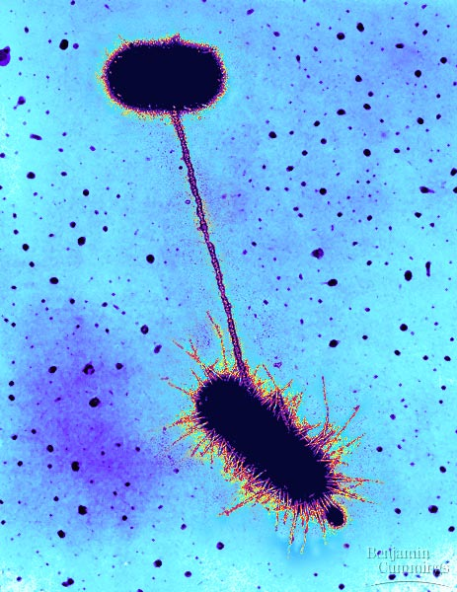
Bacterial DNA-transfer processes
Transformation: genotype alteration by the uptake of naked, foreign DNA from the environment (Griffith expt.)
Transduction: phages that carry bacterial genes from 1 host cell to another •generalized~ random transfer of host cell chromosome •specialized~ incorporation of prophage DNA into host chromosome
Conjugation: direct transfer of genetic material; cytoplasmic bridges; pili; sexual

Slide 32
Bacterial Plasmids
Small, circular, self-replicating DNA separate from the bacterial chromosome
F (fertility) Plasmid: codes for the production of sex pili (F+ or F-)
R (resistance) Plasmid: codes for antibiotic drug resistance
Transposons: transposable genetic element; piece of DNA that can move from location to another in a cell’s genome (chromosome to plasmid, plasmid to plasmid, etc.); “jumping genes”

Slide 33
Operons, I
Def: Unit of genetic function consisting of coordinately related clusters of genes with related functions (transcription unit)
Repressible (trp operon):
tryptophan (a.a.) synthesis
promoter: RNA polymerase binding site; begins transcription
operator: controls access of RNA polymerase to genes (tryptophan not present)
repressor: protein that binds to operator and prevents attachment of RNA polymerase ~ coded from a regulatory gene (tryptophan present ~ acts as a corepressor)
transcription is repressed when tryptophan binds to a regulatory protein
Why do you think bacteria group related genes together?

Slide 34
Operons, II
Def: Unit of genetic function consisting of coordinately related clusters of genes with related functions (transcription unit)
Inducible (lac operon):
lactose metabolism
lactose not present: repressor active, operon off; no transcription for lactose enzymes
lactose present: repressor inactive, operon on; inducer molecule inactivates protein repressor (allolactose)
transcription is stimulated when inducer binds to a regulatory protein

Slide 35
Day 3
Explain how the lysogenic life cycle function in viruses and can lead to increased pathogenicity
Discuss the contributing factors to genetic diversity in viruses
Explain why RNA viruses mutate at a higher rate than other viruses
Describe the evolutionary history of the HIV virus

Slide 36
Chapter 28
Prokaryotes and the Origins of Metabolic Diversity

Slide 37
Structural characteristics
Cell wall - peptidoglycan (sugars & proteins);
Gram +: w/peptidoglycan penicillin action
Gram -: little peptidoglycan, lipopolysaccharides; most pathogens; impede drug action
Capsule: adherence; protection
Pili: adherence; conjugation

Slide 38
Form & Function
Nucleoid region (genophore: non-eukaryotic chromosome)
Plasmids
Asexual reproduction:
binary fission (not mitosis)
“Sexual” reproduction (not meiosis):
transformation~ uptake of genes from surrounding environment
conjugation~ direct gene transfer from 1 prokaryote to another
Endospore: resistant cells for harsh conditions (250 million years!)

Slide 39
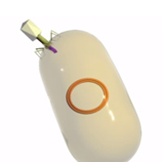
Transduction
A virus transfers genetic material from one bacterium to another.
Bacteriophages are able to infect bacterial cells and use them as hosts to make more viruses.
After multiplying, these viruses assemble and occasionally remove a portion of the host cell's bacterial DNA.
Later, when one of these bacteriophages infects a new host cell, this piece of bacterial DNA may be incorporated into the genome of the new host.

Slide 40
Using a Taxonomic Key
Dichotomous Key: A commonly used key to identify organisms.
Has paired statements describing characteristics of organisms.

Slide 41
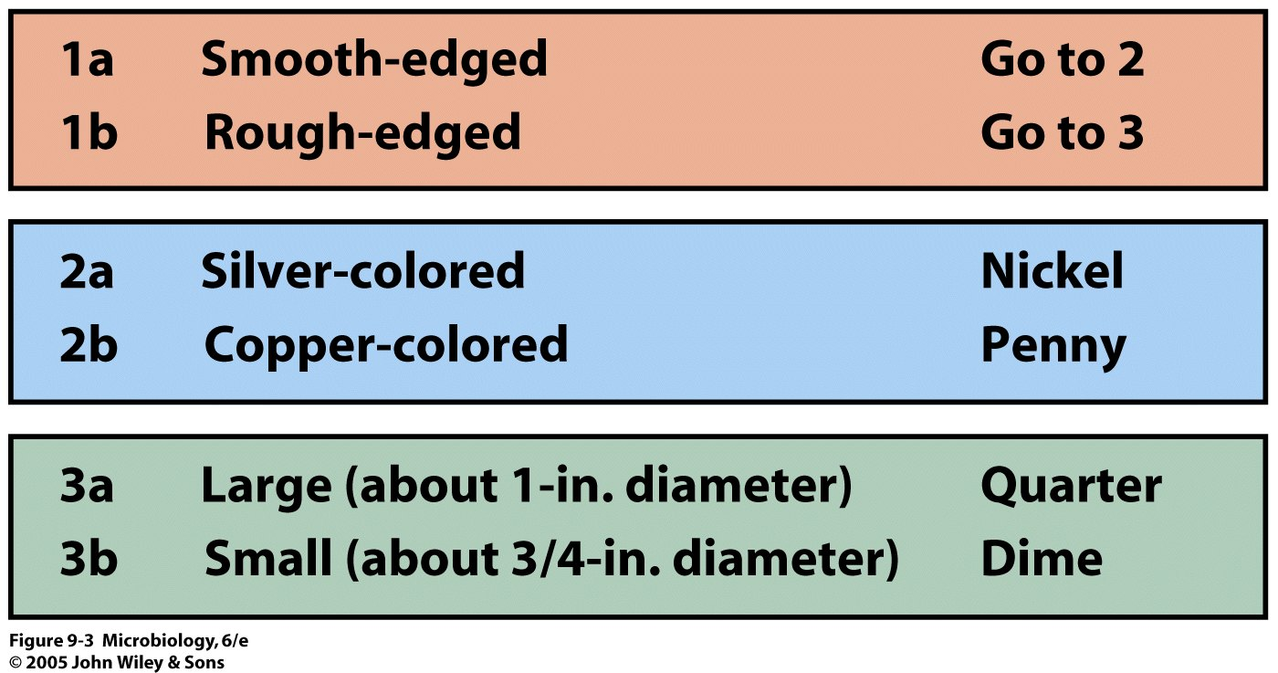
Dichotomous Key for Classifying U.S. Coins

Slide 42
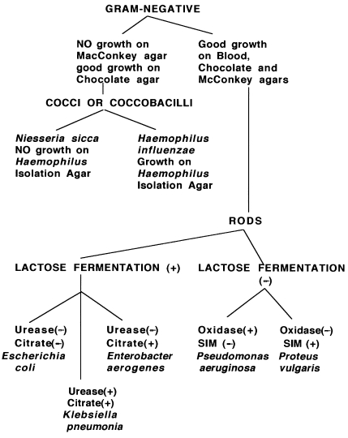
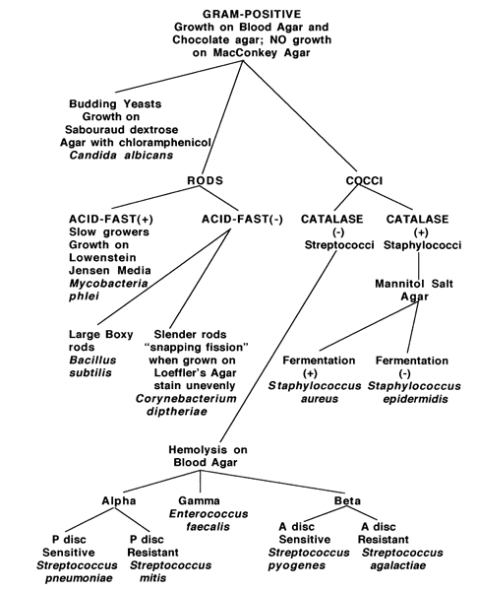
Bacterial Identification Tree

Slide 44
Day 4
Describe the process of transduction
Explain the significance of transposons
3. Describe how homeotic genes are involved in developmental patterns
4. Explain how genetic transplantation experiments support the link between gene expression and normal development
5. Explain why not all individuals respond to a disease outbreak in the same way

Slide 45
The Body’s Defenses

Slide 46
Killer T Cell
Killer T-Cell Engulfs a cancer cell

Slide 47
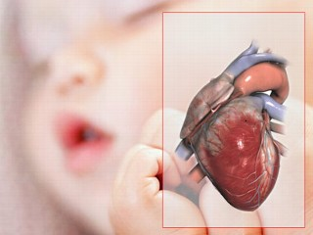
QOD
Explain why organ transplants might be more successful in very young children

Slide 48
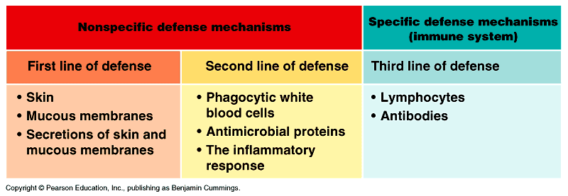
Lines of Defense
Nonspecific Defense Mechanisms……

Slide 49
Phagocytic and Natural Killer Cells
Neutrophils 60-70% WBCs; engulf and destroy microbes at infected tissue
Monocytes 5% WBCs; develop into….
Macrophages enzymatically destroy microbes
Eosinophils 1.5% WBCs; destroy large parasitic invaders (blood flukes)
Natural killer (NK) cells destroy virus-infected body cells & abnormal cells

Slide 50
How we conquered smallpox
https://www.youtube.com/watch?v=yqUFy-t4MlQ

Slide 51
The Inflammatory Response
1- Tissue injury; release of chemical signals~
histamine (basophils/mast cells): causes Step 2...
prostaglandins: increases blood flow & vessel permeability
2/3- Dilation and increased permeability of capillary~
chemokines: secreted by blood vessel endothelial cells mediates phagocytotic migration of WBCs
4- Phagocytosis of pathogens~
fever & pyrogens: leukocyte-released molecules increase body temperature

Slide 52
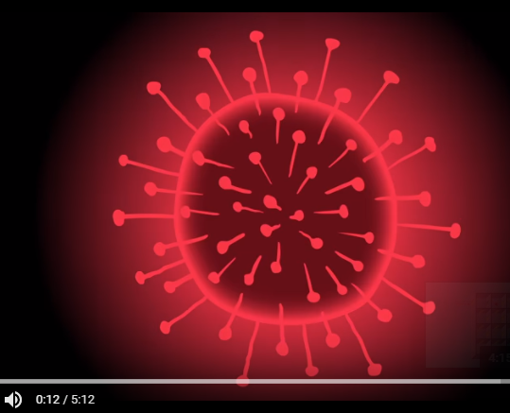
Solve the Virus riddle
https://ed.ted.com/lessons/can-you-solve-the-virus-riddle-lisa-winer

Slide 53
Specific Immunity
Lymphocyctes
•pluripotent stem cells...
• B Cells ( mature in bone marrow)
• T Cells (mature in thymus – self tolerance)
Antigen: a foreign molecule that elicits a response by lymphocytes (virus, bacteria, fungus, protozoa, parasitic worms)
Antibodies: antigen-binding immunoglobulin, produced by B cells
Antigen receptors: plasma membrane receptors on b and T cells

Slide 54
Clonal selection
Effector cells: short-lived cells that combat the antigen
Memory cells: long-lived cells that bear receptors for the antigen
Clonal selection: antigen-driven cloning of lymphocytes
“Each antigen, by binding to specific receptors, selectively activates a tiny fraction of cells from the body’s diverse pool of lymphocytes; this relatively small number of selected cells gives rise to clones of thousands of cells, all specific for and dedicated to eliminating the antigen.”

Slide 55
How we conquered smallpox
https://www.youtube.com/watch?v=yqUFy-t4MlQ

Slide 56
Induction of Immune Responses
Primary immune response: lymphocyte proliferation and differentiation the 1st time the body is exposed to an antigen
Plasma cells: antibody-producing effector B-cells
Secondary immune response: immune response if the individual is exposed to the same antigen at some later time~ Immunological memory

Slide 57
Types of immune responses
Humoral immunity
B cell activation
Production of antibodies
Defend against bacteria, toxins, and viruses free in the lymph and blood plasma
Cell-mediated immunity
T cell activation
Binds to and/or lyses cells
Defend against cells infected with bacteria, viruses, fungi, protozoa, and parasites; nonself interaction

Slide 58
Helper T lymphocytes
Function in both humoral & cell-mediated immunity
Stimulated by antigen presenting cells (APCs)
T cell surface protein CD4 enhances activation
Cytokines secreted (stimulate other lymphocytes): a) interleukin-2 (IL-2): activates B cells and cytotoxic T cells b) interleukin-1 (IL-1): activates helper T cell to produce IL-2

Slide 59
Cell-mediated: cytotoxic T cells
Destroy cells infected by intracellular pathogens and cancer cells
Class I MHC molecules (nucleated body cells) expose foreign proteins
Activity enhanced by CD8 surface protein present on most cytotoxic T cells (similar to CD4 and class II MHC)
TC cell releases perforin, a protein that forms pores in the target cell membrane; cell lysis and pathogen exposure to circulating antibodies

Slide 60
Humoral response: B cells
Stimulated by T-dependent antigens (help from TH cells)
Macrophage (APCs) with class II MHC proteins
Helper T cell (CD4 protein)
Activated T cell secretes IL-2 (cytokines) that activate B cell
B cell differentiates into memory and plasma cells (antibodies)

Slide 61
Antibody Structure & Function
Epitope: region on antigen surface recognized by antibodies
2 heavy chains and 2 light chains joined by disulfide bridges
Antigen-binding site (variable region)

Slide 62
Antibody-mediated Antigen Disposal
Neutralization (opsonization): antibody binds to and blocks antigen activity
Agglutination: antigen clumping
Precipitation: cross-linking of soluble antigens
Complement fixation: activation of 20 serum proteins, through cascading action, lyse viruses and pathogenic cells

Slide 63
Antibiotic Resistance
https://www.hhmi.org/biointeractive/superbugs-resist-antibiotics-can-evolve-11-days
(9 min)

Slide 64
Self/Nonself Recognition
Self-tolerance: capacity to distinguish self from non-self
Autoimmune diseases: failure of self-tolerance; multiple sclerosis, lupus, rheumatoid arthritis, insulin-dependent diabetes mellitus
Major Histocompatability Complex (MHC): body cell surface antigens coded by a family of genes
Class I MHC molecules: found on all nucleated cells
Class II MHC molecules: found on macrophages, B cells, and activated T cells
Antigen presentation: process by which an MHC molecule “presents’ an intracellular protein to an antigen receptor on a nearby T cell
Cytotoxic T cells (TC): bind to protein fragments displayed on class I MHC molecules
Helper T cells (TH): bind to proteins displayed by class II MHC molecules

Slide 65
Immunity in Health & Disease
Active immunity/natural: conferred immunity by recovering from disease
Active immunity/artificial: immunization and vaccination; produces a primary response
Passive immunity: transfer of immunity from one individual to another • natural: mother to fetus; breast milk • artificial: rabies antibodies
ABO blood groups (antigen presence)
Rh factor (blood cell antigen); Rh- mother vs. an Rh+ fetus (inherited from father)

Slide 66
Abnormal immune function
Allergies (anaphylactic shock): hypersensitive responses to environmental antigens (allergens); causes dilation and blood vessel permeability (antihistamines); epinephrine
Autoimmune disease: multiple sclerosis, lupus, rheumatoid arthritis, insulin-dependent diabetes mellitus
Immunodeficiency disease: SCIDS (bubble-boy); A.I.D.S.

Slide 67
Day 5
Explain why not all individuals respond to a disease outbreak in the same way
Describe the role of MHC proteins in cell function
Describe specific and nonspecific response to pathogens in vertebrates
Explain how specific immune responses disrupt dynamic homeostasis
Explain how cytotoxic tcells target intracellular pathogens
Explain how the humoral response produces antibodies

Slide 68
Day 6
Explain the role of molecular diversity of antibodies in response to antigens
Differentiate between cell mediated and humoral responses
Describe how antigens are recognized by antibodies
Describe the structure and function of antibodies
Explain how second exposure is more rapid than initial response.

Slide 69
Day 7
review
Explain how second exposure is more rapid than initial response.

Slide 70
Day 8
test

Slide 71
Day 1
Intro to immunity
Balloon nonspecific immunity
Germ theory video: http://ed.ted.com/lessons/how-a-few-scientists-transformed-the-way-we-think-about-disease-tien-nguyen

Slide 72
Day 2
Specific Immunity
Immune System play

Slide 73
Day 3
Intro to viruses
QOD – compare and contrast the lytic and lysogenic virus life cycle
Video: measles – to vaccinate or not: https://www.youtube.com/watch?v=y0opgc1WoS4

Slide 74
Day 3
AIDS and viral diseases
Movie: Philadelphia

Slide 75
Day 4
The science of HIV/AIDS
https://www.youtube.com/watch?v=FDVNdn0CvKI&index=7&list=PLvFsG9gYFxY8uSNHPYlruX_w5l6Ir1wyn

Slide 76
Day 5
Prokaryotic Genetics
Antibiotic resistance simulation
Video: Intro to immunity: https://www.youtube.com/watch?v=zQGOcOUBi6s
(6:48)

Slide 77
Day 1
Origin of Life and Classification
Animal Game

Slide 78
Animal Game

Slide 79
Animal Game
Goal: to place one animal in each box while naming as few animals as possible. Best possible score is 9

Slide 80
The Major Lineages of Life

Slide 81
Day 6
The list:
Rheumatoid arthritis
Allergies
Anaphylactic shock
Severe combined immunodeficiency syndrome
AIDS
LUPUS
Asthma
Diabetes
Crohn’s disease
Organ failure following transplant
Rh incompatibility
1. Review day
2. Choose one immune system issue from the following list and with a partner, prepare a 5 sentence description of how it alters “normal” immune system response. Include a brief reference to how the immune system would typically function and then describe how its function is altered when the condition is present
3. Clicker review

Slide 82
Day 7
Test

Slide 83
Chapter 31 ~ Fungi

Slide 84
Fungi
Heterotrophic by absorption (exoenzymes)
Decomposers (saprobes), parasites, mutualistic symbionts (lichens)
Hyphae: body filaments •septate (cross walls) •coenocytic (no cross walls)
Mycelium: network of hyphae
Chitin cell walls (polysaccharide)

Slide 85
Fungus Life Cycle

Slide 86
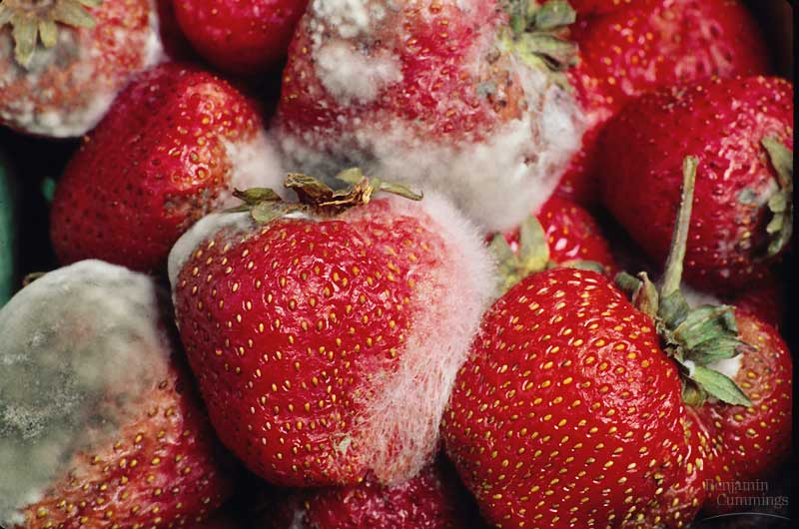
Fungi Diversity, I
Phy: Chytridiomycota •aquatic fungi; chytrids •lineage closest to protists (flagella)
Phy: Zygomycota •Rhizopus (food mold) •mycorrhizae: mutualistic with plant roots •zygosporangia: resistant structure (freezing and drying)

Slide 87
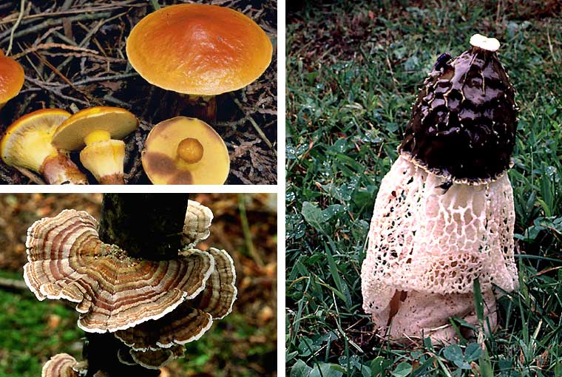
Fungi Diversity, II
Phy.: Ascomycota •sac fungi • yeasts, truffles, morels, Sordaria •asci: sexual spores •conidia: asexual spores
Phy.: Basidiomycota • club fungus •mushrooms, puffballs, shelf fungus, rusts •basidiocarps: produce sexual spores

Slide 88
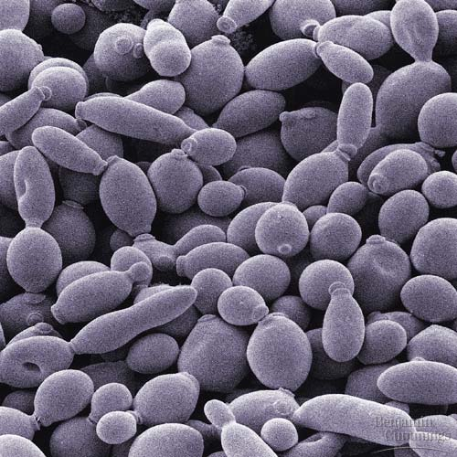
Specialized Lifestyles, I
Molds •only the asexual stage (asexual spores) •Penicillium (antibiotic, cheese)
Yeasts •unicellular, asexual budding •Saccharomyces (bread, alcohol)

Slide 89
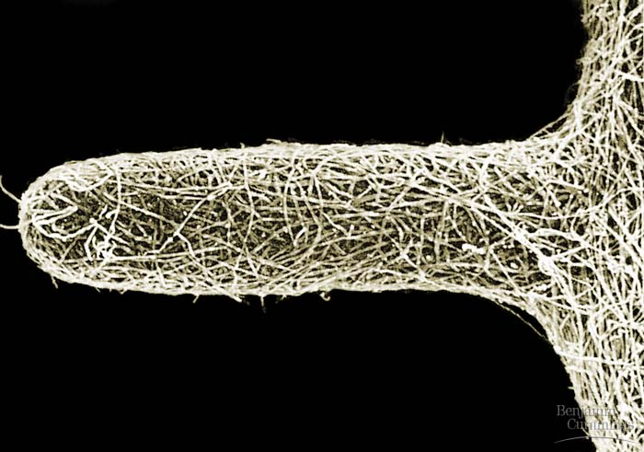
Specialized Lifestyles, II
Lichens • symbiotic association held in a hyphae mesh •alga provides food, fungus provides physical environment •pioneer organisms •air pollution detection
Mycorrhizae •root and fungi mutualism •found in 95% of vascular plants •exchange of organic minerals •increases absorptive surface of roots

Slide 90
Chapter 32 ~ Introduction to Animal Evolution

Slide 91
Def: an•i•mal (n)
Unique characteristics:
Heterotrophic eukaryotes; ingestion
Lack cell walls; collagen
Nervous & muscular tissue
Sexual; diploid; cleavage; blastula; gastrulation; larvae; metamorphosis
Regulatory genes: Hox genes

Slide 92
QOD#2
Define and give examples of acoelomates, psuedocolemates and coelomates

Slide 93
Concept 32.3: Animals can be characterized by “body plans”
Zoologists sometimes categorize animals according to a body plan, a set of morphological and developmental traits
A grade is a group whose members share key biological features
A grade is not necessarily a clade, or monophyletic group

Slide 94
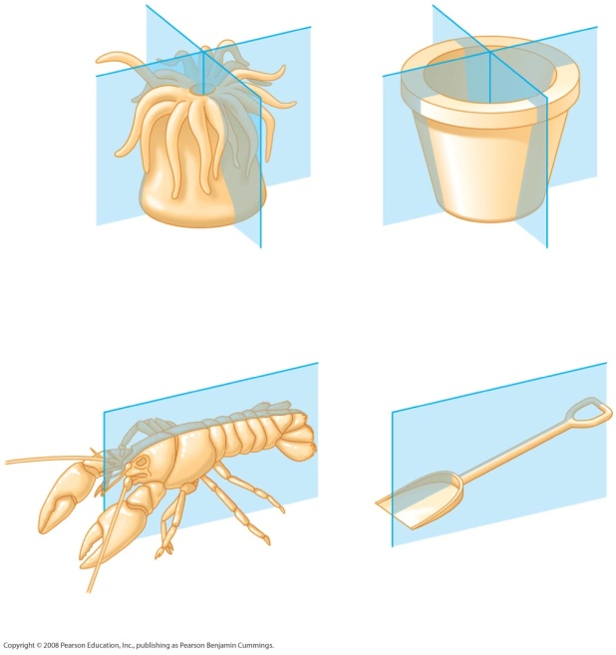
Symmetry
Animals can be categorized according to the symmetry of their bodies, or lack of it
Some animals have radial symmetry

Slide 95
Two-sided symmetry is called bilateral symmetry
Bilaterally symmetrical animals have:
A dorsal (top) side and a ventral (bottom) side
A right and left side
Anterior (head) and posterior (tail) ends
Cephalization, the development of a head

Slide 96
Animal body plans also vary according to the organization of the animal’s tissues
Ectoderm is the germ layer covering the embryo’s surface
Endoderm is the innermost germ layer and lines the developing digestive tube, called the archenteron
Diploblastic animals have ectoderm and endoderm
Triploblastic animals also have an intervening mesoderm layer; these include all bilaterians

Slide 97
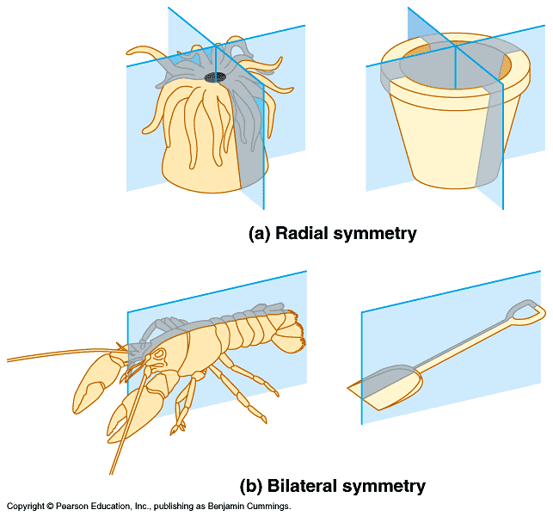
Animal phylogeny & diversity, I
Monophyletic; colonial flagellated protist ancestor
1- Parazoa-Eumetazoa dichotomy: sponges (Parazoa)~ no true tissues; all other animals (Eumetazoa)~ true tissues
2- Radiata-Bilateria dichotomy: Cnidaria (hydra; ‘jellyfish’; sea anemones) & Ctenophora (comb jellies)~ radial body symmetry; all other animals~ bilateral body symmetry (also: cephalization)

Slide 98
Body Cavities
Most triploblastic animals possess a body cavity
A true body cavity is called a coelom and is derived from mesoderm
Coelomates are animals that possess a true coelom

Slide 99
Animal phylogeny & diversity, II
3- Gastrulation: germ layer development; ectoderm (outer), mesoderm (middle), endoderm (inner); radiata are diploblastic-2 layers; no mesoderm; bilateria are triploblastic-all 3 layers
4- Acoelomate, Pseudocoelomate, and Coelomate Grades: triploblastic animals~ solid body, no body cavity called acoelomates (Platyhelminthes-flatworms); body cavity, but not lined with mesoderm called pseudocoelomates (Rotifers); true coelom (body cavity) lined with mesoderm called coelomate

Slide 100
Animal phylogeny & diversity, III
Based on early development, many animals can be categorized as having protostome development or deuterostome development
5- Protostome-Deuterostome dichotomy among coelomates: protostomes (mollusks, annelids, arthropods); deuterostomes (echinoderms, chordates)
a) cleavage: protostomes~ spiral and determinate; deuterotomes~ radial and indeterminate
b) coelom formation: protostomes~ schizocoelous; deuterostomes~ enterocoelous
c) blastopore fate: protostomes~ mouth from blastopore; deuterostomes~ anus from blastopore

Slide 101
Introduction to Animal Evolution

Slide 102
QOD
What are the main characteristics shared by all animals that distinguish them from the other kingdoms

Slide 103
Def: an•i•mal (n)
Characteristics:
Multicellular – cell junctions, specialized tissues
eukaryotic
Unique characteristics:
Heterotrophic eukaryotes; ingestion
Lack cell walls; collagen
Nervous & muscular tissue
Tissues which develop from embryonic layers
Sexual; diploid; cleavage; blastula; gastrulation; larvae; metamorphosis

Slide 104
Reproduction and Development
Most animals reproduce sexually, with the diploid stage usually dominating the life cycle
After a sperm fertilizes an egg, the zygote undergoes rapid cell division called cleavage
Cleavage leads to formation of a blastula
The blastula undergoes gastrulation, forming a gastrula with different layers of embryonic tissues
Video: Sea Urchin Embryonic Development

Slide 105
Hox Genes
Conserved, clustered gene segments
Homeobox 180 nucleotides = 60 a.a.
First found in fruitflies, now studied in many species

Slide 106
Era Flipbook of Animal Evolution
Eras:
Neoproteozoic
Paleozoic
Mesozoic
Cenozoic
Fold paper (hot dog with tab)
Divide into 4 sections (don’t have to be even)
Illustrate the front cover
Label the tab
Use the inside to summarize the major animal evolution that occurred in this era

Slide 107
Animal phylogeny & diversity, I
Monophyletic; colonial flagellated protist ancestor
1- Parazoa-Eumetazoa dichotomy: sponges (Parazoa)~ no true tissues; all other animals (Eumetazoa)~ true tissues
2- Radiata-Bilateria dichotomy: Cnidaria (hydra; ‘jellyfish’; sea anemones) & Ctenophora (comb jellies)~ radial body symmetry; all other animals~ bilateral body symmetry (also: cephalization)

Slide 108
Animal phylogeny & diversity, II
3- Gastrulation: germ layer development; ectoderm (outer), mesoderm (middle), endoderm (inner); radiata are diploblastic-2 layers; no mesoderm; bilateria are triploblastic-all 3 layers
4- Acoelomate, Pseudocoelomate, and Coelomate Grades: triploblastic animals~ solid body, no body cavity called acoelomates (Platyhelminthes-flatworms); body cavity, but not lined with mesoderm called pseudocoelomates (Rotifers); true coelom (body cavity) lined with mesoderm called coelomate

Slide 109
Animal phylogeny & diversity, III
5- Protostome-Deuterostome dichotomy among coelomates: protostomes (mollusks, annelids, arthropods); deuterostomes (echinoderms, chordates)
a) cleavage: protostomes~ spiral and determinate; deuterotomes~ radial and indeterminate
b) coelom formation: protostomes~ schizocoelous; deuterostomes~ enterocoelous
c) blastopore fate: protostomes~ mouth from blastopore; deuterostomes~ anus from blastopore

