Slide 1
AP Biology Unit 0
Introductory Unit
Levels of Organization
Emergent Properties
Characteristics of Life

Slide 2
Unit 0 Day 1 - Termites
Look at Syllabus and Student Learning Plan
Find Someone who
Termite Behavior Lab
Discuss “emergent properties”
Student Information
Textbook Scavenger Hunt

Slide 3
Unit 0 Day 1
Breakout EDU
Syllabus, supplies, class organization
Emergent Properties Discussion
Textbook checkout

Slide 4
Unit 0 Day 1
Breakout EDU
Syllabus, supplies, class organization
Emergent Properties Discussion
Textbook checkout

Slide 5
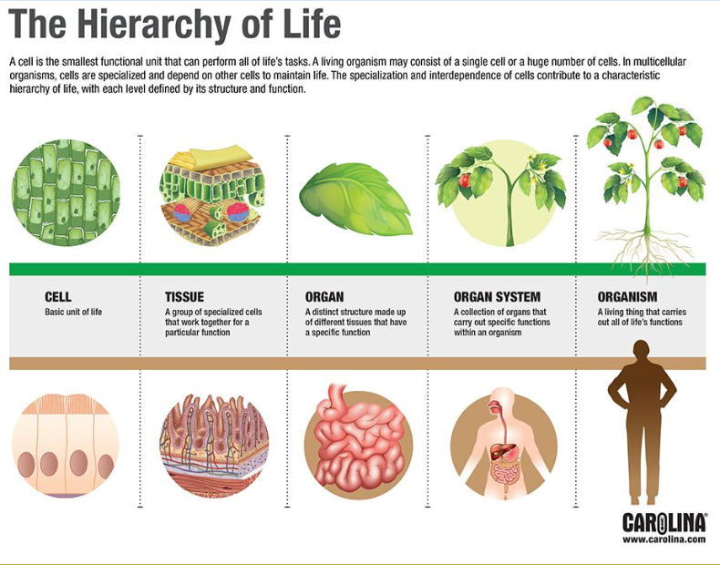

Slide 6
Unit 0 Day 2
Termite Behavior Lab
Small to Large – How Life Fits Together - https://ed.ted.com/lessons/making-sense-of-how-life-fits-together-bobbi-seleski
Safety contracts
Formula sheets
Textbook checkouts
http://ed.ted.com/lessons/curiosity-discovery-and-gecko-feet-robert-full
(Period 3 assemblies for grades 11 and 12)

Slide 7
Unit 0 Day 2
Termite Behavior Lab
Small to Large – How Life Fits Together - https://ed.ted.com/lessons/making-sense-of-how-life-fits-together-bobbi-seleski
Safety contracts
Formula sheets
Textbook checkouts
http://ed.ted.com/lessons/curiosity-discovery-and-gecko-feet-robert-full
(Period 3 assemblies for grades 11 and 12)

Slide 8
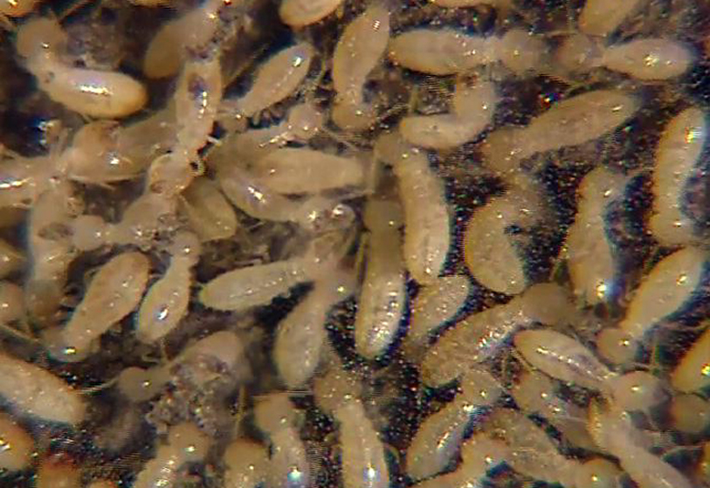
Termite Behavior Lab
Spend 5 minutes observing your termites.
Based on your observations, write a hypothesis about how termites learn

Slide 9
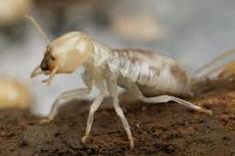

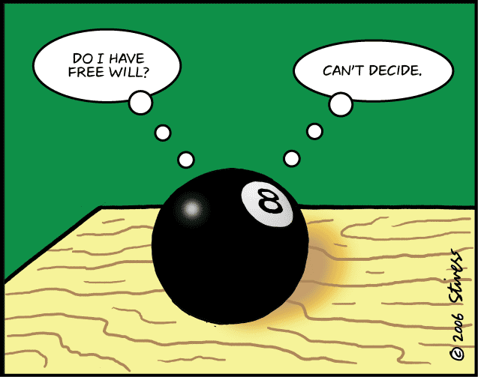
Purpose
Now that you have a guess about how termites learn, your goal is to train termites to follow a figure 8 pattern.
Use the knowledge you gained during your 5 minute observation
Record your data in an organized manner

Slide 10
Unit 0 Day 2 - Life
Emergent Properties Cooperative Discussion
Safety Contract
Procedures
Textbook scavenger hunt
Characteristics of Living Things Activity with petri dishes
Gecko Video:
                http://ed.ted.com/lessons/curiosity-discovery-and-gecko-feet-robert-full

Slide 11
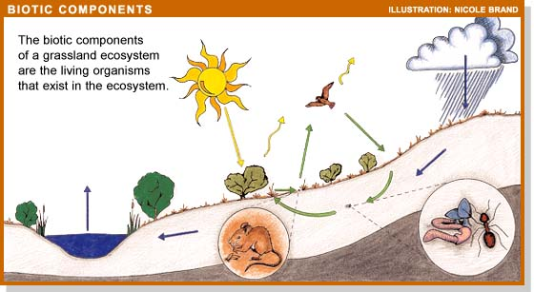
Biotic and Abiotic
Both biotic and abiotic features interact in an ecosystem. Can you list three of each in a grassland ecosystem?
Although we tend to focus on the biotic factors, we can’t neglect the abiotic.

Slide 12
Unit 0 Day 3 – Levels of Organization
Turn in safety contract
Small to Large
Themes and Organization of AP Biology
Set up lab notebook
Finish textbook scavenger hunt

Slide 13
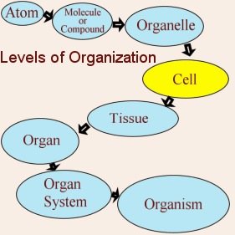
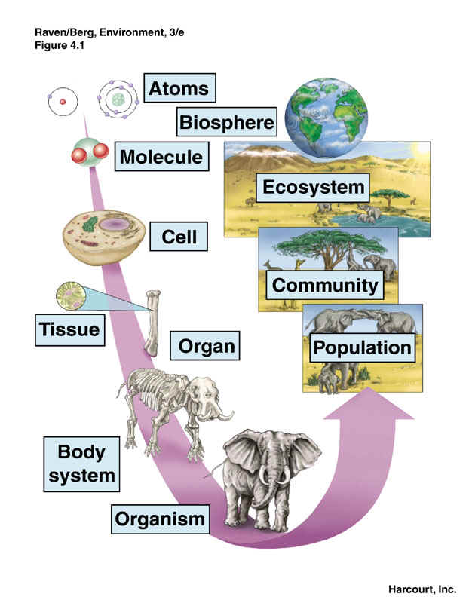
Levels of Organization
Life can be studied at many levels
Emergent Properties

Slide 14
Images for Small to Large Activity

Slide 15
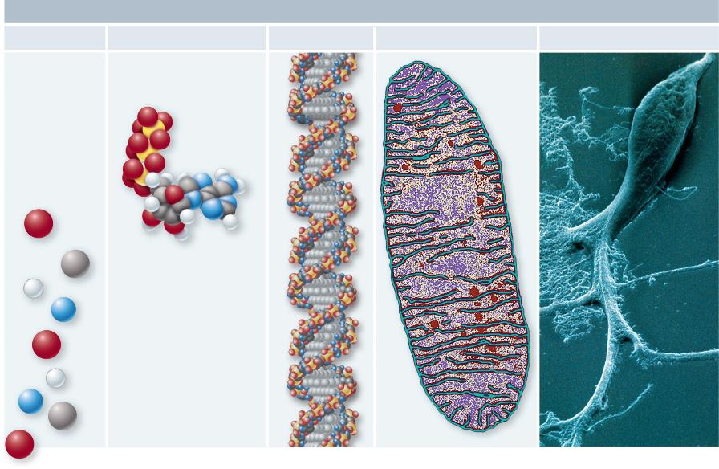
Fig. 1.1a
Copyright © The McGraw-Hill Companies, Inc. Permission required for reproduction or display.
CELLULAR LEVEL
Atoms
Molecule
Macromolecule
Organelle
Cell
O
C
H
N
O
H
N
C
O
0.2 µm
0.5 µm
d: © Dr. Donald Fawcett & Porter/Visuals Unlimited e: © Lennart Nilsson/Albert Bonniers Förlag AB

Slide 16
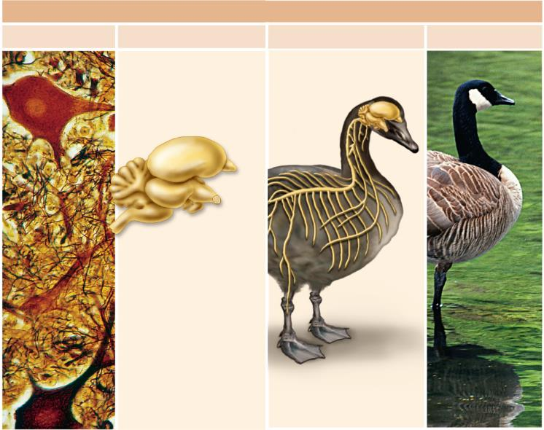
Fig. 1.1b
Copyright © The McGraw-Hill Companies, Inc. Permission required for reproduction or display.
ORGANISMAL LEVEL
Tissue
Organ
Organ system
Organism
100 µm
f: © Ed Reschke i: © Getty RF

Slide 17
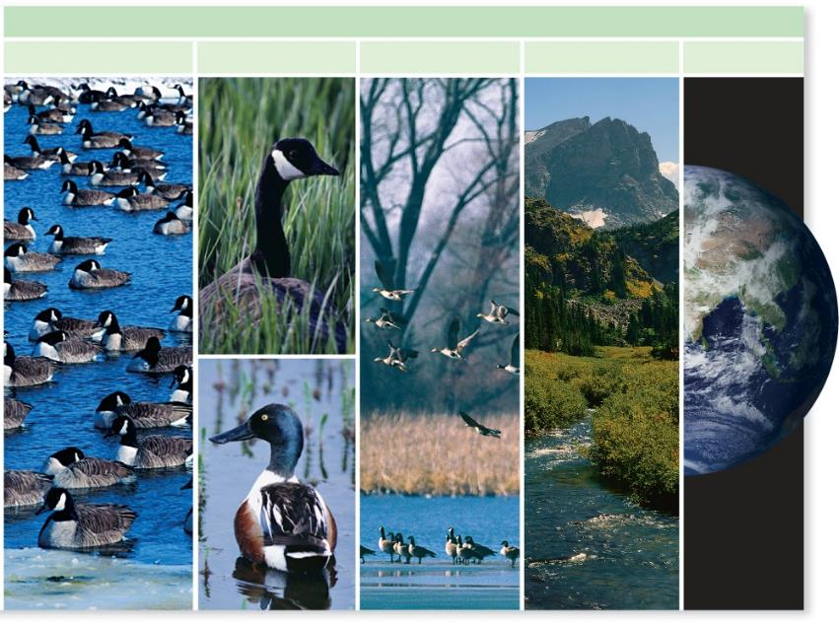
Fig. 1.1c
Copyright © The McGraw-Hill Companies, Inc. Permission required for reproduction or display.
POPULATIONAL LEVEL
Population
Species
Community
Ecosystem
Biosphere
i-j: © Getty RF; 1.1k-l: © Volume 44/Getty RF; m: © Steve Harper/Grant Heilman Photography, Inc.; n: © Robert and Jean ollock; o: NASA

Slide 18
Biotic and Abiotic
Both biotic and abiotic features interact in an ecosystem. Can you list three of each in a grassland ecosystem?
Although we tend to focus on the biotic factors, we can’t neglect the abiotic.

Slide 19
Levels of Organization
Life can be studied at many levels
Emergent Properties

Slide 20
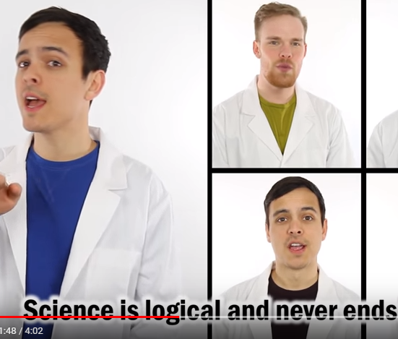
Science Style
https://www.youtube.com/watch?v=sWwd5vks9n8

